Slide 1

Poster Planning
Who is your audience?
________________________________________________________________________
How much do they know about the topic?
Tip: People can really only think on a few new ideas at a time, design with that in mind.
What is the research question/
project objective?
________________________________________________________________________
What is the purpose and the main message?
Tip: Design all elements of the poster around this purpose.
Why would the audience care?
________________________________________________________________________
How do you connect your project to an audience member’s life?
Tip: When shared with random people, your answer should resonate.
Essential Methods/ Results
________________________________________________________________________
What methods and results are needed to tell your story?
Tip: If the methodology is standard, summarize it in a sentence. Graph all data.
Key takeaways
________________________________________________________________________
What did you learn from this experience (good and bad)? Areas for future study?
Tip: Leave room for references and acknowledgements.

Slide 2

Poster Planning
Design concepts that will make your poster
standout and be effective:
Before you start, decide on the size of the poster following event guidelines and adjust your file (PowerPoint, etc.).
Titles matter. Design yours to be bold, fun, and professional.
Limit your poster to 500 words or less.
Make all fonts 36 or larger (including graphs and figures).
High resolution images only.
If possible, use PNG files for images and graphs.
50-75 % of the space is blank or visuals.
Less is more: colors, fonts, styles, etc.
Bullets points over sentences.
Light background colors and dark text.
The entire poster should relate directly to your main message and research objectives.
Pro tip: Remember your audience will only be able to absorb a few concepts. Ask yourself each time you put something into your poster if you really need it.

Slide 3
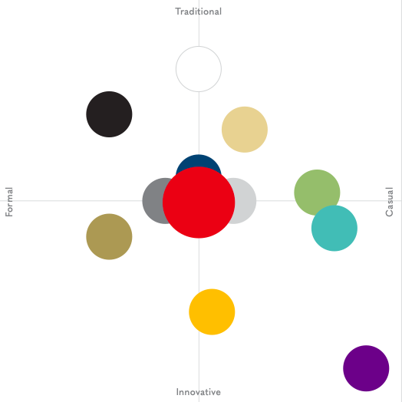
Poster Planning
Radford University colors:
Radford Red, Dark gray, Navy Blue, Light gray, Black, Green, Gold, Purple, Tan, Teal, Yellow
Sketch the layout

Slide 4
Poster Planning
Once you finish your poster check to make sure:
Did you leave a ¾ inch margin?
Is the poster 50 % white space and visuals?
Does the title and design draw you in?
Are your fonts consistent? 36 point or larger?
Have you mainly used only 2-3 colors?
Is your word count under 500?
At 100 % zoom do all of your figures look sharp and clear?
Do all your elements relate to your main objective?
Are your headers, columns, textboxes aligned vertically and horizontally?
Did you acknowledge funding, mentoring, poster printing, etc.?
Did you include references and cite using an appropriate system?
Have all other co-authors, presenters and mentors seen and approved of the final copy?
Once last time with fresh eyes, proof read for spelling, grammar, etc.
Submit your poster as a pdf for free printing through OURS www.radford.edu/ours

