Slide 1
Radford University Police Department (RUPD) Allen Building 540-831-5500
Quest 2017
Allen Building
540-831-5500

Slide 2
RUPD
A fully sworn, armed, and accredited agency with jurisdiction on campus, campus owned/controlled property and adjacent streets and sidewalks
Same police powers as your local police and sheriffs’ departments
Mutual Aid Agreements are in place with surrounding jurisdictions
24 Sworn police officers, 3 security officers and 8 full-time dispatchers
Radford University Police Department

Slide 3
RUPD
Provides vehicle, bicycle, ATV and foot patrol response on all campus property
Safety escorts
Personal Safety presentations
Alcohol/Drug Safety & Awareness programs
University 100 Programming
Radford University Police Department

Slide 4
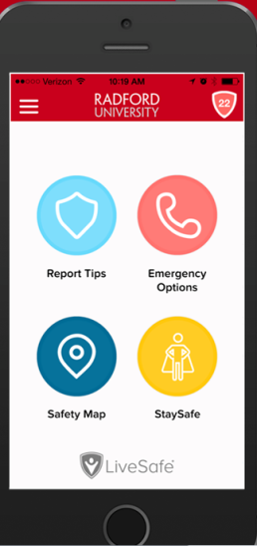
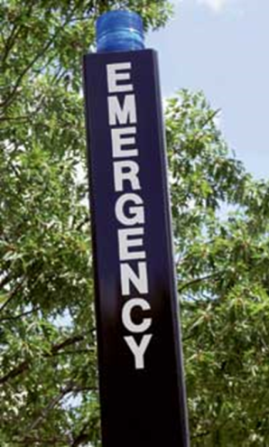
Safety at a glance…
Restricted access to Residential Facilities
Emergency blue light phones
LiveSafe App
RU ALERT
Radford University Police Department

Slide 5
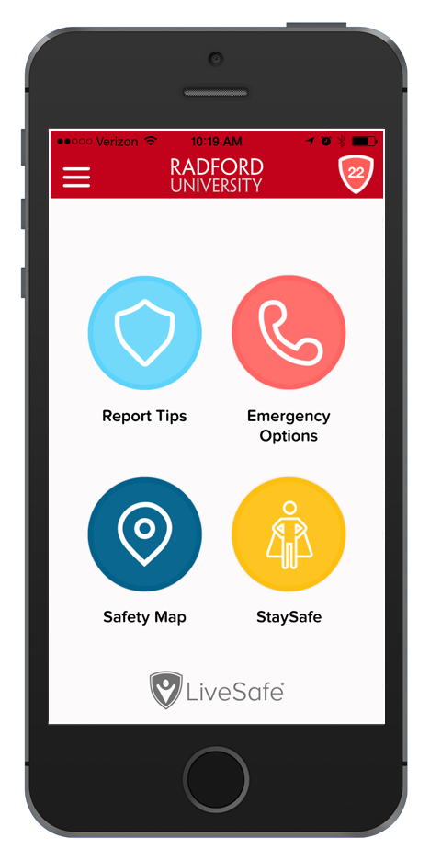
Download the Radford
University LiveSafe App
A two-way communication tool to help you and your friends look out for each other.
Anonymously share information with safety officials (text or call). We’ll respond immediately and send help.
Access counseling services and other campus resources.
Request an on-campus safety escort late at night to get you to your destination safely.
SafeWalk™ with friends to see them get to their destination on a safety map.
Radford University Police Department

Slide 6
Download the app
Go to Google Play or the Apple App Store.
Search for “LiveSafe”. Look for the blue shield and install.
Enter your email. Create a password and fill in your name.
Verify your email address.
Search for and select “Radford University”. You’re set!
Allow “location services” and “push notifications” when prompted. It’s for your safety.
Radford University Police Department

Slide 7
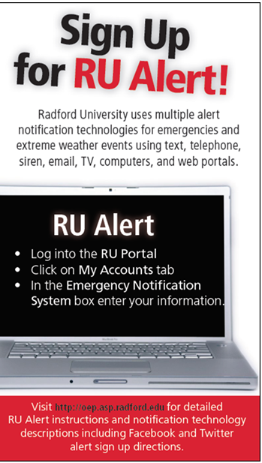
Radford University Police Department

Slide 8
RU Alert
Text & Telephone
Email
Web Sites
Campus Computers
IP Telephones
Signage System
Siren
Cable TV
WVRU Radio
Facebook/ Twitter
Notes:
These are methods/tools that Radford University uses to communicate emergency and/or important information to the campus community-students/faculty, staff and visitors.

Slide 9
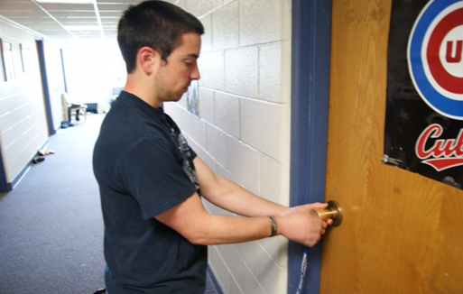
RUPD
Larceny is the number one crime reported on campus.
Keep your door locked when sleeping or when you are out of your room. This includes “just going down the hall for a few seconds.”
Report suspicious behavior to police or building staff immediately.
Keep valuables locked in a safe place, out of view.
Mark or engrave all valuables and record serial numbers.
Operation ID
Radford University Police Department

Slide 10
#1 Question asked by parents: How safe is Radford?? Feel free to look it up!!
Radford University Police Department

Slide 11
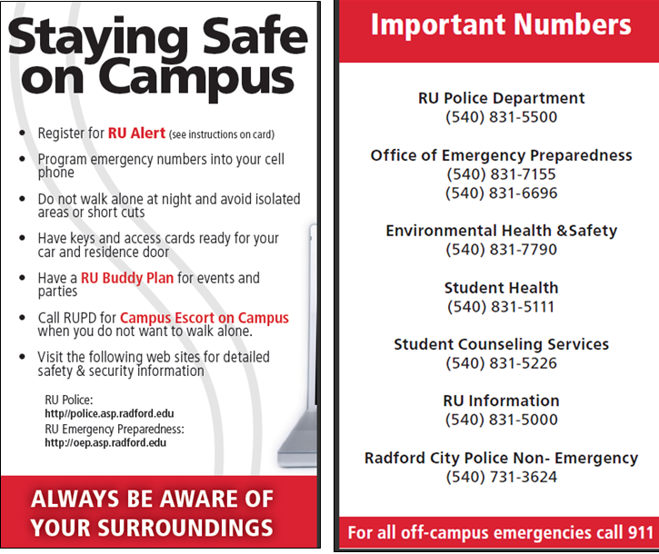
Come see us at the Info Fair!
Radford University Police Department

