Slide 1

WELCOME TO THE
BOOKSTORE

Slide 2
Barnes & Noble Radford University
Address
  Fairfax St. – Dalton Hall
  Beneath the dining hall in Dalton
Hours
  Fall and Spring Semester hours:
  M-F 7:30am – 7:30pm
  Saturday 10am – 5pm
  Sunday 11am – 3pm
We’re Open 24/7 Online
  www.radfordu.bncollege.com
  www.facebook.com/RadfordBookstore

Slide 3
Best Source for Textbooks
RENT OR BUY New, Used, and Digital Textbooks
  To save the most money up front, RENT your textbooks
    We’ll email you a reminder when your rentals are due back
  Buying your books? Save with USED textbooks
    Sell us your used textbooks during finals week and get cash back
  Go DIGITAL
    Digital textbooks let you organize & read your content on your devices or via a web browser
  Get the best price with PRICE MATCH
    See a bookseller or visit our website for full details.

Slide 4
We Are a Support System
When you RENT OR BUY textbooks from Barnes & Noble Radford University, you’re guaranteed:
  THE RIGHT TEXTBOOK
    We work directly with your professors to get the right textbook for your class
  SAVINGS
    Rent or Buy, save up to 90% on textbooks from the bookstore
  CONVENIENCE
    The bookstore is located right on campus. Order online with free in-store pickup.
  NO HASSLE RETURNS
    Get a full refund when you return the book [customize return policy – use the date or timeframe for full refund such as add/drop]

Slide 5

Buying Textbooks In Store
Visit us in store with your course schedule. Our booksellers are ready & waiting to help you.
In the textbook aisle, find your department & class. The aisles are in alphabetical order by subject.
Look for the tag under each stack of books and match your schedule’s department and course number for each class.
Choose your textbook format and you’re done!

Slide 6
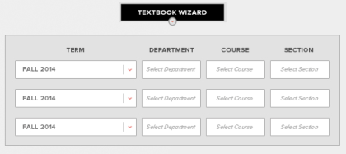
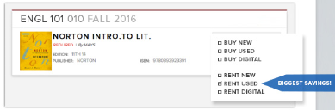
Buying Textbooks Online
Visit radfordu.bncollege.com to place your order online
Add your courses into the textbook wizard to find the books you need
Choose your textbook format. Rent or Buy: New, Used, Digital.
Select “Pickup” or “Ship” & proceed to checkout. You’ll get an email when your order is shipped or ready for in store pickup.

Slide 7
We Have Everything You Need to Succeed
School Supplies
  Radford Binders, Miquel Ruis notebooks, Popin accessories, etc.
Technology & Electronics
    HP and Dell computers, Beats Headphones
Radford University Apparel & Gifts
    Nike, Under Armour, Champion, Blue 84, etc.
Snacks & More
    Variety of sweet and salty options, and convenience items
Team Shop
    www.radfordteamshop.com
Can’t find what you’re looking for? Our Booksellers are happy to help.

Slide 8
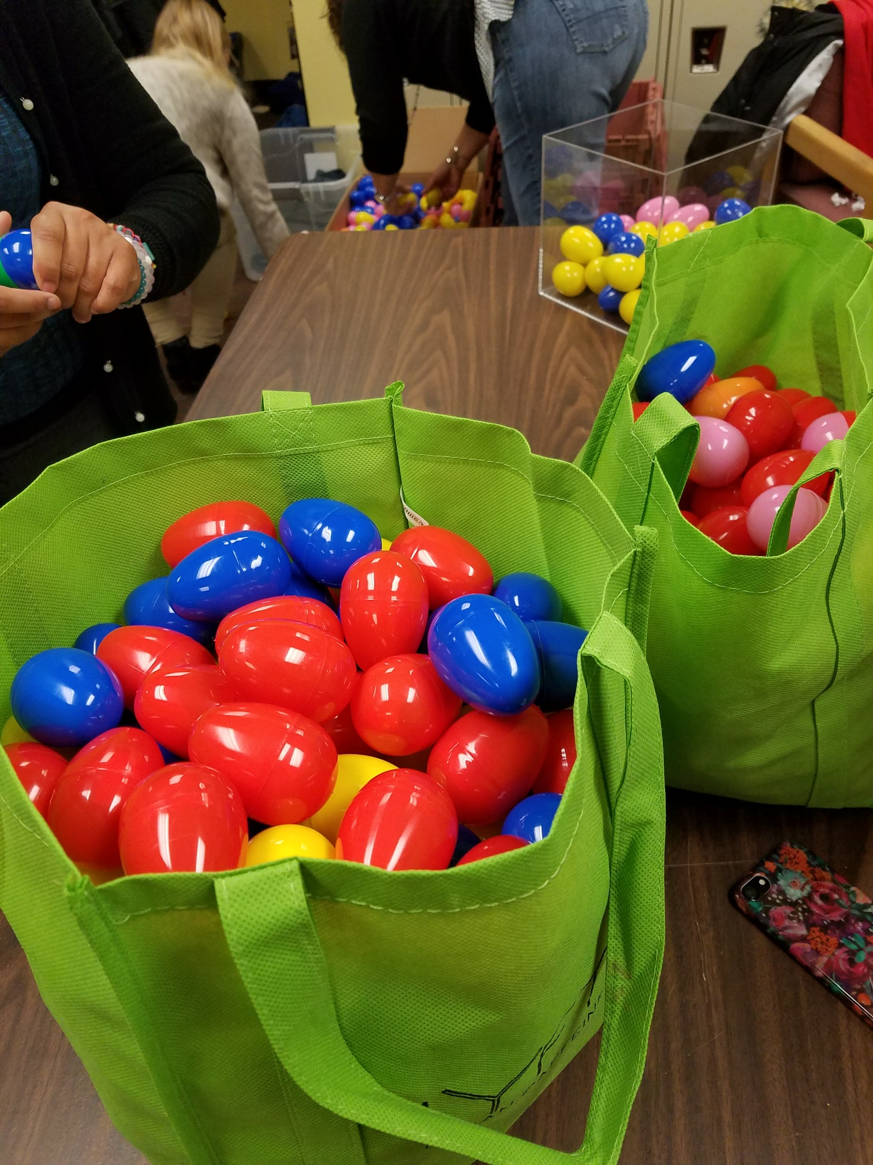


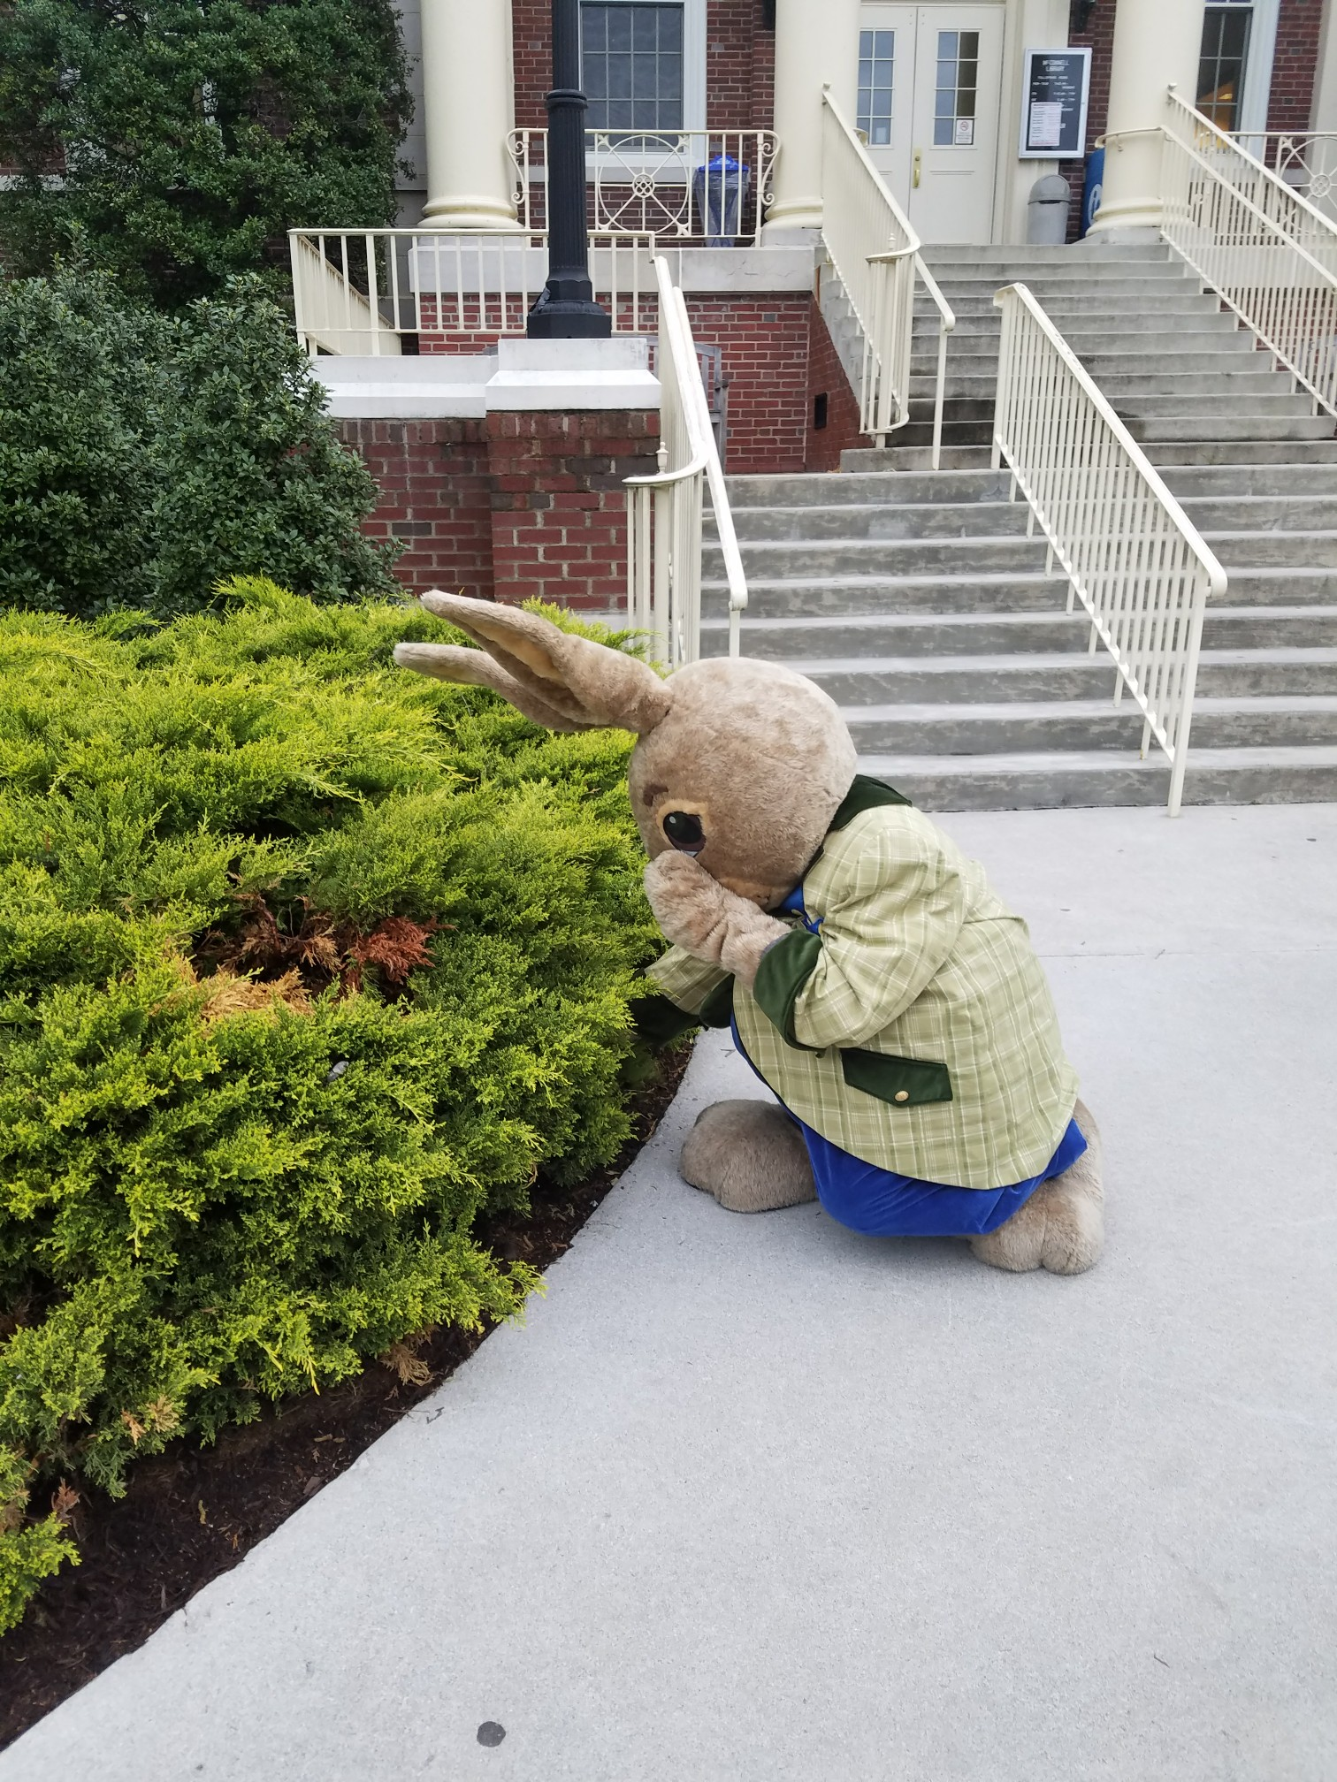

Bookstore Hosted and Partnered Events
In partnership with the Move-In Events committee we are developing an exciting weekend of events happening just after move in Thursday, August 22nd
  Meet new friends
  Play games and win cool prizes
  Enter to win bookstore gift cards and other cool prizes!

Slide 9

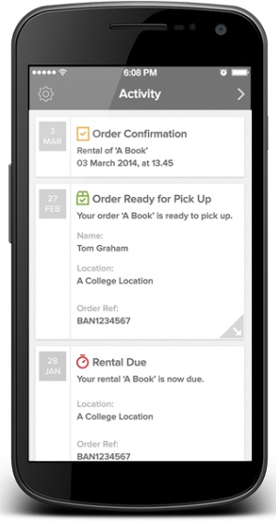
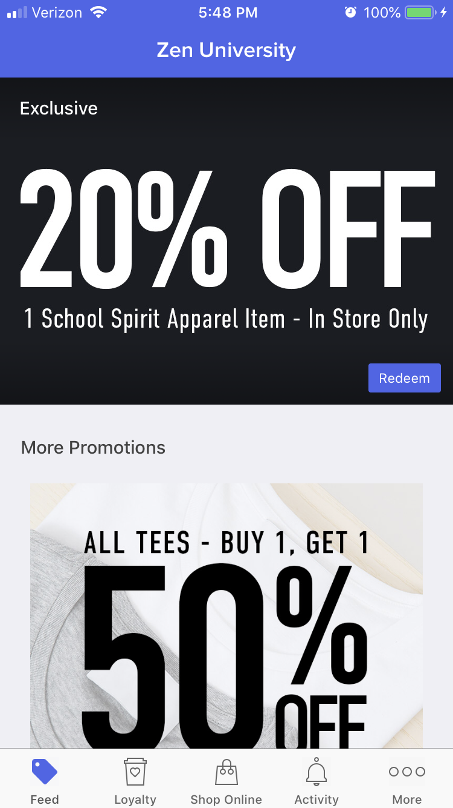
My College Bookstore App
How to Download
  Search for ‘My College Bookstore’ in the App Store or visit appbnc.com
  Select and install the Barnes & Noble College Bookstore App
  Click on the Get Started button and enter your information
Features of the App
  Coupons & exclusive discounts
  Rental due date reminders
  Order & shipment updates
  Tips & advice for students
  DOWNLOAD NOW AND GET 20% OFF ONE RADFORD UNIVERSITY ITEM

Slide 10
Frequently Asked Questions
When should I order my textbooks? Should I wait until classes start?
  Buying or renting your textbooks as soon as you get your course schedule ensures that you get the best price.
What is the difference between a “required package” and a “package component”? Do I need to buy both?
  You do not need to buy both! The package components make up the required package. If you are unsure please check with a bookseller.
Can I highlight and take notes in my textbook rental?
  Yes, write in them and highlight as usual!
What if I drop a class?
  Get a full refund when you return the book by Tuesday 9/3/19

Slide 11
Frequently Asked Questions
What if I forget when my textbook rental is due?
  Rental textbooks are due 12/12/19. We will send you an email reminder and mobile app alert when they’re due back.
Can I use my Financial Aid as a method of payment?
  Begin requesting Book Voucher through the MyRU Portal 7/29/19
  Funds are available to use in store through 9/20/19.
  Last day to request funds is 8/30/19
If I decide I want to keep my rental book, can I buy it?
  Yes! At the end of term you will have the option to purchase and keep your rental book.

Slide 12


Download the My College Bookstore app and
GET 20% Off School Spirit Apparel

Slide 13
Join Our Team
  Fun Environment
    Earn competitive wages in a professional working environment; view open positions & apply online: bncollegejobs.com
  Employee Discount
  Discount on textbooks and other bookstore merchandise
  Flexible Schedule
    We’ll partner with you to create a work schedule that works with your classes
  Convenient
    We’re right on campus, near everywhere else you need to be

Slide 14


Stay Connected
BNcollege OR your store’s Facebook
@bncollege OR your store’s Twitter
My College Bookstore App
@bncollege OR your store’s Instagram
Plus, sign up for email to get access to spirit gear promotions, new arrivals, trending supplies & more
Visit welcomeclassof.com or our website to get started

