Slide 1
Financial Aid & the Bursar:
Need to Know
Office of Financial Aid & The Bursar

Slide 2
The Role of the Financial Aid Office at Radford University:
Process FAFSA to confirm eligibility
Award federal, state, institutional aid programs
Process private education & Parent PLUS loans
Disburse awards to the Office of Bursar

Slide 3
Complete & Submit a FERPA
RU Family Educational Rights and Privacy Act (FERPA) Policy
  Radford University student record policies and practices are in full compliance with the Family and Educational Rights and Privacy Act (FERPA).
  The University will not release information about a student from records, except directory information, to people (including parents) other than a specified list of exceptions without obtaining the written consent of the student.
Full policy and form is found online – www.radford.edu/ferpa

Slide 4
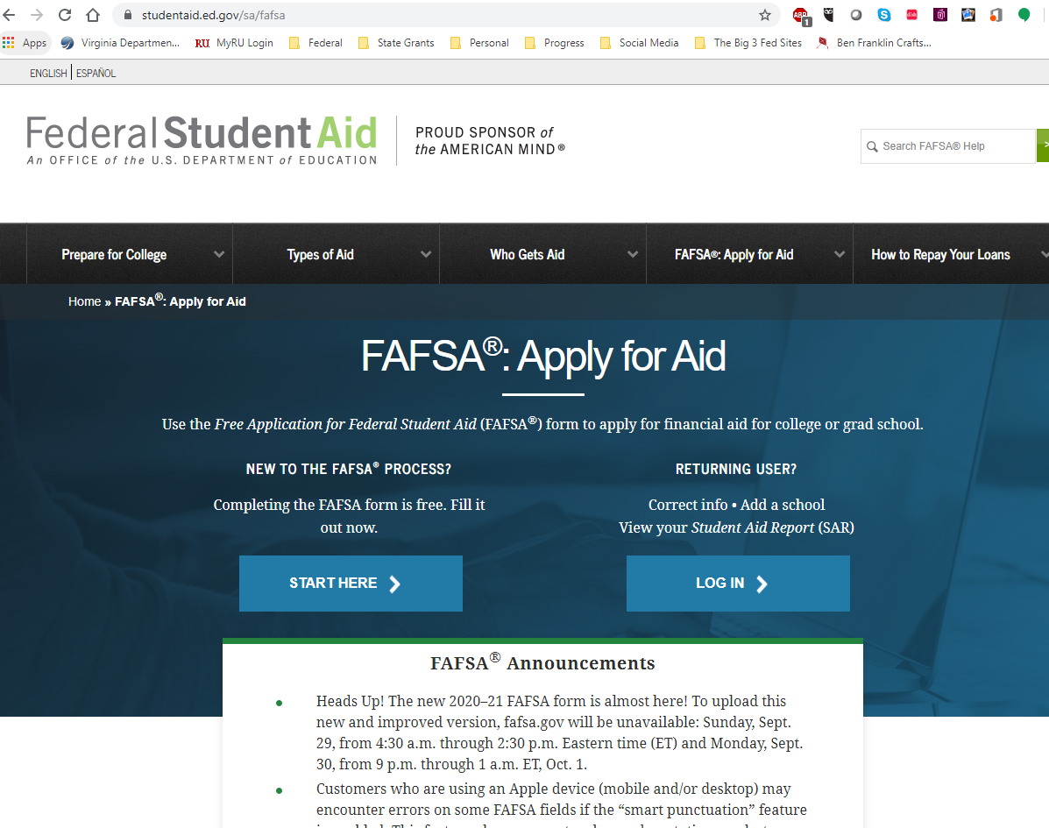
What is the FAFSA?
F – Free
A – Application
F – for Federal
S – Student
A – Aid
    https://fafsa.ed.gov

Slide 5
If I haven’t yet, can I do the FAFSA?
Yes! We do have a priority deadline, but we continue to receive and process FAFSA’s through out the year.
Late applicants are still eligible to receive federal financial aid funds.

Slide 6
What Happens After I Submit the FAFSA?
You receive your expected family contribution (EFC), which is what Radford University uses to determine what aid you are eligible to receive
Radford University typically receives your FAFSA within a week of submission
FAFSA will be reviewed by the Financial Aid Office

Slide 7
What is Verification?
Selected by Department of Education upon initial FAFSA submission
Verification is the process your school uses to confirm that the data reported on your FAFSA form is accurate.
Your school has the authority to contact you for documentation that supports the information you reported
Submit the documents we are requesting as soon as possible to prevent delays in your application review.
Notes:
Selected by the Department of Education, not Radford University
Verifies tax information, household information, etc.
Radford is responsible for collecting and verifying this information prior to awarding any financial aid.

Slide 8
What happens when my
FAFSA review is complete?
You will receive a financial aid award notification electronically
Online award system will outline eligibility for federal and state grants, loans, federal work-study, and scholarships
If you have not received your Financial Aid award letter please contact the Financial Aid office today to check your account.
  540-831-5408
8
Notes:
When you are notified of an award package, review your award package, accept your financial aid awards.
Don’t be afraid to ask questions about your financial aid awards. Make sure you understand how your awards will be applied to charges. Take a few minutes to calculate what your out-of-pocket expenses will be for each semester or the full academic year.
We anticipate the first round of award letters will be release in December.

Slide 9
Types of aid included in your offer:
Grants are free money that do not require repayment and are most often need based.
Student loans are money that is repaid over several years-- typically after graduation, usually with interest.
Student employment, such as part-time work-study jobs, which lets you earn as you learn.

Slide 10
Other Payment Options
Parent PLUS loans are loans taken out by the parent to help pay the education expenses.
Private Education loans are loans taken out by the student to help pay the education expenses.
Notes:
We encourage to start investigating other payment options early. There are multiple options for additional education loans. The Parent PLUS loan is federal loan program available to parents. Additionally, there are Private Education loans that are borrowed by the student with a credit worthy co-signer.
Our payment plan is a partnership with Nelnet. There are various plan options, it is important to sign-up early to maximize the number of payment periods. You can learn more about the payment plan by visiting the Office of the Bursar’s website.
We do accept pre-paid education plans. We encourage you to contact the Office of the Bursar about submitting the necessary paperwork once you are ready to commit to Radford for the fall semester.

Slide 11
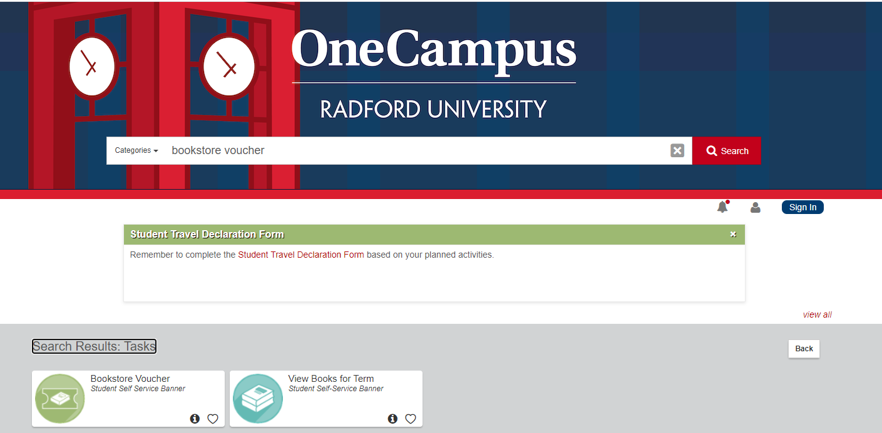
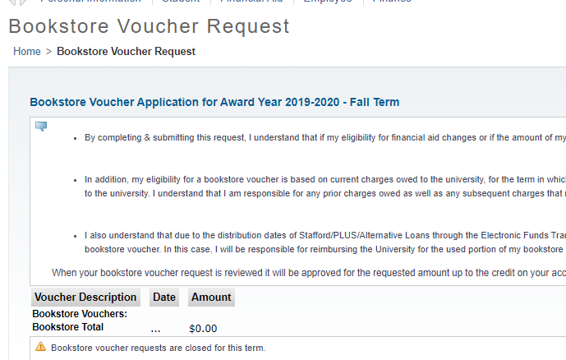
Bookstore Voucher
If you are receiving excess funds (above your charges), your student can apply for a book voucher directly through their Radford portal.

Slide 12
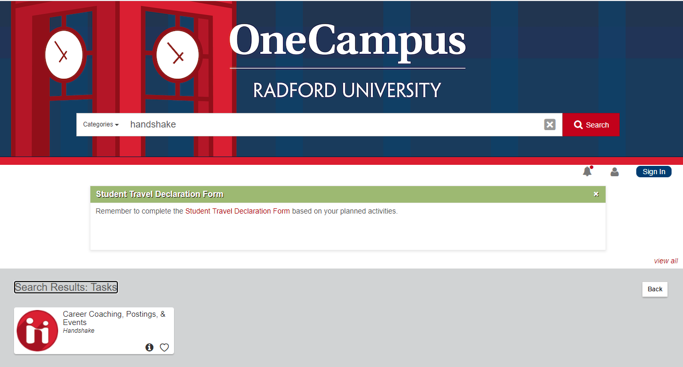
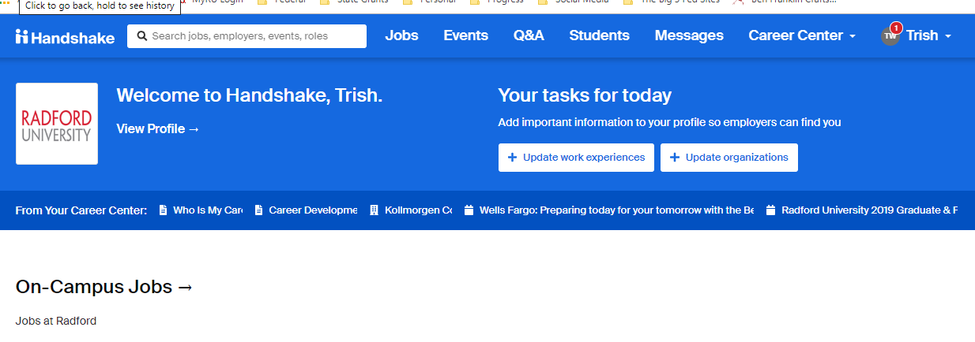
Handshake App
Students who were awarded work study are responsible for finding a job on campus.
Students will need to look for a job through the Handshake app in the portal.

Slide 13
The Role of the Bursar’s Office at Radford University:
Billing
Refunds
Payment Plans
Processing Payments

Slide 14
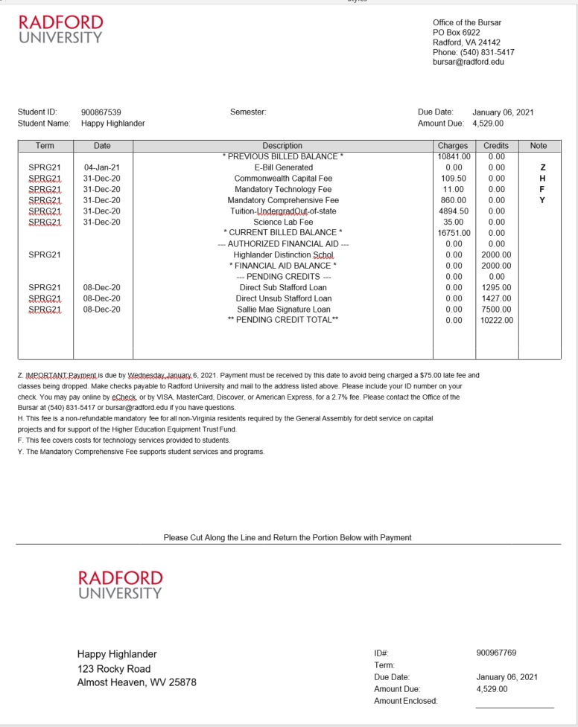
The Bill
Semester Bills are sent electronically to all pre-registered students
  Classes will be cancelled if payment in full is not received or covered by January 28, 2021.
  Payment Options- Financial Aid and Payment Plan
  Students access their account and make payments through the RU Portal
  Parents/guardians have the same access by becoming an “Authorized Payer”
  Payment Methods – cash, check, electronic check, or credit card (plus a 2.7% service fee)

Slide 15
Tuition and Fee Rates (per semester)
In State Tuition |  | Out-of-State Tuition
Tuition & Required Fees | $ 5,983.00 | Tuition & Required Fees | $12,024.00
Housing | $ 2,747.50 | Housing | $ 2,747.50
Meal Plan | $ 2,112.50 | Meal Plan | $ 2,112.50
Total Tuition, Fees, Room and Board | $10,843.00 | Total Tuition, Fees, Room and Board | $16,884.00
Housing and Meal Plan rates are based on Standard Double Room & Flex Meal Plan, Pending Board of Visitors approval

Slide 16
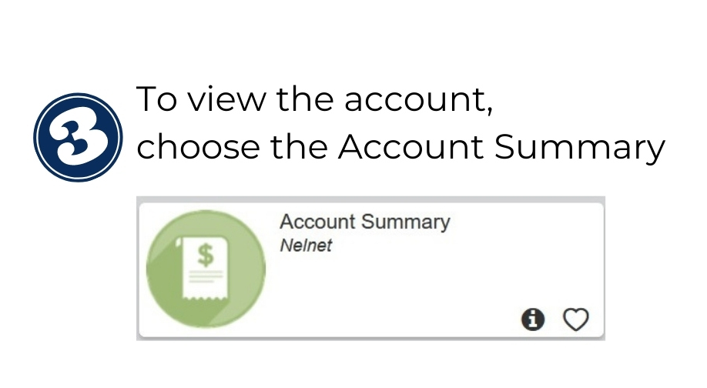
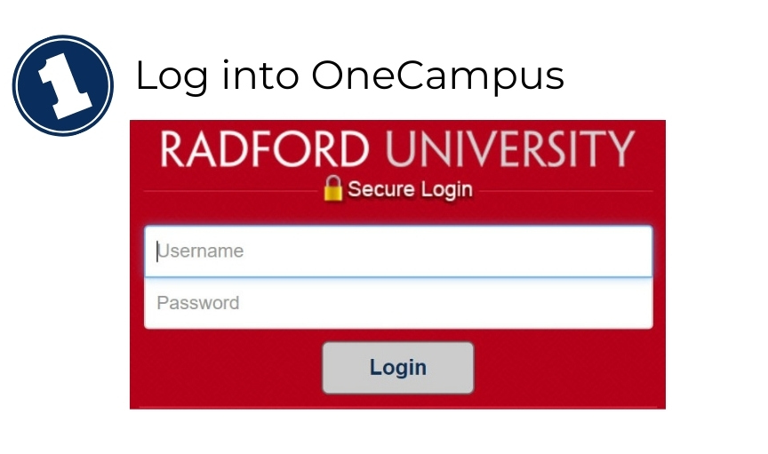
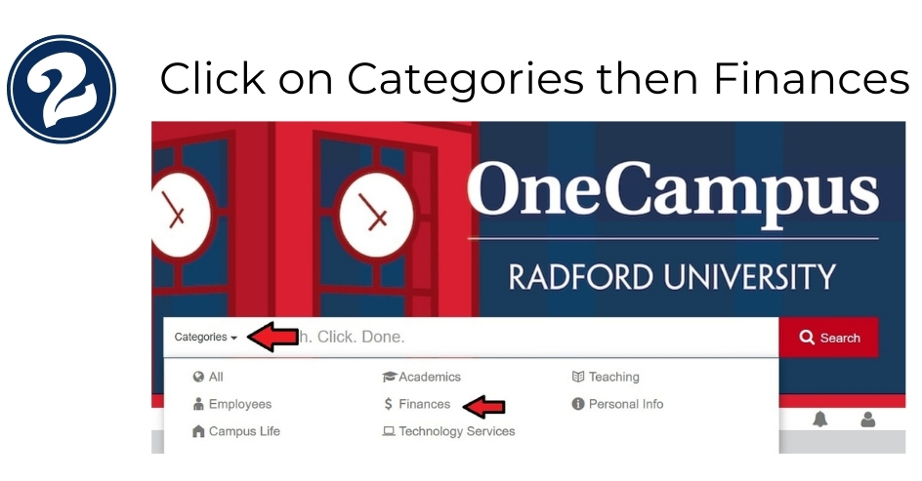
Viewing your Student’s Account Online

Slide 17
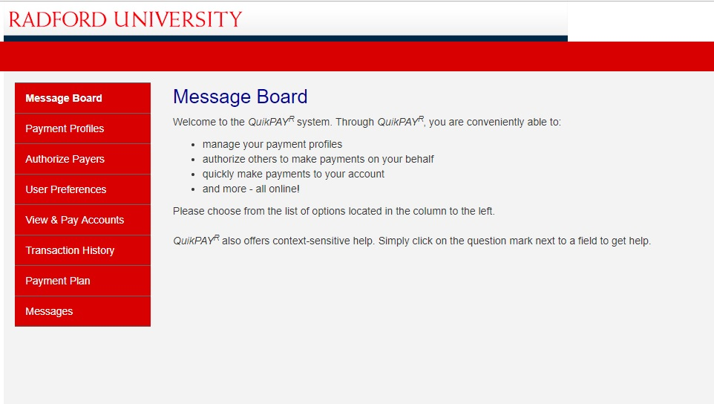
The Quikpay Site
On this site you can:
View and pay your student account charges
Set up an Authorized Payer
Set up a Payment Plan

Slide 18
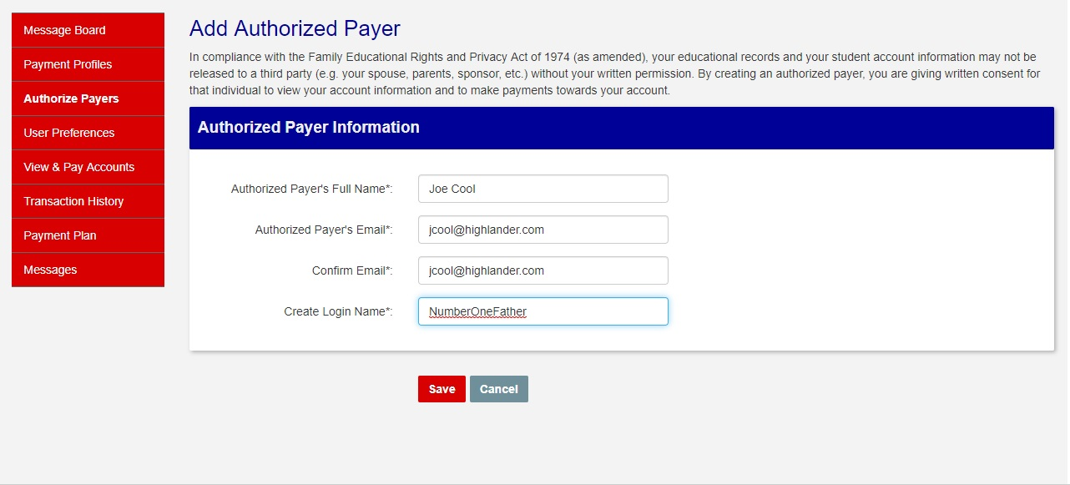
Authorized Payer
An authorized payer is someone other than the student that needs access to the online account to view the bills and make payments. This access is separate from the FERPA*.

Slide 19
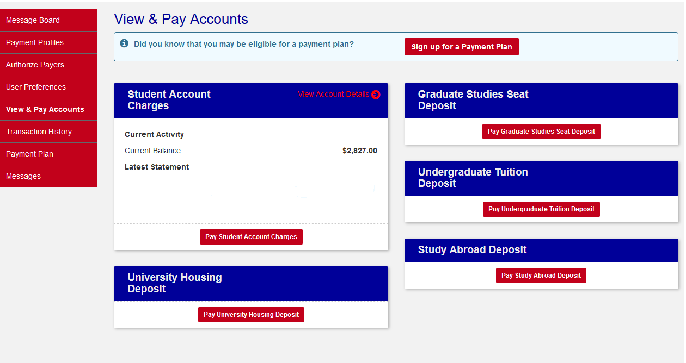
Viewing your Student’s Account Charges:
Click on View & Pay Accounts to see the current balance.
To view the details, click on the “View Account Details” (in red).

Slide 20
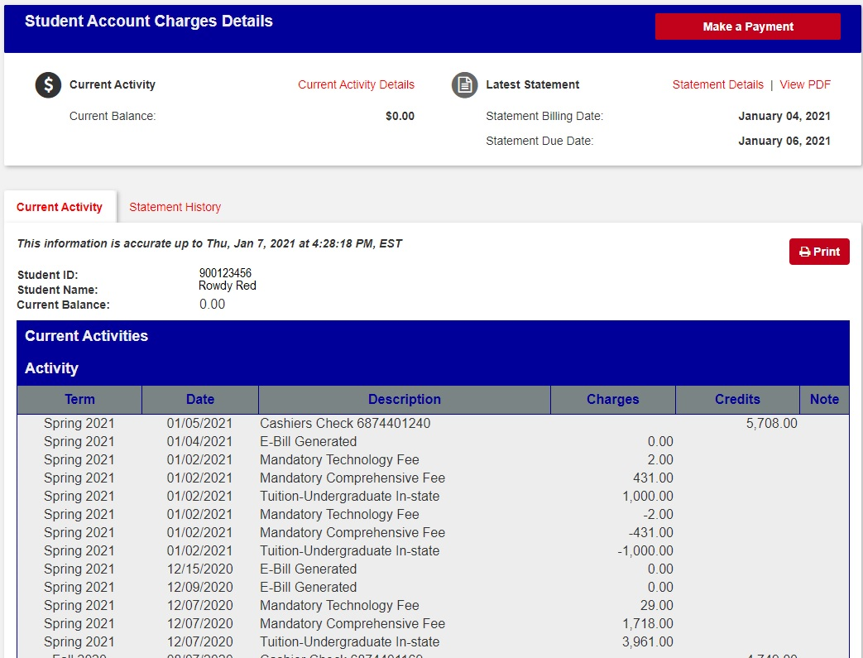
The “Current Activity” is the most up-to-date version of the account and the best place to:
Monitor the account to make sure expected financial aid funds and outside payments such as scholarships, 529 plans, etc. are listed as either pending or actual payments.
Verify refund dates and amounts.

Slide 21
Payments
You may pay your account online with an e-Check or Credit Card.
  e-Check is an electronic check which will draft your bank account.
    No additional fees.
    Must have the routing and account number of the checking or savings account that funds will be drafted from.
  Credit Cards and Debit Cards
    American Express, Discover, MasterCard and VISA
    2.7% service charge calculated based on the payment amount.
You may also mail your payment or pay in person. We accept cash, check and credit cards. Again, if you choose to pay by a credit or debit card, even in person, a 2.7% service charge will apply.

Slide 22
Tuition Payment Plan
Advantages:
  Easy online enrollment
  Monthly payments
  Flexible payment options
  No interest
Payment Methods:
  e-Check
  Credit/Debit Card (2.7% service fee)
Cost to Participate:
$45.00 nonrefundable enrollment fee per semester
Available Plans:
Plan | Payment Dates | Enroll By
4 Payment Plan | January - April 5 | January 22, 2021
3 Payment Plan | January – April 5 | January 28, 2021

Slide 23
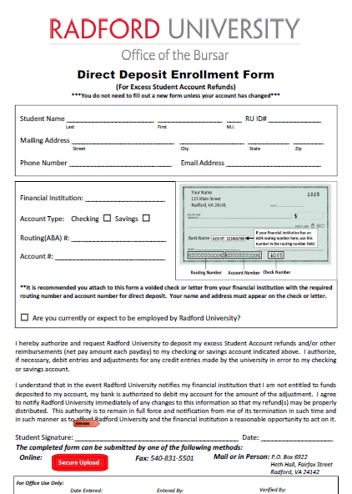
Refunds
If financial aid overpays the student account, the student will receive a refund. The safest and fastest method to receive these funds is direct deposit. Students who opt to enroll in direct deposit will receive their refund within 2 to 3 business days vs. receiving a paper check in the mail (which could take up to 2 weeks for delivery).
The form to enroll in direct deposit is available on the Radford Portal and in our office.

Slide 24
Bursar Basics
Friendly Reminders
Read all university emails
Review student account information through the Radford portal
Register parents/guardians as Authorized Payers
Sign up for Direct Deposit
Always keep your address and/or bank account information up to date with the university.
Provide our office with documentation for any payments coming from a 3rd party

Slide 25
The Office of the Bursar
Contact Information
PO Box 6922
Fairfax Street, Heth Hall
Radford, VA 24142
Phone: 540-831-5417
Fax: 540-831-5501
Email: bursar@radford.edu
web address: www.radford.edu/bursar
Office Hours – Monday-Friday
Phones: 8:00am – 5:00pm
Windows: 8:00am – 4:30pm

Slide 26
Financial Aid Basics
Friendly Reminders
Review and respond to all correspondence sent from the Office of Financial Aid (finaid@radford.edu)
Review award information through the Radford portal
Remind your student to complete a FERPA for those helping them pay for college. We can only discuss your student’s account with individuals listed on their FERPA.
Remind your student to file the FAFSA every year. The 2021-2022 FAFSA opened on October 1, 2020!

Slide 27



Financial Aid Office
Contact Information
PO Box 6905, Heth Hall
Phone: 540-831-5408
Fax: 540-831-5138
Text: 540-328-9360
Email: finaid@radford.edu
Web address: www.radford.edu/finaid
Office Hours – Monday-Friday 8:00am – 5:00pm

