Slide 1


2021 MEAL PLAN INFORMATION
“It’s More Than Just Food…
It’s a Lifestyle ”
@radfordudining
www.dineoncampus.com/radford
Notes:
Create a unique QR code here:
https://www.qr-code-generator.com/?ut_source=google_c&ut_medium=cpc&ut_campaign=g_en_dsa&ut_content=home&ut_term=_b&gclid=CjwKCAjwkPX0BRBKEiwA7THxiAIC4pBn-_ZaJA-sXEoTEb4ieGCt-q_u-mqW2cME12eH8sqbHQsSsRoCO7YQAvD

Slide 2

This Year’s Theme
Our goal with this theme is to spread positivity within our dining locations and showcase our true love for food! More than ever we also want to ensure our campus feels sense of community and realizes our brands care about your student and their safety.

Slide 3
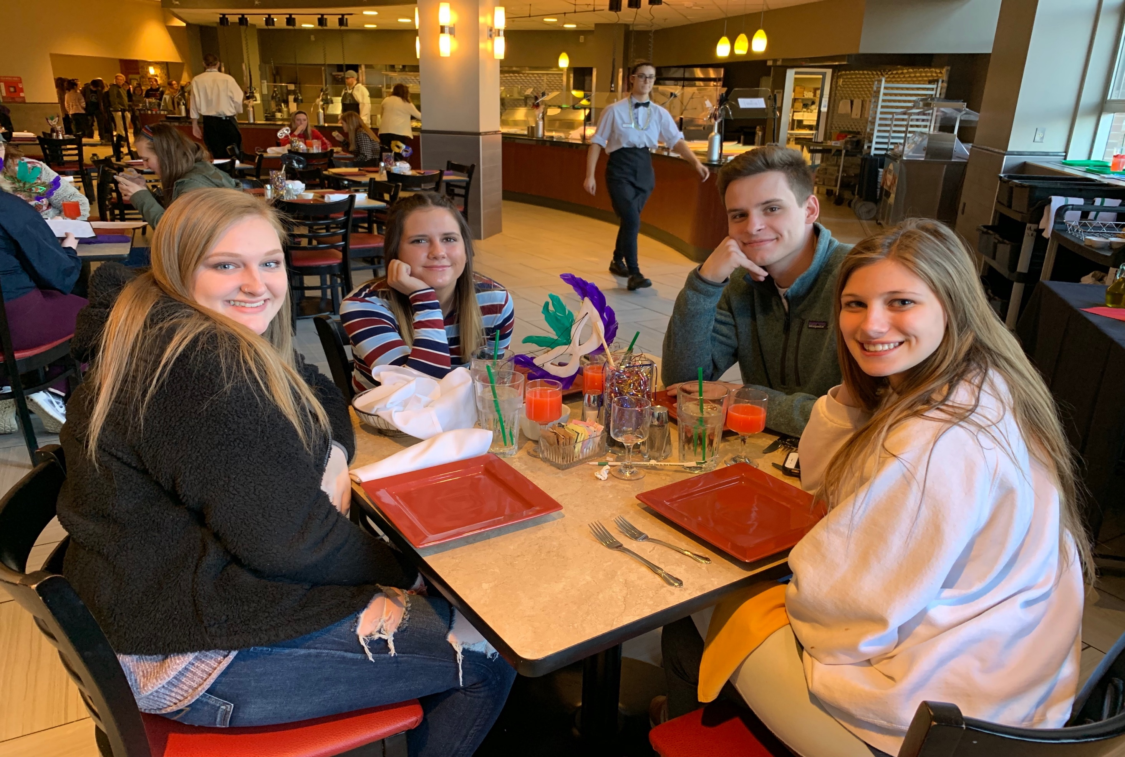
Gather IN THE DINING HALLS
Dalton Kitchen
All-you-care-to-eat dining facility with varying main dishes and sides plus unique specials daily. Pizza, pasta, hamburgers, salad bar, deli bar, and breakfast served all day.
NEW RIVER GRILLE HOUSE
Fine-dining, sit-down meal during dinner complete with table service.

Slide 4
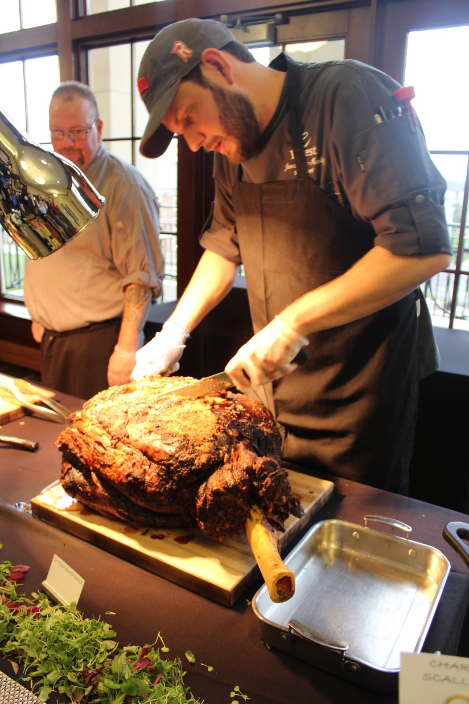
Explore new tastes with friends
Sample menu
Savor
Bourbon Chicken
Mesquite Beef Brisket
Wild Rice Blend
Cornbread Muffin
Miso and Ginger Sweet Potatoes
Taste
Hamburgers
Carolina Pulled Pork Sliders
Hot Dogs
French Fries
Chicken Nuggets
Crave
Cheese Pizza
Sundried Tomato Salami Pizza
Italian Sausage Flatbread
Rigatoni Pasta w/ Carbonara Sauce
Cheese Manicotti
Other
Fresh Salad Bar
Fresh Deli Bar
MTO Breakfast + cereal and waffles
Rooted station featuring vegan/vegetarian options
Nourish station featuring gluten-conscious items

Slide 5









Socialize on other parts of campus
The Bonnie
Terrace shops
Other locations

Slide 6

Allergen Friendly Dining
Don’t Be Shy, Self-Identify – it’s easy!
Register your allergy concerns with us at the Quest table fair
Look for an email prior to the start of the semester with information on how to log your allergen on Dine on Campus
Talk with a Manager or Chef on duty at any location to assist you with meal options using your Allergen Card (if needed)

Slide 7




Understanding Your options
Meal plans - how do they work
Choose the plan that best fits your needs
Meal Plans are loaded to your RU ID card
Swipe at applicable locations and enjoy

Slide 8

Meal Membership Perks
Meal Membership Perks
TAX FREE PURCHASES
ACCESS TO MOBILE ORDERING
RETAIL DISCOUNTS
LEGACY EVENTS
Less dirty dishes and more free time

Slide 9

On Campus Resident Meal Memberships
Flex Plan: This plan you receive $660 Flex Dollars at a declining balance + $30 vending dollars. With the use of this plan you receive a built in discount of 50-70% all dining purchases.
15 or 19 Plus Plan: This plan provides 15/19 meals per week in our all you can eat dining halls and $150 Food Dollars which can be spent at all retail locations.
*What’s a Flex Dollar?
When using flex dollars, the meal plan discount is automatically applied on the front-end dollar amount. Meaning, the price paid for meals is 50% (retail) or 66-70% (dining halls) below what is advertised.
*The Flex Plan is the default (and most popular) plan for on-campus residents, so if you’re satisfied with it, no need to do anything on your end!
Notes:
Create a unique QR code here:
https://www.qr-code-generator.com/?ut_source=google_c&ut_medium=cpc&ut_campaign=g_en_dsa&ut_content=home&ut_term=_b&gclid=CjwKCAjwkPX0BRBKEiwA7THxiAIC4pBn-_ZaJA-sXEoTEb4ieGCt-q_u-mqW2cME12eH8sqbHQsSsRoCO7YQAvD

Slide 10


Commuter options include Residential options as well as the following:
Block 65 Plan: At the start of each semester you will begin with 65 meals swipes/exchanges to be used at any time. (The exchange rate is $8.37 in all retail locations)
Block 90 Plan: At the start of each semester you will begin with 90 meals swipes/exchanges to be used at any time. (The exchange rate is $8.37 in all retail locations)
Flex Jr.: This plan you receive $330 Flex Dollars at a declining balance. With the use of this plan you receive a built in discount of 50-70% all dining purchases.
Notes:
Create a unique QR code here:
https://www.qr-code-generator.com/?ut_source=google_c&ut_medium=cpc&ut_campaign=g_en_dsa&ut_content=home&ut_term=_b&gclid=CjwKCAjwkPX0BRBKEiwA7THxiAIC4pBn-_ZaJA-sXEoTEb4ieGCt-q_u-mqW2cME12eH8sqbHQsSsRoCO7YQAvD

Slide 11
Apartment Meal Memberships
University Apt Plan: This plan provides a total of 105 meals and $200 Food Dollars (at an $8.37 exchange rate in all retail locations) to be used throughout the semester.
Save time, wash less dishes, and eat on the go any time!
Save time, wash less dishes, and eat on the go any time!
Notes:
Create a unique QR code here:
https://www.qr-code-generator.com/?ut_source=google_c&ut_medium=cpc&ut_campaign=g_en_dsa&ut_content=home&ut_term=_b&gclid=CjwKCAjwkPX0BRBKEiwA7THxiAIC4pBn-_ZaJA-sXEoTEb4ieGCt-q_u-mqW2cME12eH8sqbHQsSsRoCO7YQAvD

Slide 12

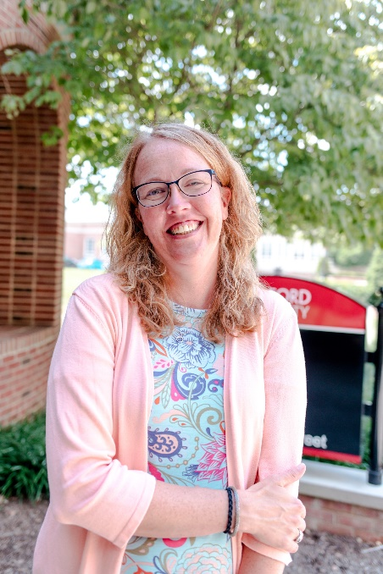
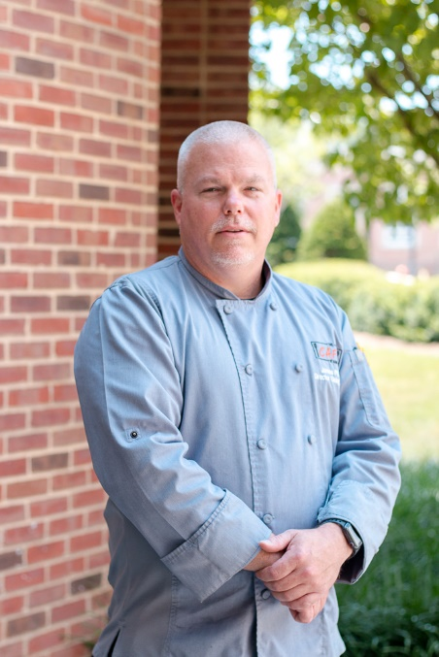
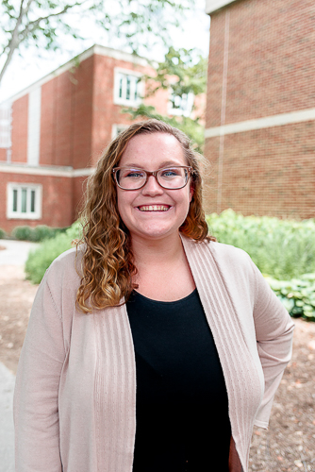
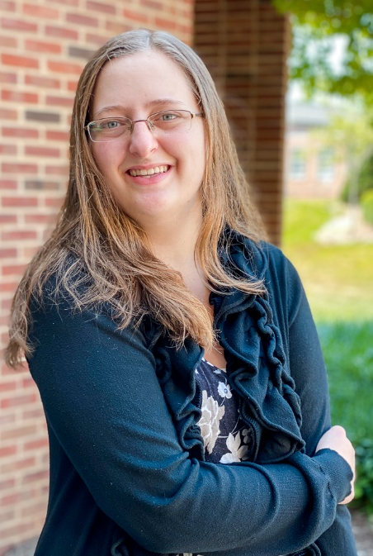
Meet the staff
Adrean Harris
Resident District Manager
Mary Beth Sutherland
Retail Operations Director
Chef Jim Pfifferling
Executive Campus Chef
Jade Sutherland
Marketing Manager
Jennifer Lynch
Controller
Experience in the kitchen and beyond

Slide 13


STAY UP TO DATE ON SUPRISE POP-UPS, RETAIL DISCOUNTS, AND SPECIAL EVENTS BY FOLLOWING US ON ALL SOCIAL PLATFORMS!
@radfordudining
www.dineoncampus.com/radford

Slide 14

Download our app for Meal Plan Information, Location Menus, Hours of Operation, Special Events, Limited Time Offers, Catering and more!
For more, visit: www.dineoncampus.com/radford

Slide 15
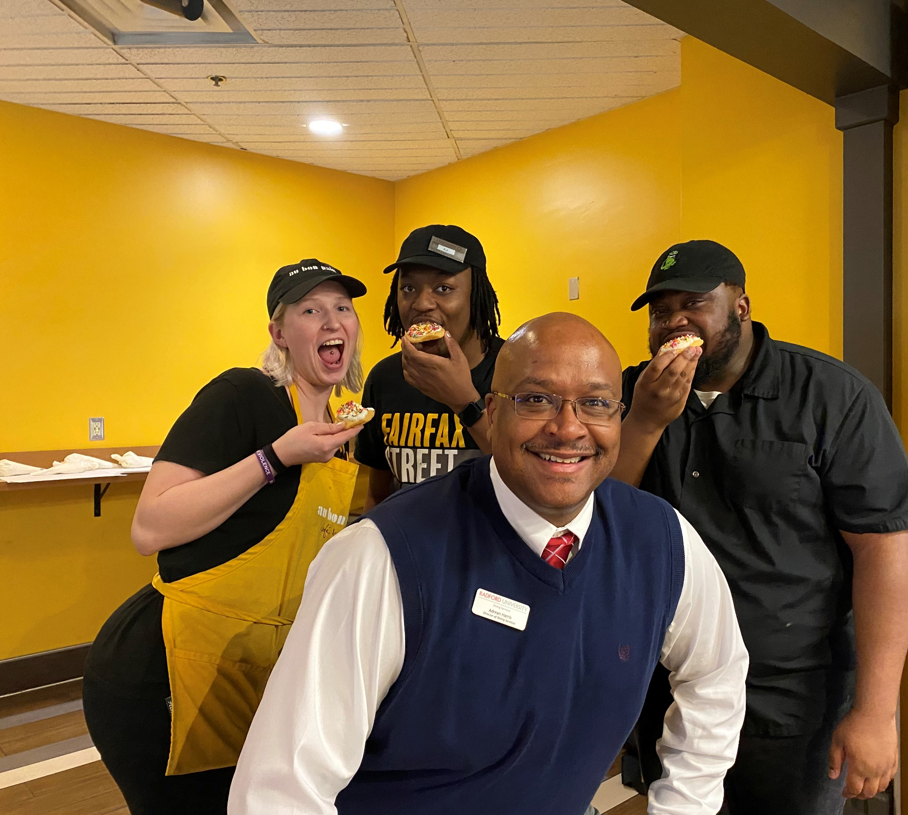
Get Paid while having fun
Free meal with every shift worked
We work with your school schedule
Learn invaluable skills to enhance your resume
No need to leave campus or move your car
  Become a barista at Starbucks
  Serve at exquisite events in Catering
  Learn what it takes to run a kitchen in Dalton
  Perfect your customer service skills in NRGH
  Craft killer salads for guests at Create
We’re hiring
Check out our website for links and additional information

Slide 16



Questions?

