Slide 1
Productive Partnerships
Student Affairs

Slide 2
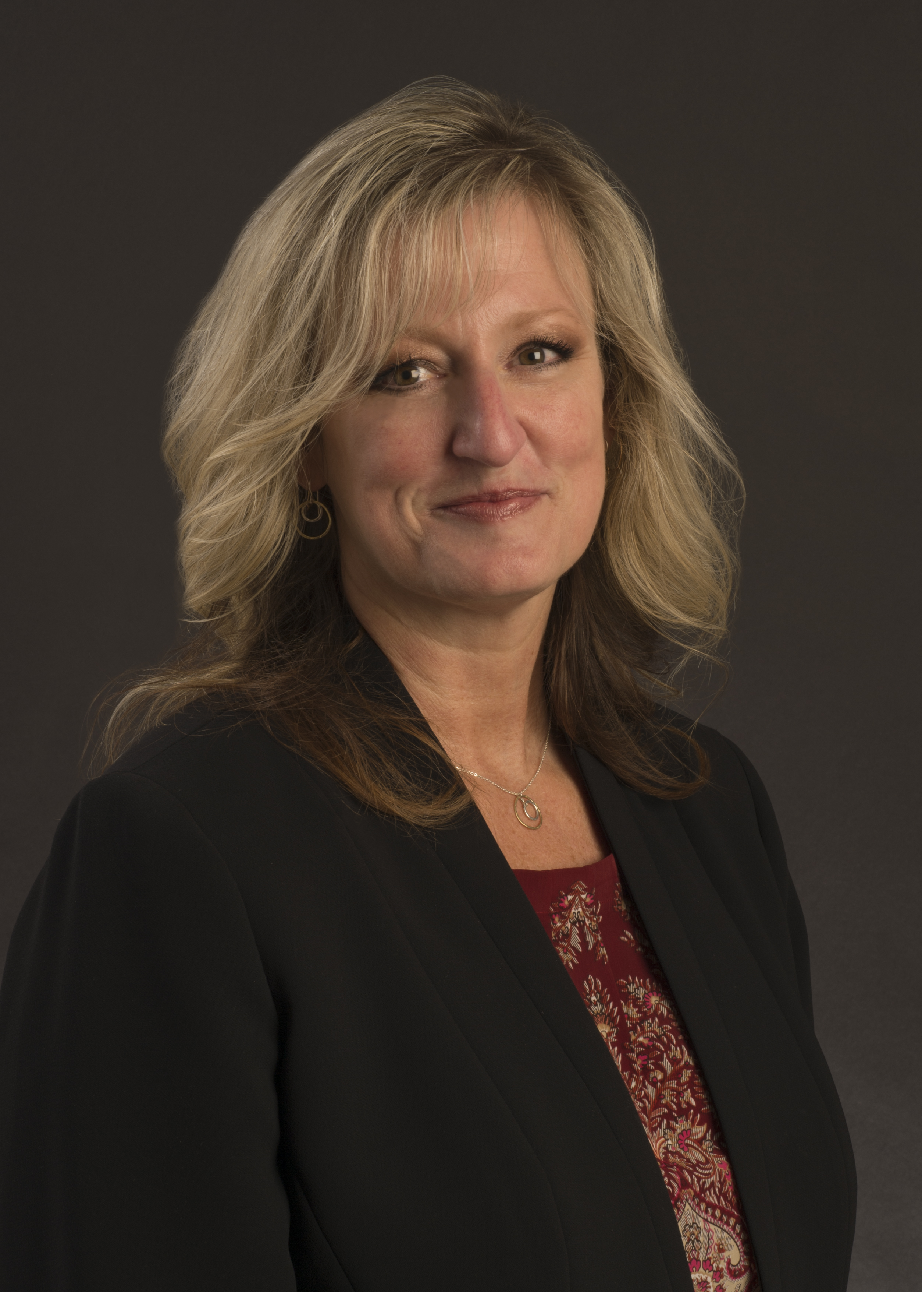
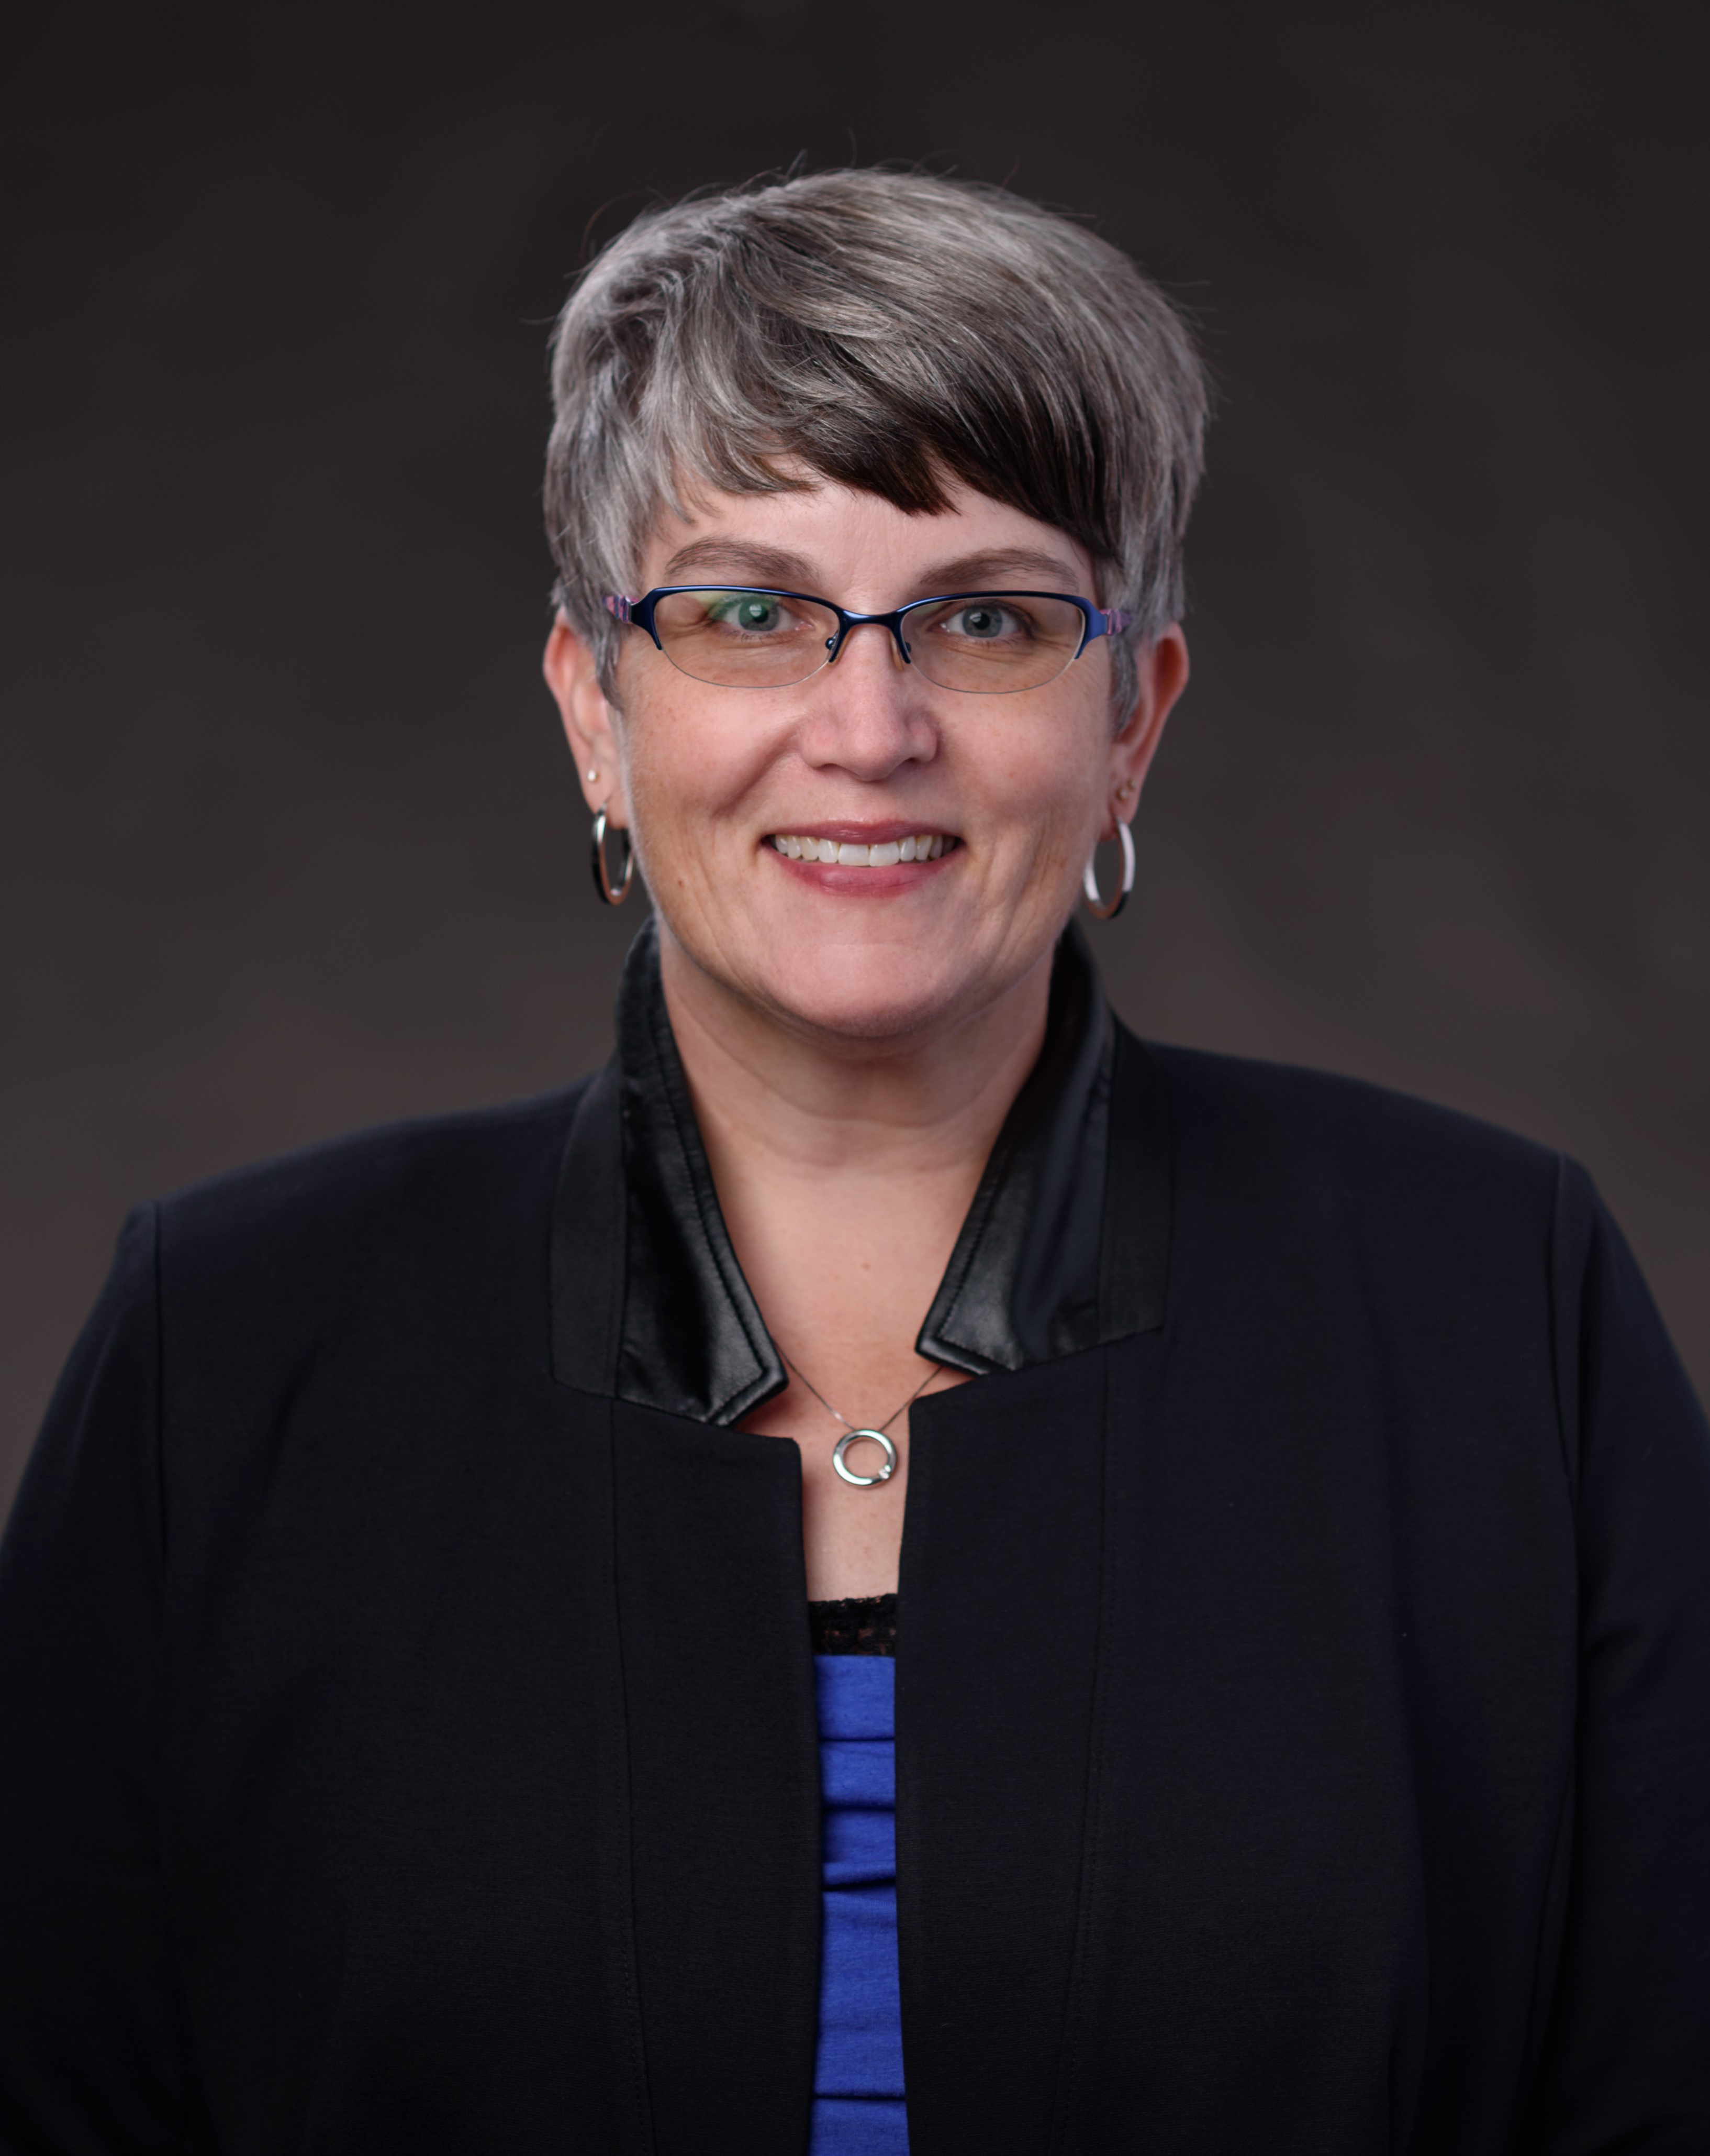
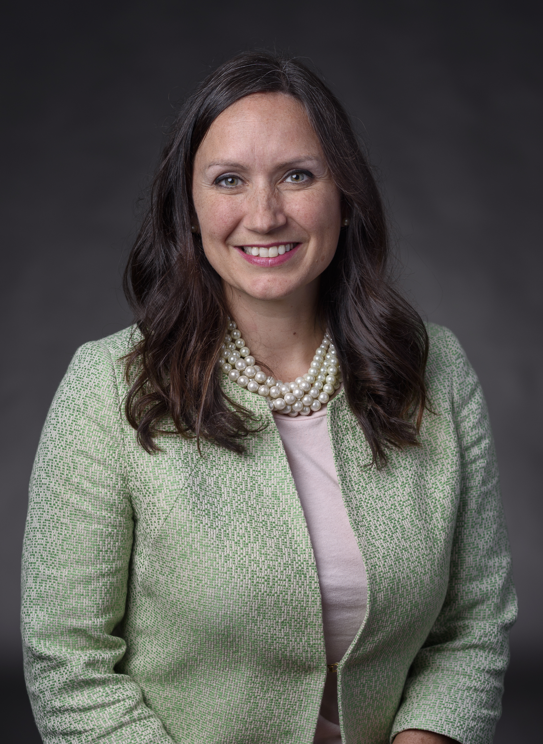
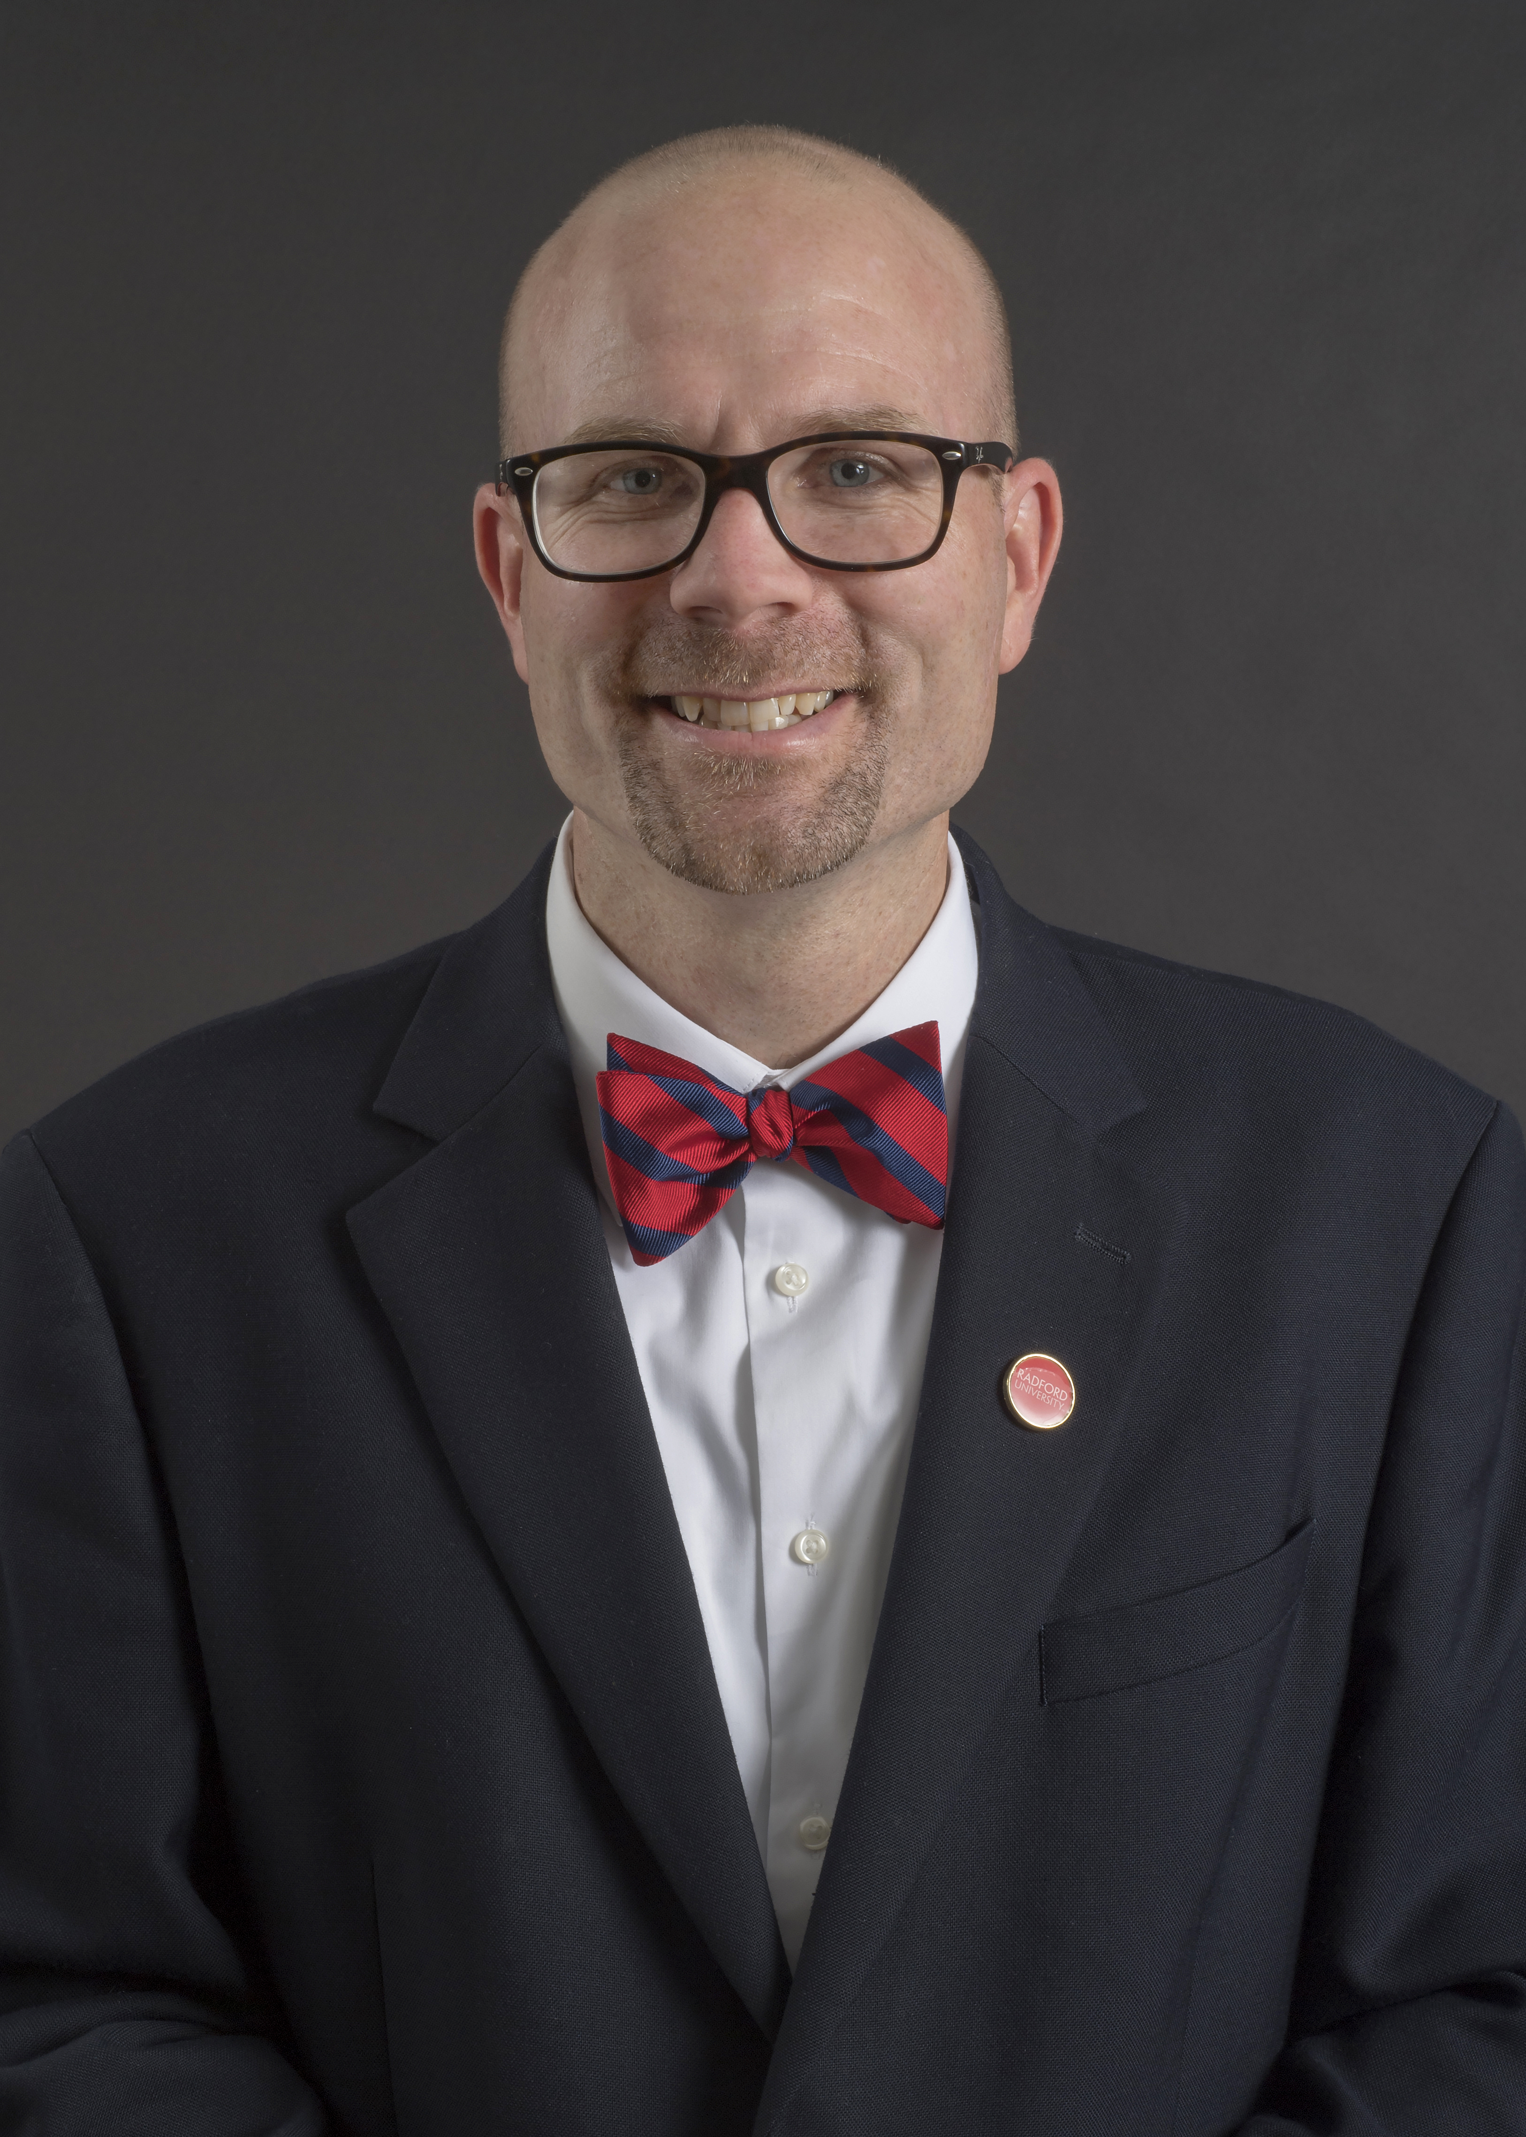
Student Affairs Leadership
Dr. Susan Trageser
Vice President for Student Affairs
Ms. Angie Mitchell
Associate Vice President & Dean of Students
Ms. Tricia Smith
Associate Vice President for Student Life
Dr. Jamie Penven
Assistant Vice President for Student Success & Retention
Student Affairs
Notes:
Welcome, introductions

Slide 3
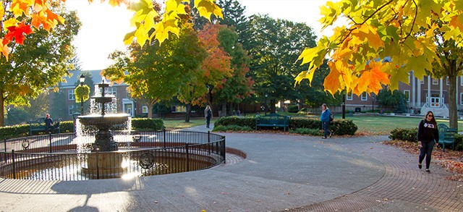
Overview
Partnerships
Welcome to the Highlander Family!
Student Affairs

Slide 4
Maslow’s Hierarchy of Needs for Families
Community
Community
Family Engagement
Family Weekend, University Events
Tie
Student Needs
Orientation, Housing, Dining, Safety, Wellness & Advocacy
Student Affairs

Slide 5
How some other campuses view families…
Helicopter Parent (always hovering and fixing)
Blackhawk Parent (think extreme helicopter)
Lawnmower Parent (mowing everyone down)
Bulldozer Parent (destroying everything in your path)
Stealth Parent (secretly hovering)
Psycho Parent (self-explanatory)
In-Denial Parent (not my perfect angel)
Lion Parent (roaring)
Wolf Parent (traveling in packs)
Mosquito Parent (always poking around)
Notes:
Feel free to use Pigeon Parent as a joke as well

Slide 6
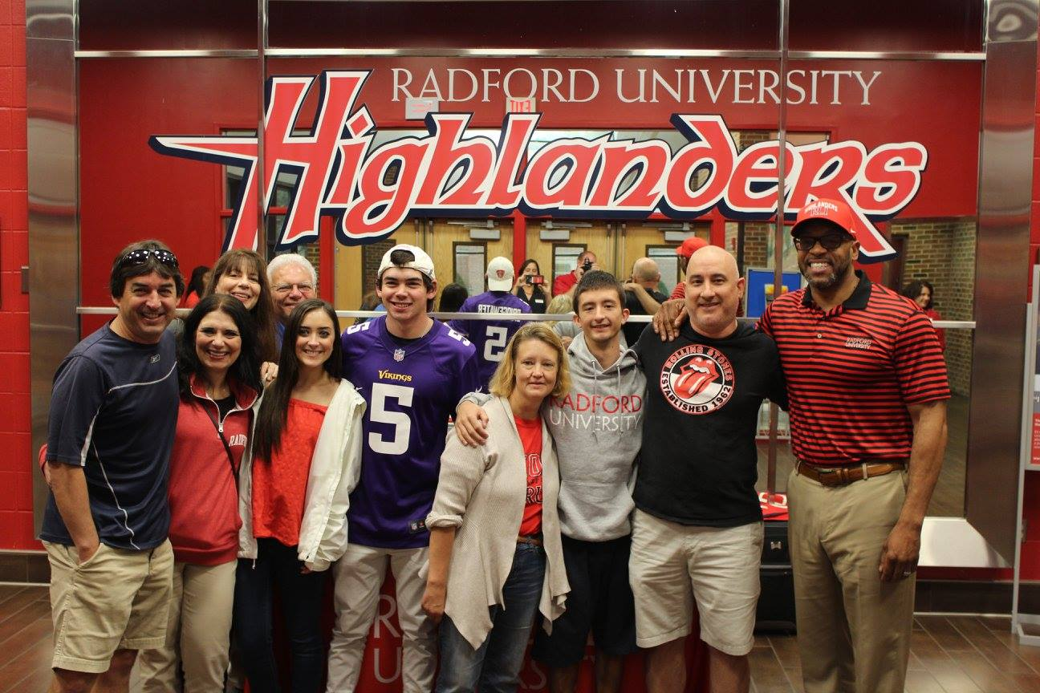
…but not at Radford
We believe in partnership
Notes:
Families are critical partners in their student’s success and engagement

Slide 7
A transitioning relationship
parent / child
coach / student

Slide 8
Navigating the Law
Family Educational Rights
and Privacy Act (FERPA)
Federal law (1974)
Directory Information
FERPA Disclosure
Health or Safety
registrar@radford.edu

Slide 9
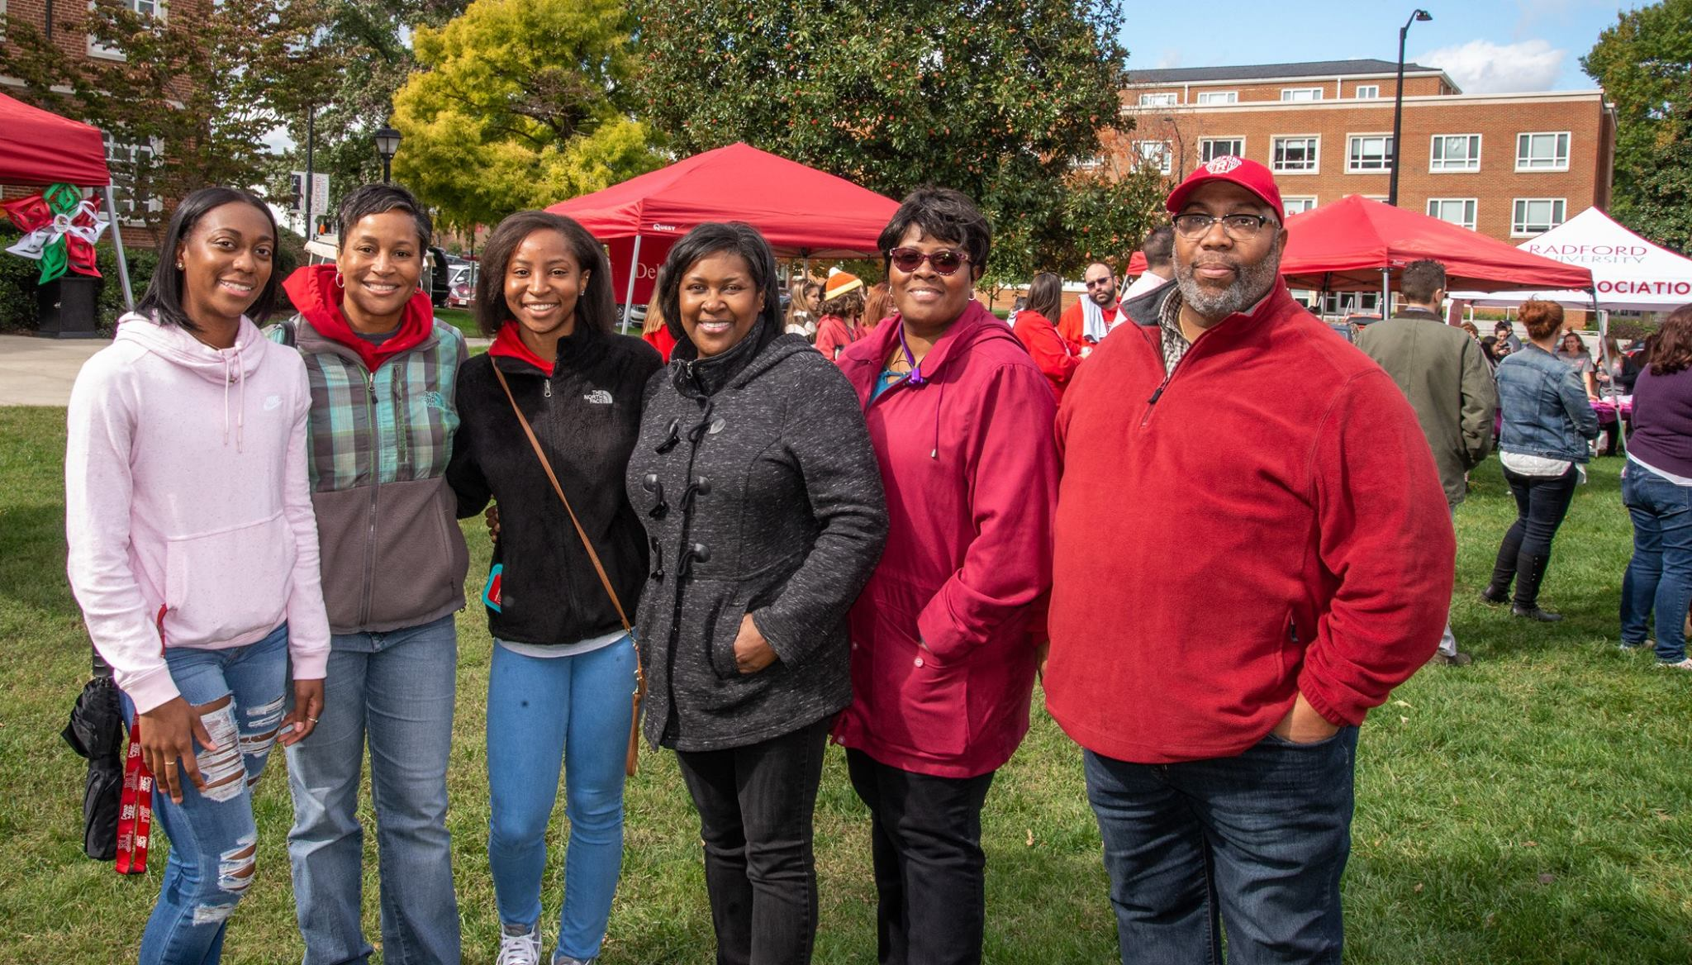
Family Conversations
Express Expectations
Open Communication
Keep a Sense of Humor

Slide 10
Family Discussion Topics
Transition to Radford
Academics: advisors, advising center, Harvey Knowledge Center
Getting involved in a student organization
Safety: RU Alerts, emergency phones
Student Services: Registrar, Parking Services, Financial Aid
Dining & Housing
Responsibility and positive choices
Alcohol policy, use and abuse
Notes:
Transition to Radford
Academics: advisors, advising center, Harvey Knowledge Center
Getting involved in a student organization
Safety: RU Alerts, emergency phones, Live Safe App
Student Services: Registrar, Parking Services, Financial Aid
Dining & Housing
Responsibility and positive choices
Alcohol policy, use and abuse

Slide 11
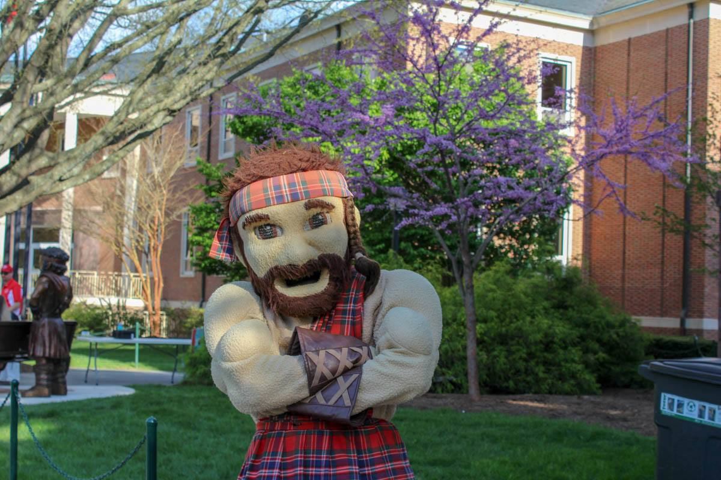
Staying Informed
Electronic communications
  Highlander Family Newsletter
  https://tinyurl.com/RadFamNews
  RU Alerts
Visit our website www.radford.edu/family
Email or Call

Slide 12
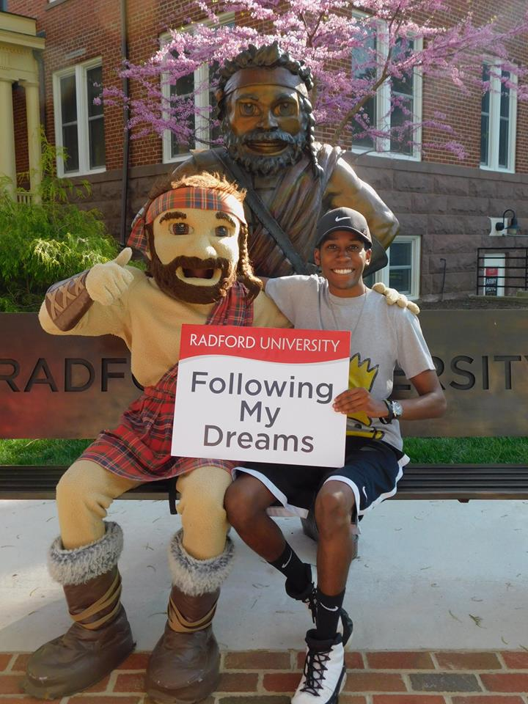
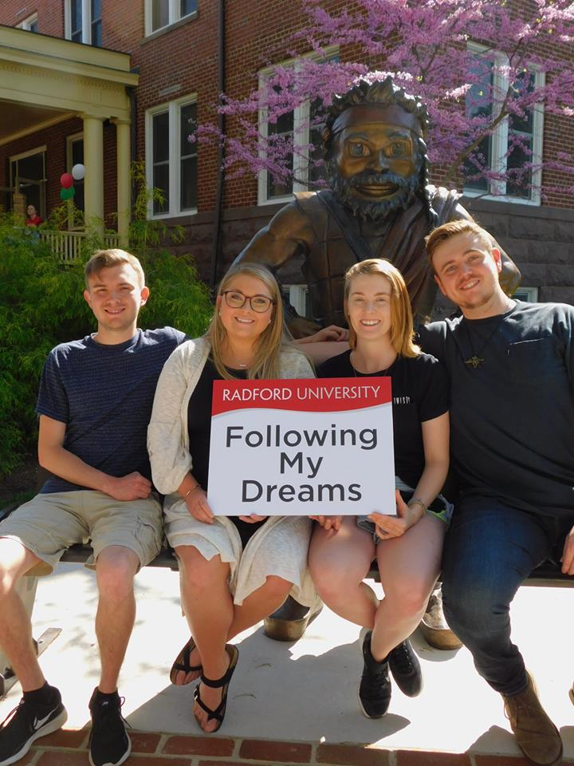
Enjoy the journey!

Slide 13

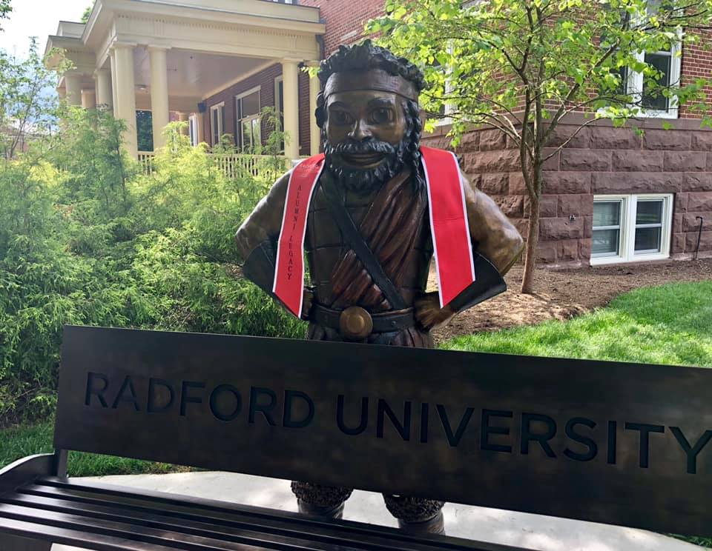
It is all worth it!

Slide 14
Student Affairs Offices
& Contact Information
Student Affairs

Slide 15
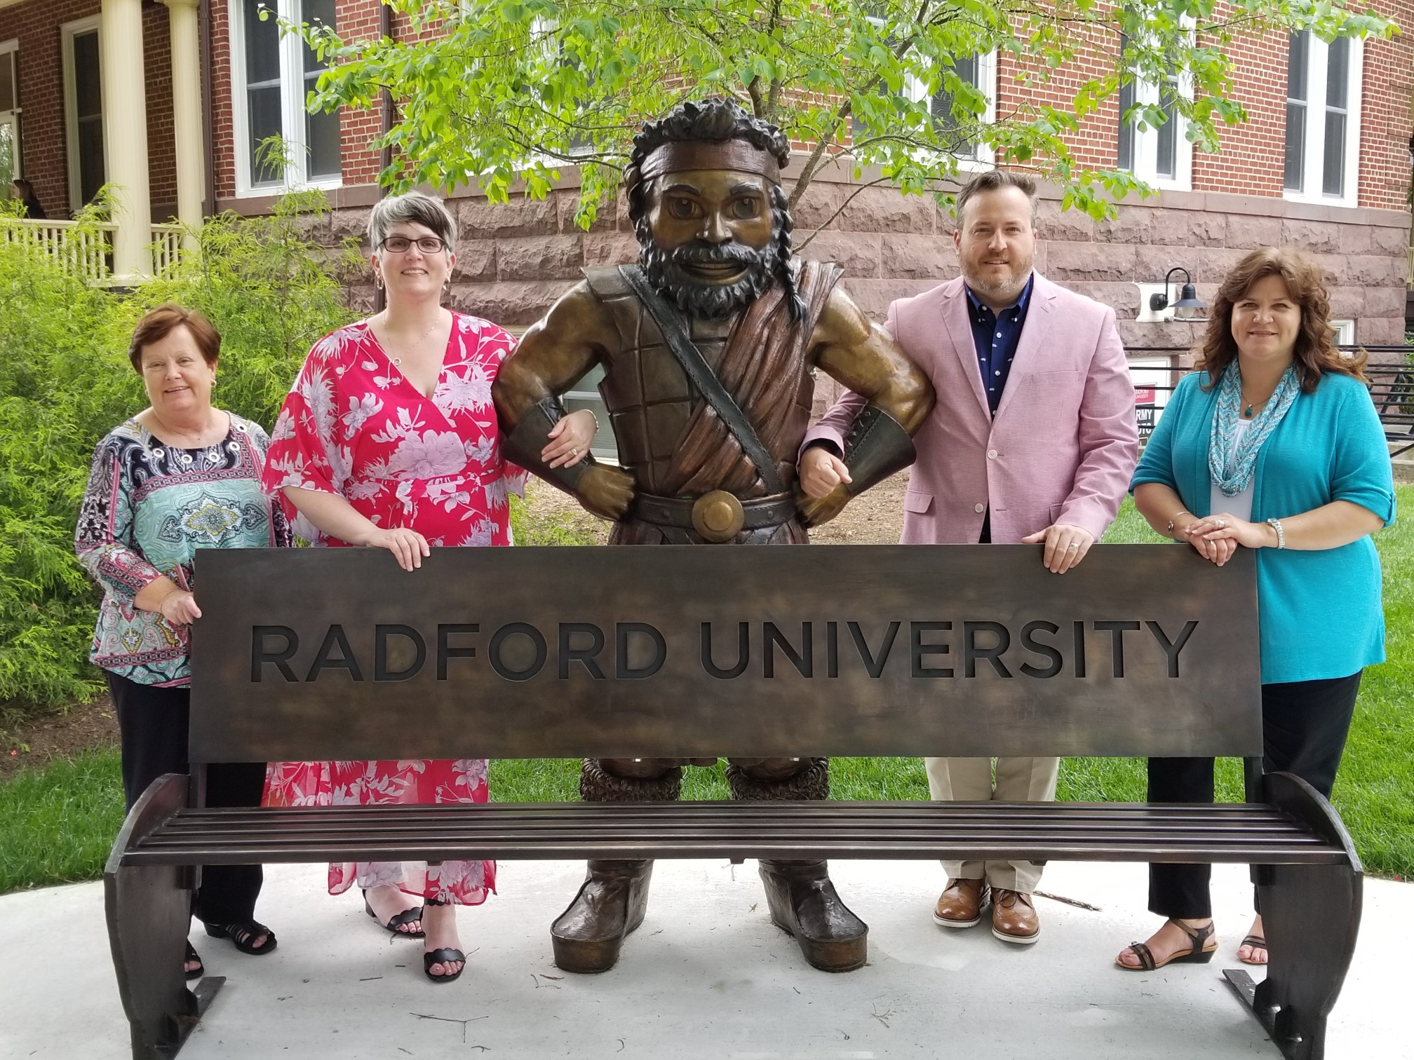
Dean of Students
Awareness, Advocacy, Accountability
Heth Hall 274
540-831-6297
dos-web@Radford.edu
Student Affairs
Notes:
Partnership
Advocacy
Communication

Slide 16
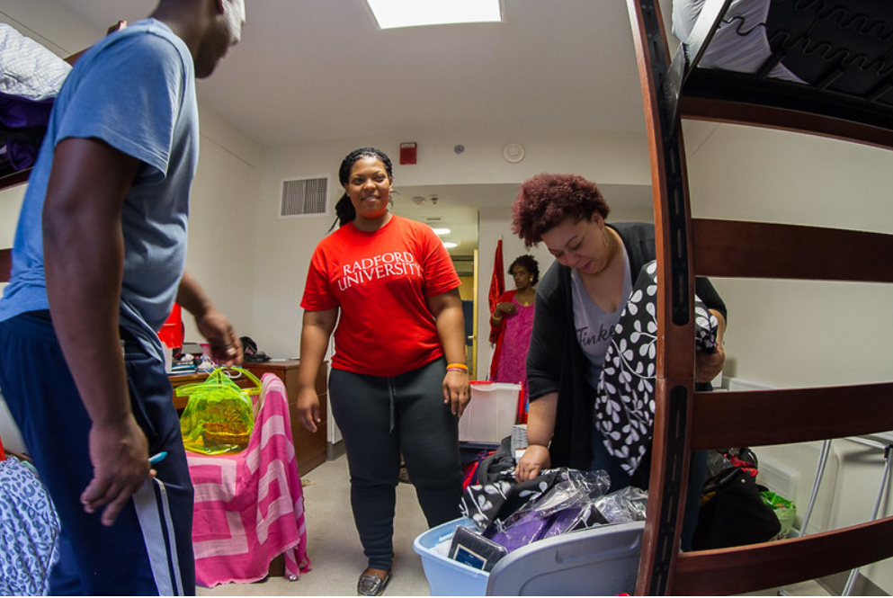
Housing and Residential Life
Your #HighlanderHome
Heth Hall 226
540-831-5375
res-life@radford.edu
Student Affairs
Notes:
Assignments emailed to RU email at the end of July. Will include info about move-in dates.
Please use the website as a resource to help your student best prepare for move in
Empower your student to communicate with their roommate and advocate for themselves if they need assistance.

Slide 17
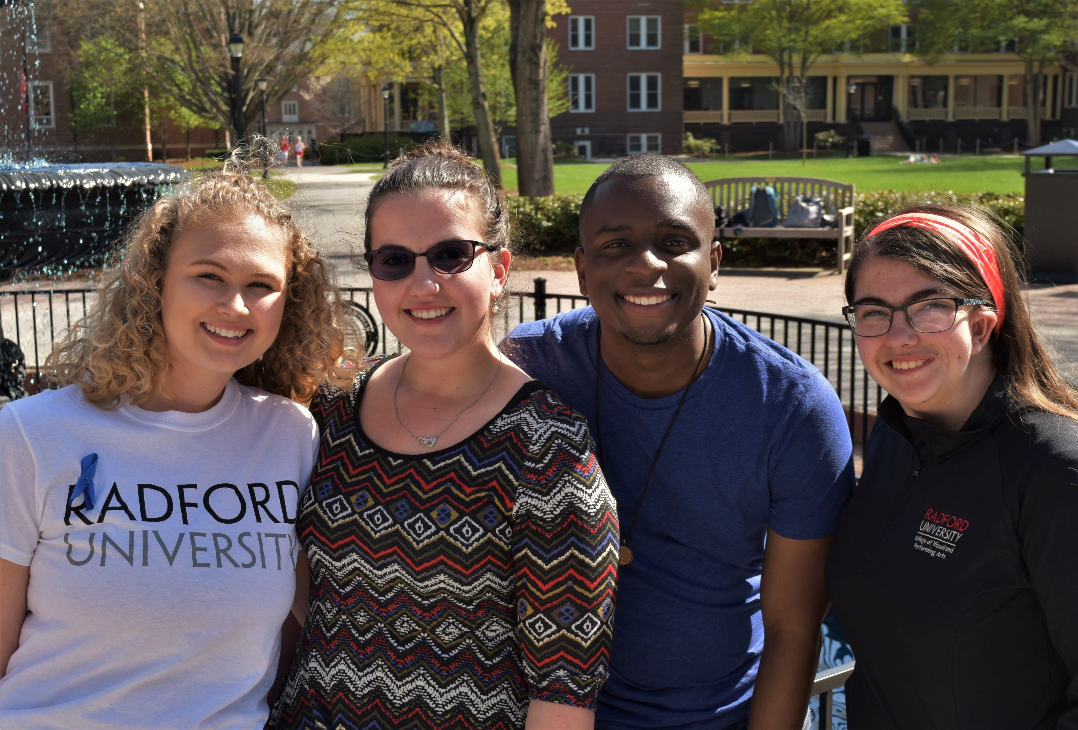
Center for Accessibility Services (CAS)
Access, Empowerment, Inclusion
Russell Hall 3rd Floor
540-831-6350
540-922-1176 (VP for ASL Users)
cas@radford.edu
Student Affairs
Notes:
Not all Superheroes have superpowers. Some learn what tools to use and when to employ them to be successful. i.e. Batman's Utility Belt
Access, Empowerment, Inclusion
First Year Families:
Who is covered- the student - not you
Why it is important to access accommodations earlier rather than later.
It is about access not guaranteed success.
Transfer Families:
Why is it important to access accommodations
Never too late to start using them

Slide 18
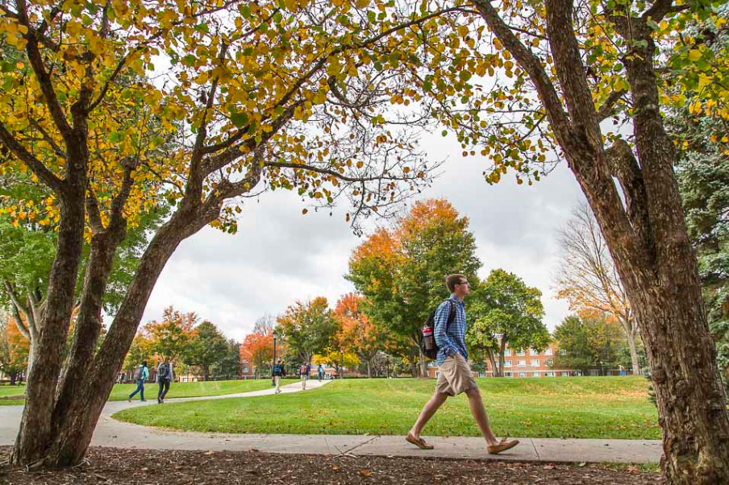
Student Standards and Conduct
Talk About It
207 Heth Hall
540-831-5321
conduct@radford.edu
Student Affairs
Notes:
Car Talk, talk about these hard subjects and your family expectations on the way home and on the way back in August because they are trapped and can't get away.

Slide 19
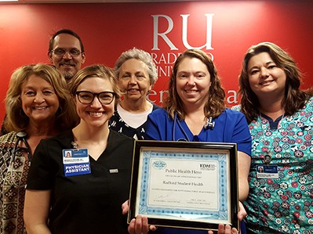

Student Health Services
We Can Help
Moffett Hall, lower level
540-831-5111
1-866-205-2164
(24/7 nurse line)
Student Affairs
Notes:
We are your doctor while away from home
Located on lower level of Moffett Hall
You can sign up for MyChart to have access to your providers -MyChart – give you access to message your provider and make your own appointment. You must first see a Student Health or Carilion Provider to sign up.
Access to 24/7 nurse line at 1-866-205-2164
Contact us at 540-831-5111
Please visit our University Website for more detailed information
As a member of Carilion Clinic we are able to provider coordinated care across the largest healthcare system within Southwest Virginia
We provide:
Free consultation
Low cost medications, testing, and procedures with and without insurance
Visit our website for more details
Office visits for diagnosis/treatment of a variety of illness/injuries
Laboratory testing (flu, glucose, strep, mono, urinalysis, etc)
Immunizations
Annual Flu Clinic
Surgical procedures and physicals
Medication pick-up program
Sexual Health Education - Testing and Treatment of sexually transmitted infections (STIs)
Electronic Medical Record
Women’s Health provider on-site:
Annual exams (PAP)
Birth control
UTI testing
Pregnancy testing
Evaluation of abnormal pap
Allergy injections
Cold Care Kits
Wound Care
Asthma Screening
Travel Vaccinations
New Student Tips:
Bring a “self help kit” this fall (Advil, Tylenol, band-aids, cold/flu medicine, nasal spray, thermometer, etc.)
Know your allergies/reaction
Bring a current list of medications with dosages
Get plenty of sleep, exercise and eat healthy meals
Come see us if you are sick, concerned, or just don’t know, we can help

Slide 20
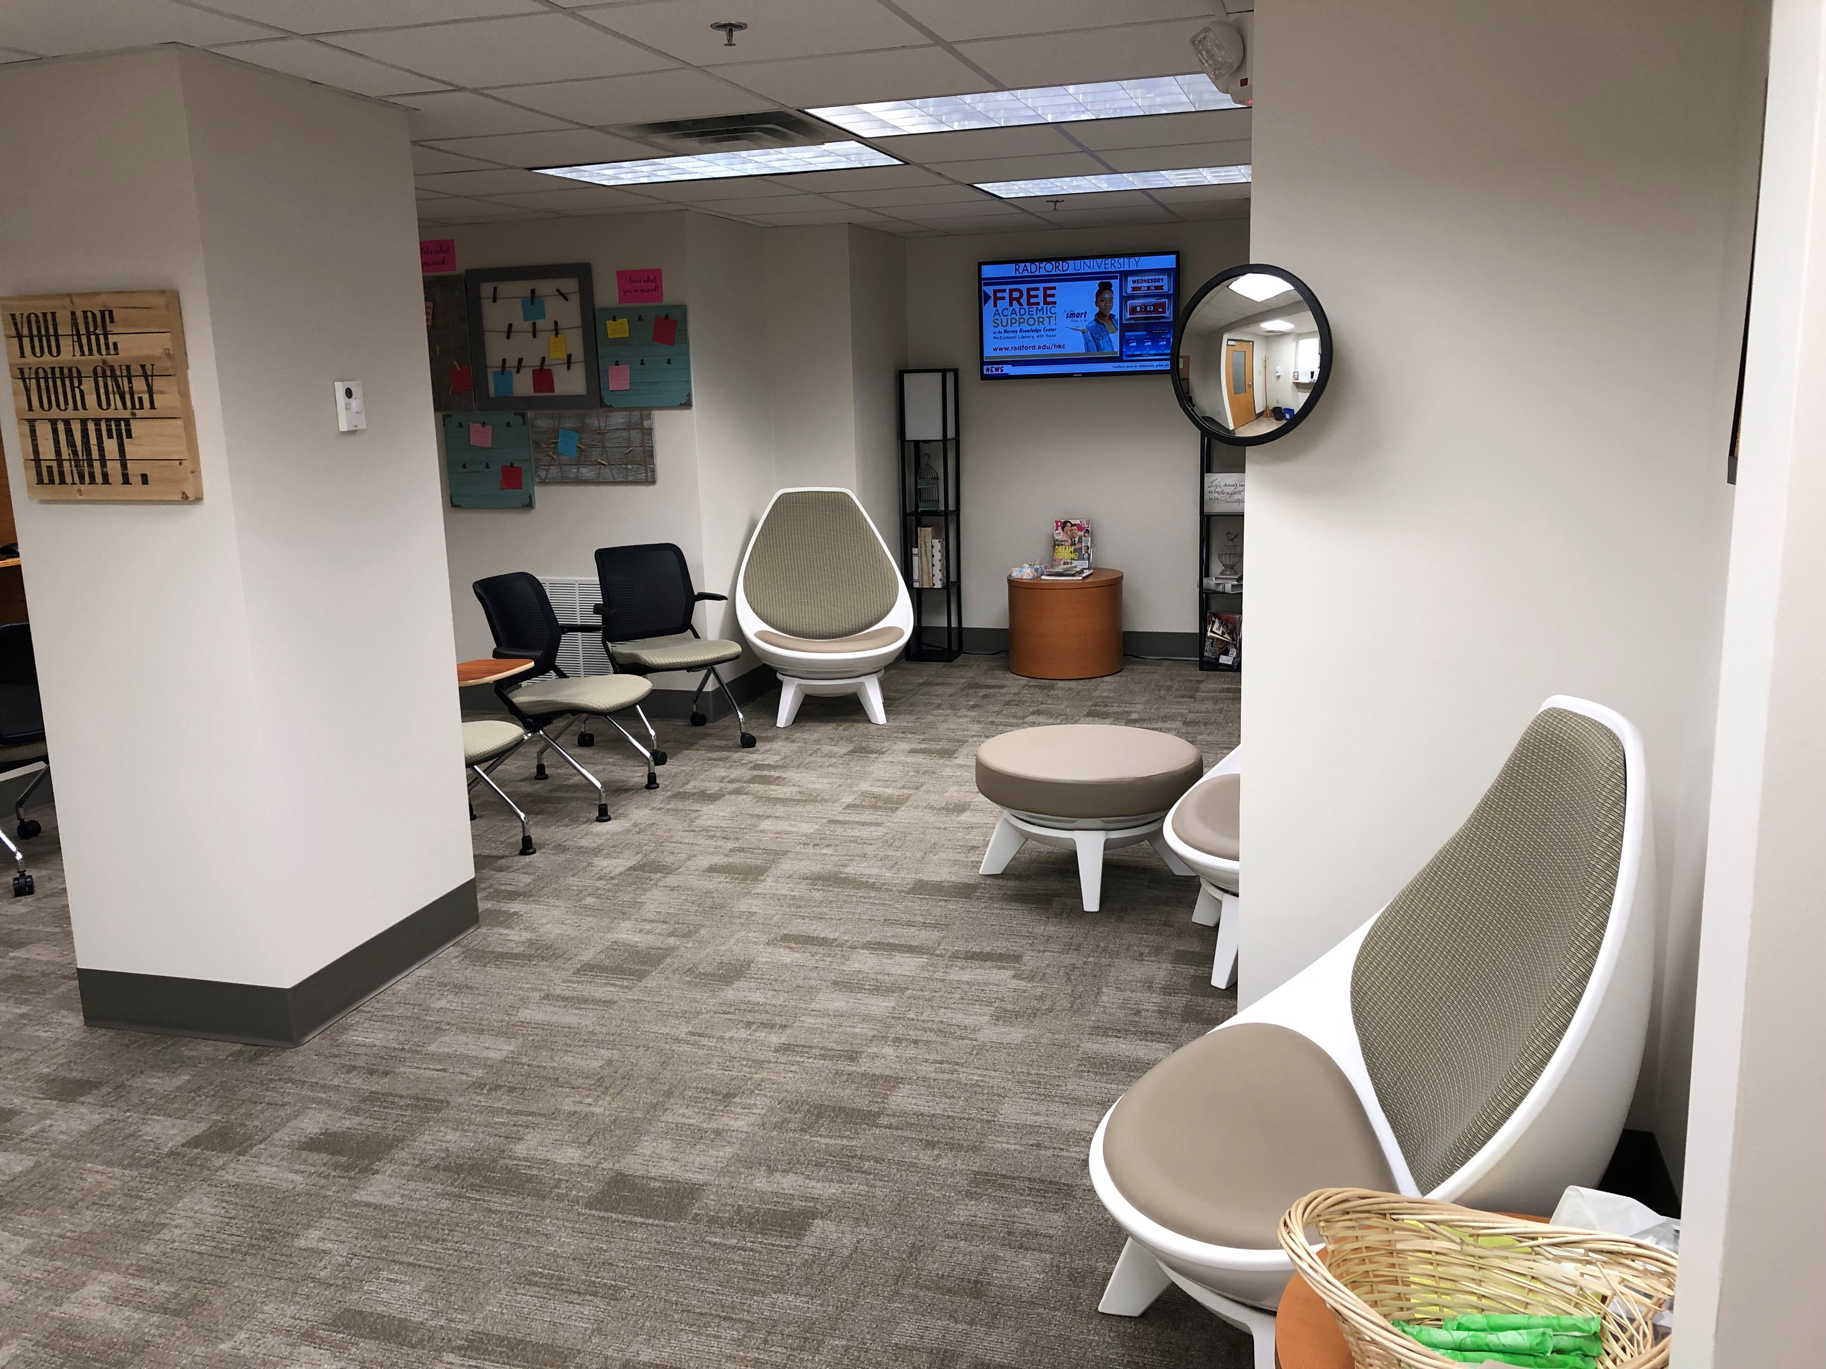
Student Counseling Services
Free, Confidential,
and Convenient
Tyler Hall, lower level
540-831-5226
Office hours: 8 a.m.-5 p.m., Monday-Friday
Drop-in hours: 1-3 p.m., Monday-Friday
Student Affairs
Notes:
Provides consultation to family members/parents to help them get their students connected to appropriate support/resources both on and off-campus
Free, on-campus counseling for students
Works within strict, ethical, and legal guidelines to protect the confidentiality of the students we see.

Slide 21
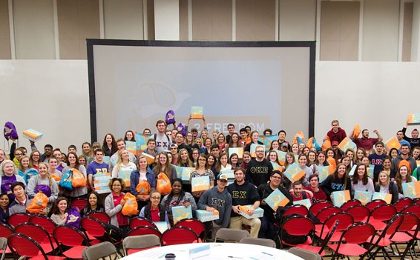
Substance Abuse and Violence Education Support services (SAVES)
Free, Confidential Services, Programs & Swag!
Tyler Hall, lower level
540-831-5709
saves@radford.edu
Student Affairs
Notes:
Confidential consultation, advocacy, and counseling services for issues of sexual violence, substance use, and recovery support
Provide prevention education and campus-wide outreach events
Completion of EverFi courses AlcoholEdu for College and Sexual Assault Prevention for Undergraduates is required for all new incoming students

Slide 22
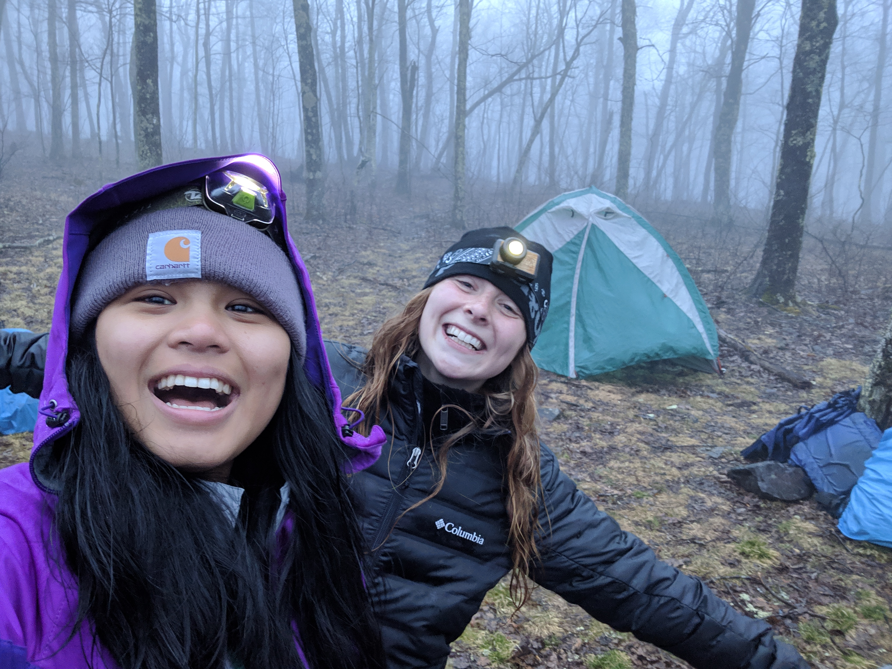
Student Recreation and Wellness
Find Your Fit
Programs
Employment
Community
Student Affairs
Notes:
Benefits of getting active: link to exercise and academic success, finding/building community, student success and retention
Follow us on social media, help guide your student to do seek out the healthy activities they participated in during high school to find stability
We offer weight and cardio options, competitive sports, outdoor programming, fitness classes and programming, and we one of the largest student employers on campus

Slide 23
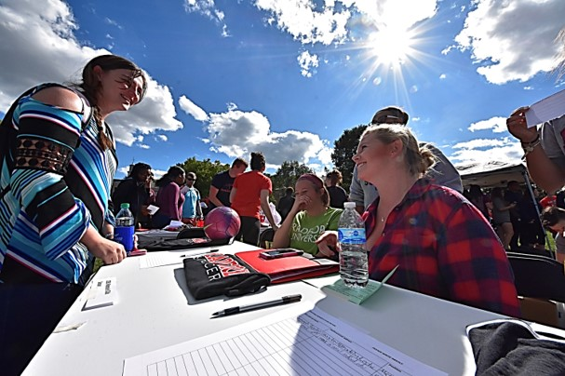
Student Involvement
Creating Memories
By Connecting
“The Bonnie”
Hurlburt Student Center 226
540-831-5332
stuact@radford.edu
Student Affairs
Notes:
"It takes a village" -- student centered
Campus employment opportunities
Engaged in the classroom as well as outside of the classroom equals success.

Slide 24
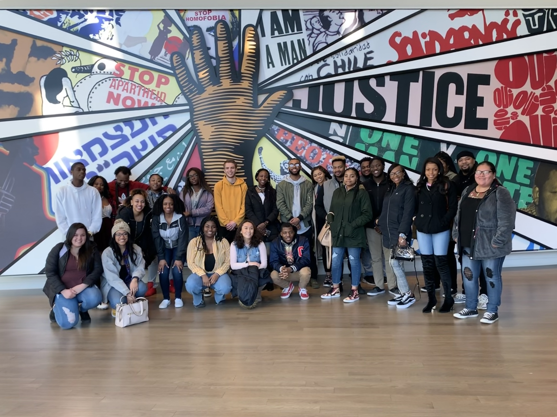
Center for Diversity and Inclusion
Home Away From Home
a place where you
matter and belong
Heth Hall 157
540-831-5765
diverse@radford.edu
Student Affairs
Notes:
Free resources for students
Safe/Inclusive/Engaging Environment
Provide advocacy for students

Slide 25

Fraternity and Sorority Life
Life-long Support & Friendship
“The Bonnie”
Hurlburt Student Center 204
540-831-5934
glo@radford.edu
Student Affairs
Notes:
2.5 GPA needed to join
Family members play an important role in the decision to join. Encourage them to talk to their students about that choice
Formal recruitment for the Panhellenic Council Sororities will now be in the Spring Semester.

Slide 26
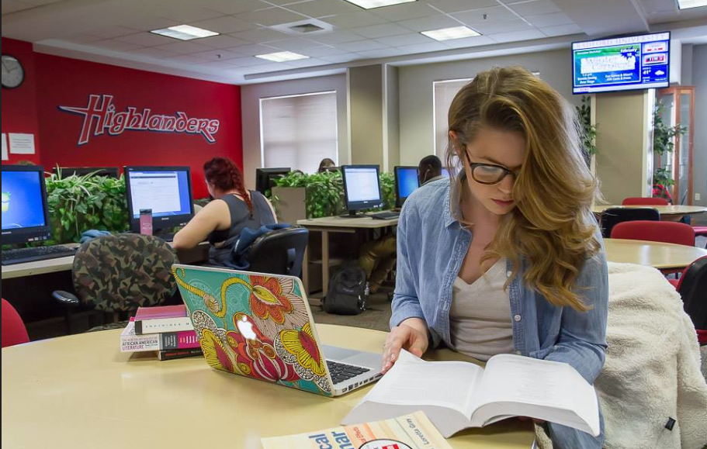
Student Success and Retention
Your Student’s Success
is Our Goal
Tyler Hall 009
540-831-2139
Student Affairs
Notes:
Your Student’s Success is our Goal!
We want your student to be successful academically and socially at Radford.
The university can be a confusing place to navigate. Being at Radford isn’t just about attending class and getting involved socially. There are business functions: Registering for classes, understanding financial aid, and knowing available resources. Think of us as a guide/or people with a map to help your student navigate all of that and connect them to their resources.
We also can help you! We know you communicate often with your student. If you are hearing from your student that she/he is struggling academically, encourage them to come see us! Our team can meet with your student and find out what is going on and help connect them to resources as well as help coach them in the right direction.
I’d like to offer three things you can do that will help with your student’s success:
Emphasize to them to GO TO CLASS! Showing up is half the battle. They can’t learn if they aren’t in class!
Encourage them to seek assistance early. Go to faculty office hours; go to the Harvey Knowledge Center for tutoring; get help from a success coach in our office on how to better manage their time.
Have specific conversations with your student about academics. You know the answer you’ll get to “How are classes going”. “FINE…”
Rather ask them:
“What is your most difficult class? What makes it difficult?”
“What are you most struggling with? What is going well?”
Knowing specifically what is going on with your student will allow for you to better encourage them to seek resources EARLY so that they can get on the right track. Finally, if you aren’t quite sure what is going on, you can still encourage them to come see us. We are friendly folks and are ready to help them.

