Slide 1
Syncing outlook in Agile advisor
Advising
August 2015

Slide 2
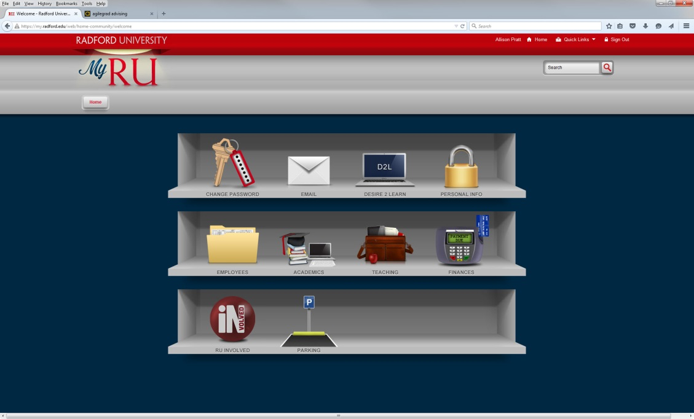
Log in to agile advisor
Sign in through your MyRU account: https://my.radford.edu
Click on the “Academics” tab.
Advising

Slide 3
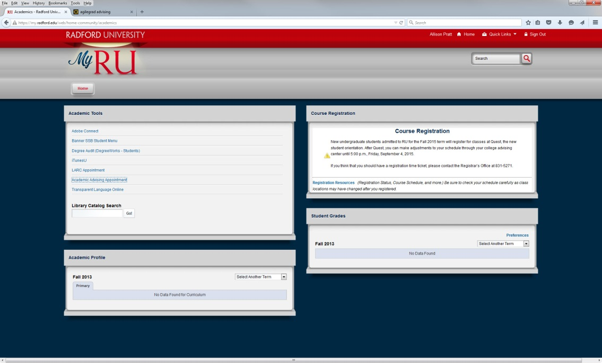
Log in to agile advisor
Then, click on “Academic
Advising Appointment.”
Advising

Slide 4
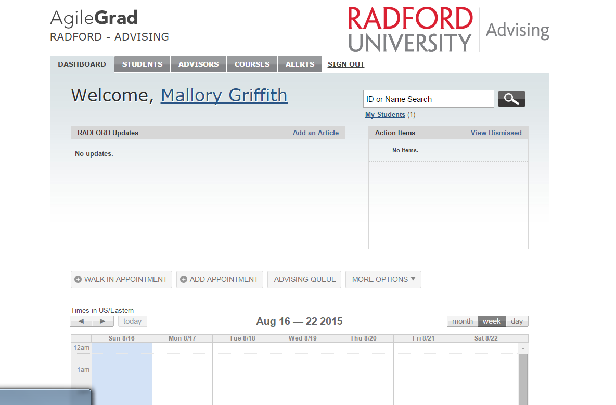
Log in to agile advisor
Once you’ve logged in (direct from MyRU or from the Agile Advisor website), this should be your view.
Once you’ve logged in, click on your name to open your profile area.
Advising

Slide 5
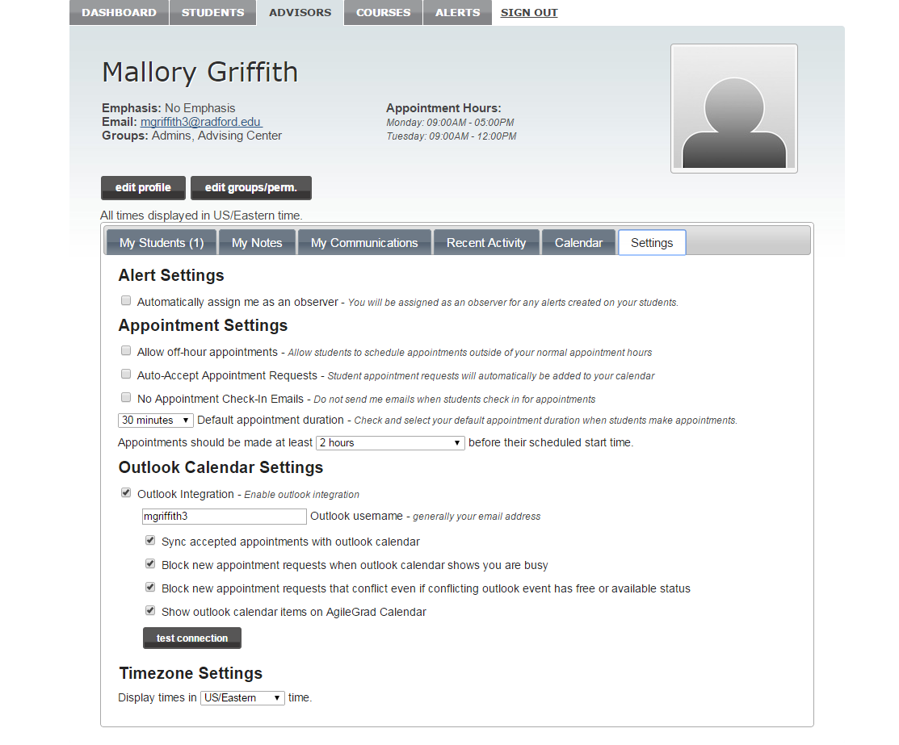
Check the outlook settings
Then, click the Settings tab on the far right side.
Review your Outlook Calendar Settings area to make sure you’ve selected the permissions you’d like to select.
Advising
Notes:
Make sure to cover appointment style.

Slide 6
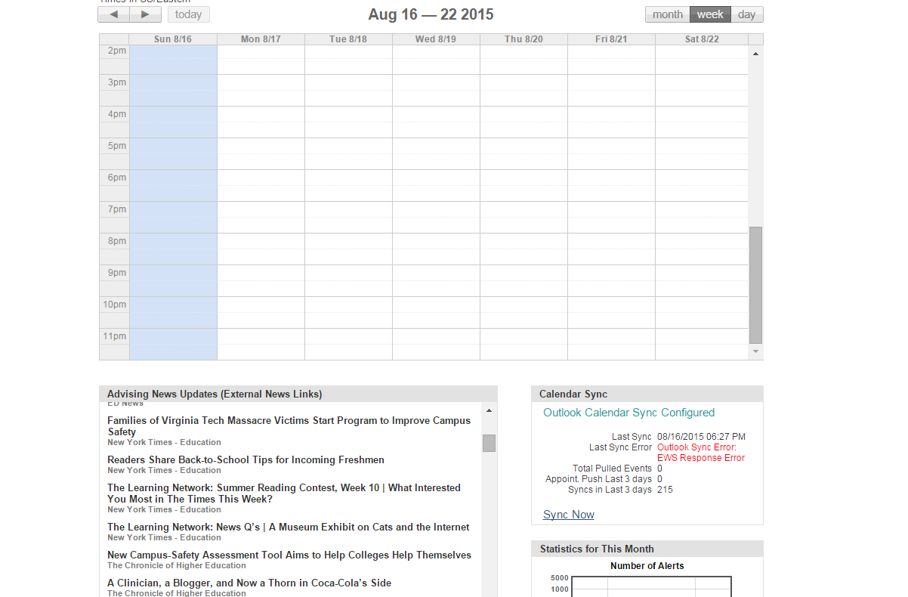
Sync your outlook
Click on the Dashboard tab to return to your homescreen.
Scroll down to the Calendar Sync box under your calendar.
Click “Sync Now”
Advising

Slide 7
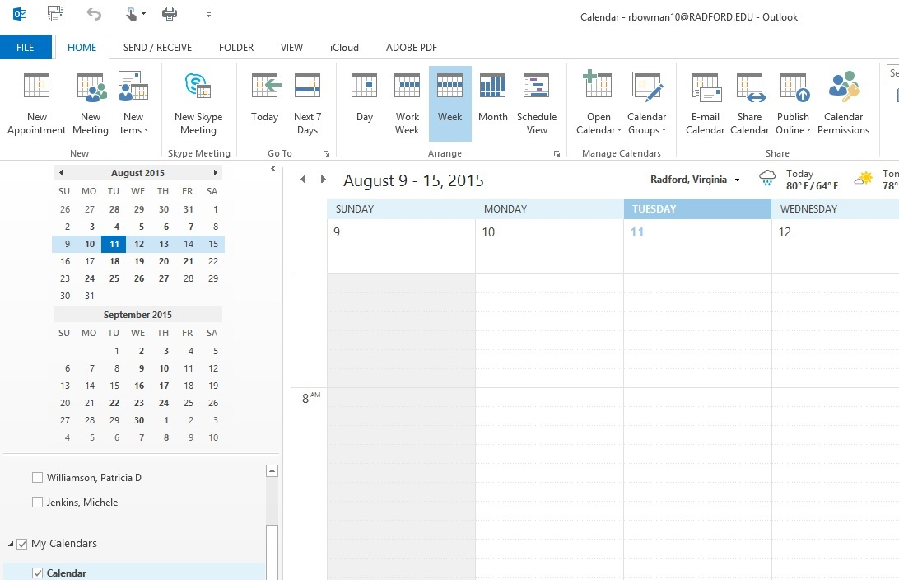
If you have an error message
Open your Outlook Calendar.
Click “Calendar Permissions”
Advising

Slide 8
If you have an error message Cont’d
Click on the Permissions tab in the pop-up box.
Then, click “Add” and choose
agile-advisor-cal
Advising

Slide 9
If you have an error message Cont’d
In the Permissions level drop down, choose “Author”
Then, click the Okay button.
Advising

Slide 10
Log back in to agile advisor
https://agilegrad.radford.com
Scroll down to the Calendar Sync box under your calendar.
Click “Sync Now”
Advising

