Slide 1
Academic Policies & Procedures Myth Busters
Megan Coulter, Associate Registrar
April 26, 2016
Radford Advising Conference

Slide 2
CATALOG
catalog.radford.edu
Radford Advising Conference

Slide 3
WITHDRAWALS, REFUNDS, CENSUS DATE
Myth:
Students can withdraw from a course through the MyRU Portal.
Policy: Withdrawal forms required
Busted
Radford Advising Conference

Slide 4
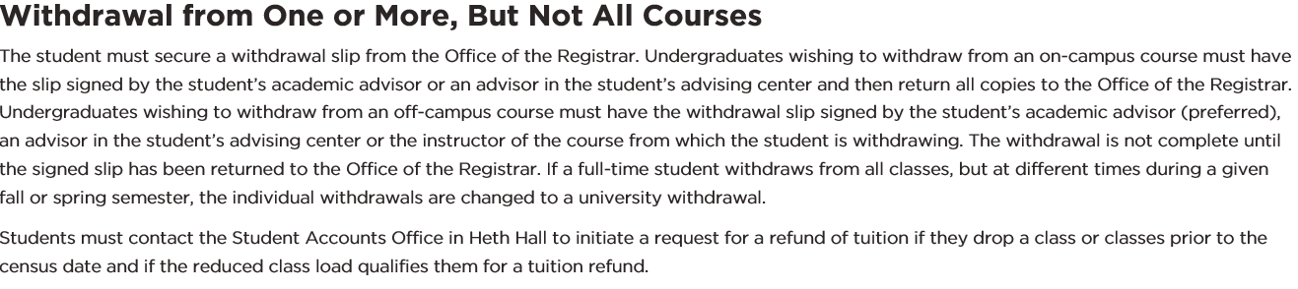
WITHDRAWALS, REFUNDS, CENSUS DATE
Under Academic Policies→Withdrawal Procedures
Radford Advising Conference

Slide 5
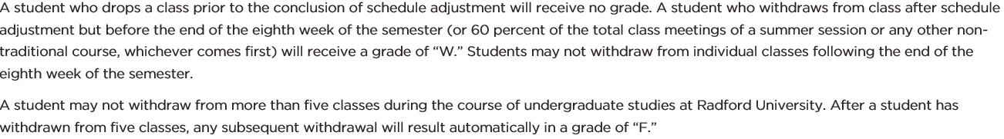
WITHDRAWALS, REFUNDS, CENSUS DATE
Under Academic Policies→Withdrawal Procedures
Radford Advising Conference

Slide 6
WITHDRAWALS, REFUNDS, CENSUS DATE
Myth:
Students expect tuition refunds for class withdrawals by census.
Partially busted.
Exceptions: part-time students, overloads, classes with built-in fees
Radford Advising Conference

Slide 7
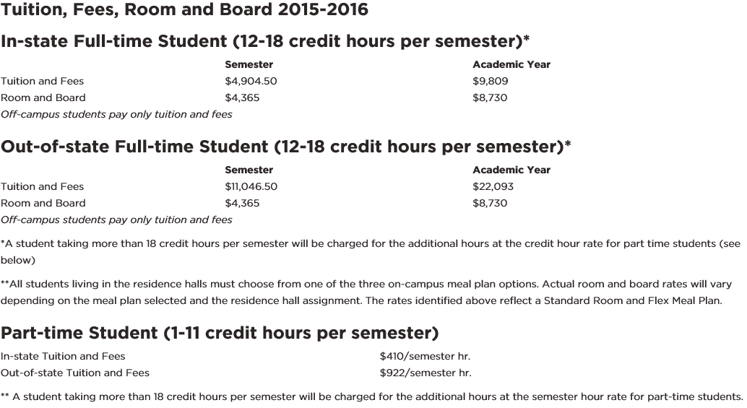
WITHDRAWALS, REFUNDS, CENSUS DATE
Under Fees and Financial Aid
Radford Advising Conference

Slide 8
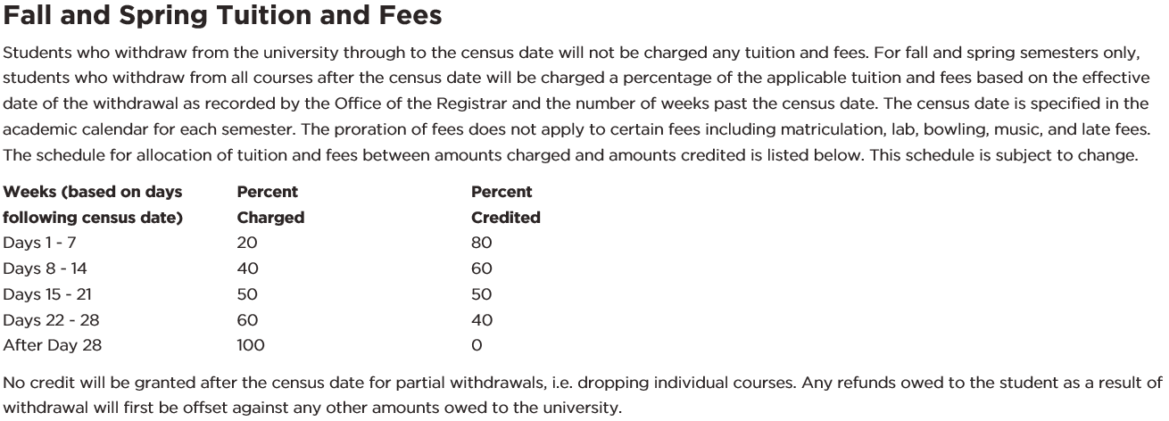
WITHDRAWALS, REFUNDS, CENSUS DATE
Under Academic Policies→Withdrawal Procedures
Radford Advising Conference

Slide 9
WITHDRAWALS, REFUNDS, CENSUS DATE
Under Academic Policies→Withdrawal Procedures
Radford Advising Conference

Slide 10
READMISSION
Myth:
Undergraduate students who sat out a semester (for various reasons) think they can automatically register for next semester classes.
Busted
Radford Advising Conference

Slide 11
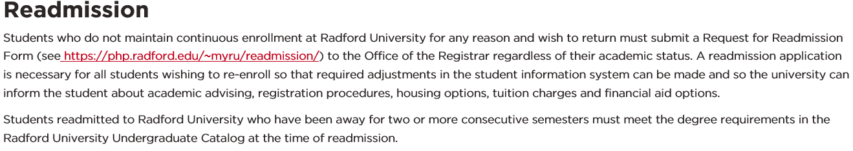
READMISSION
Under Academic Policies→Readmission
Radford Advising Conference

Slide 12
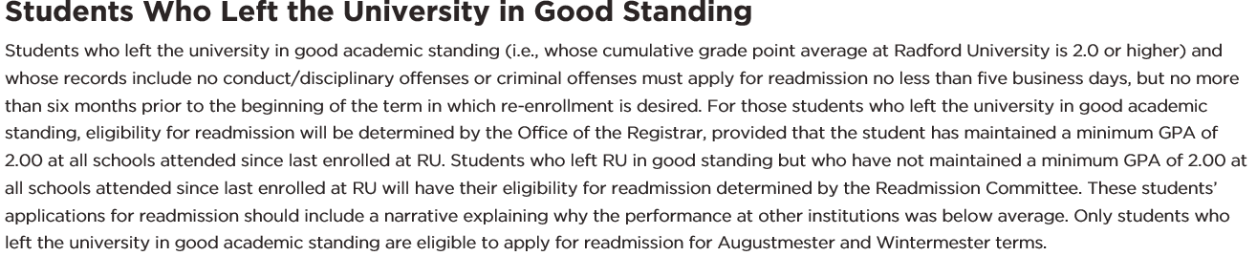
READMISSION
Under Academic Policies→Readmission
Radford Advising Conference

Slide 13
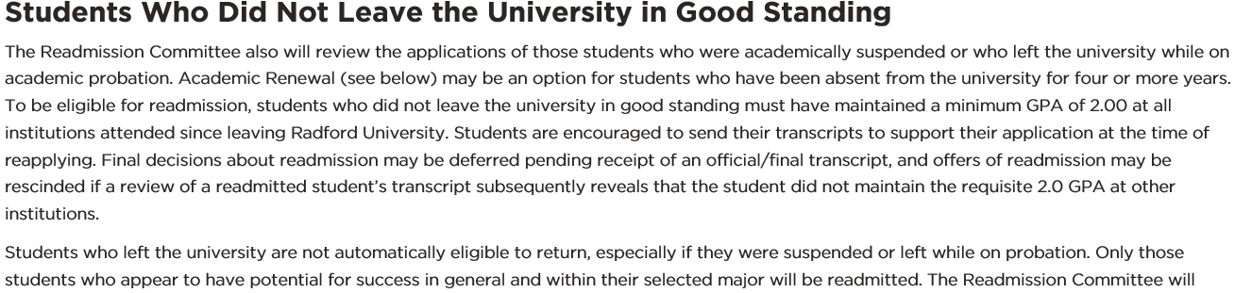
READMISSION
Under Academic Policies→Readmission
Radford Advising Conference

Slide 14
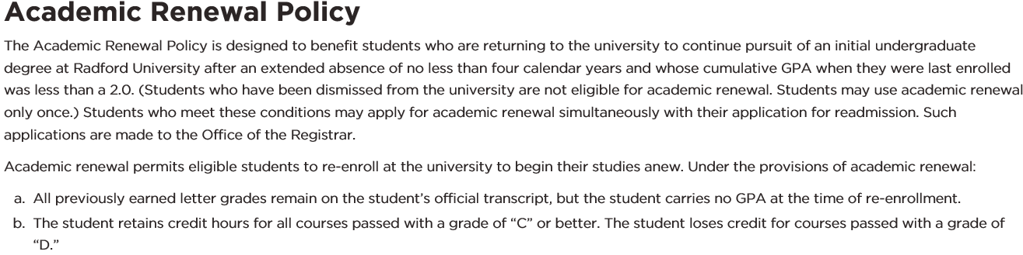
READMISSION
Under Academic Policies→Readmission→Academic Renewal Policy
Radford Advising Conference

Slide 15
SUSPENSION & PROBATION
Probation: Less than 2.0 cumulative GPA not subject to suspension or dismissal
Suspension:
New Students: Full-time, below 1.00
Continuing Students: Threshold based on hours attempted and GPA (may attend Wintermester or Summer)
Hours Attempted Cumulative GPA Required
13-23 1.00
24-35 1.50
36-47 1.80
48 or more 2.00
Dismissal: After suspension and readmission, falls below suspension threshold again
Radford Advising Conference

Slide 16
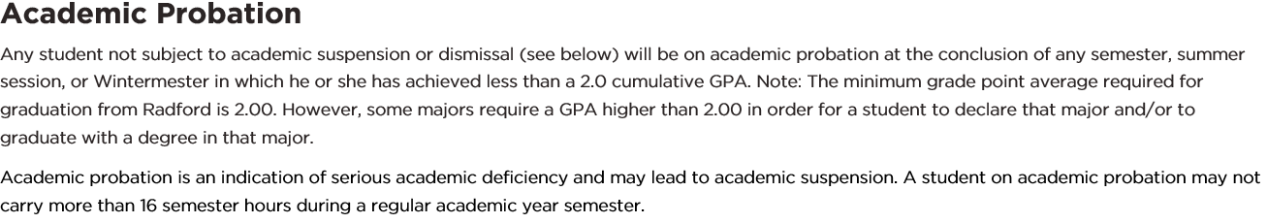
SUSPENSION & PROBATION
Under Academic Policies→Academic Probation and Suspension→Academic Probation
Radford Advising Conference

Slide 17
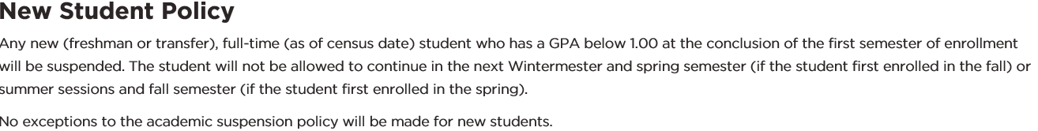
SUSPENSION & PROBATION
Under Academic Policies→Academic Probation and Suspension→Academic Suspension→New Student Policy
Radford Advising Conference

Slide 18
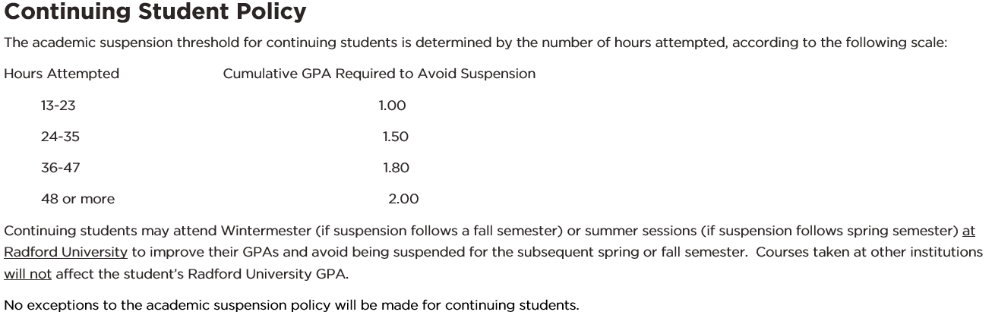
SUSPENSION & PROBATION
Under Academic Policies→Academic Probation and Suspension→Academic Suspension→Continuing Student Policy
Radford Advising Conference

Slide 19
SUSPENSION & PROBATION
Under Academic Policies→Academic Probation and Suspension→Additional Information about Suspension→Suspension and Dismissal
Radford Advising Conference

Slide 20
SUSPENSION & PROBATION
Pre-13 Suspension Policy:
Attempted 30 or more hours, must have 2.0 cumulative GPA by the end of the last summer session
Radford Advising Conference

Slide 21
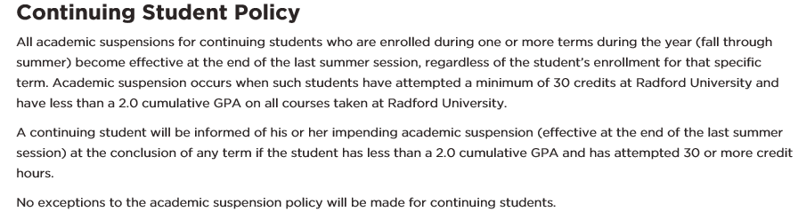
SUSPENSION & PROBATION
Under Academic Policies→Academic Probation and Suspension (Select 2012-2013 or earlier catalog)
Radford Advising Conference

Slide 22
SUSPENSION & PROBATION
Readmits who left not in good academic standing:
2013 Policy Forward: Regular policy
Pre-2013 Policy: Attain half deficit in readmit term, remaining deficit (2.0) by last summer session
Academic Renewal Readmits: 2.0 by the time attempted 12 hours
Radford Advising Conference
April 26, 2016

Slide 23
SUSPENSION & PROBATION
Under Academic Policies→Readmission
Under Academic Policies→Readmission (Select 2012-2013 or earlier catalog)
Under Academic Policies→Academic Renewal Policy
Radford Advising Conference
April 26, 2016

Slide 24
REPETITION OF COURSES
Myth:
Undergraduate students think they have taken enough credit hours and are surprised when they are short hours for graduation.
Depends on the specific situation but often involves classes repeated or retaken.
Radford Advising Conference

Slide 25
REPETITION OF COURSES
**All courses completed and grades earned will remain on the student’s transcript.**
REPEATS
Grade earned in repeat course replaces the original grade (even if it is worse). Think of as excluded or included in GPA calculation.
Additional credit hours are not earned unless the previous grade was an F.
RETAKES
All attempted credit hours and all earned grade points included in GPA calculation.
Additional credit hours are not earned unless the previous grade was an F.
Radford Advising Conference

Slide 26
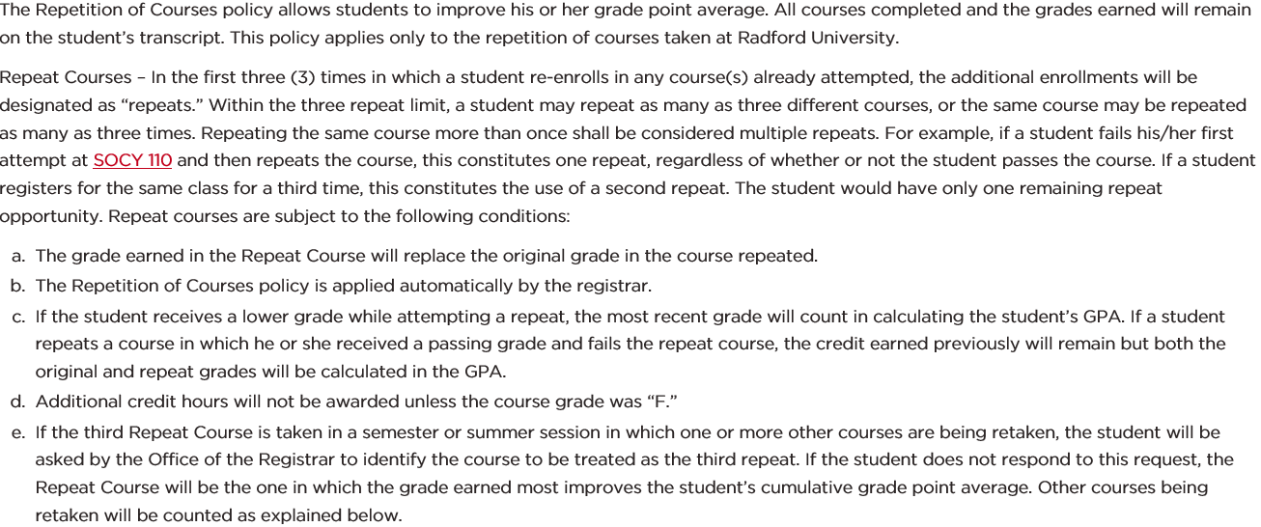
REPETITION OF COURSES
Under Academic Policies→Repetition of Courses
Radford Advising Conference

Slide 27
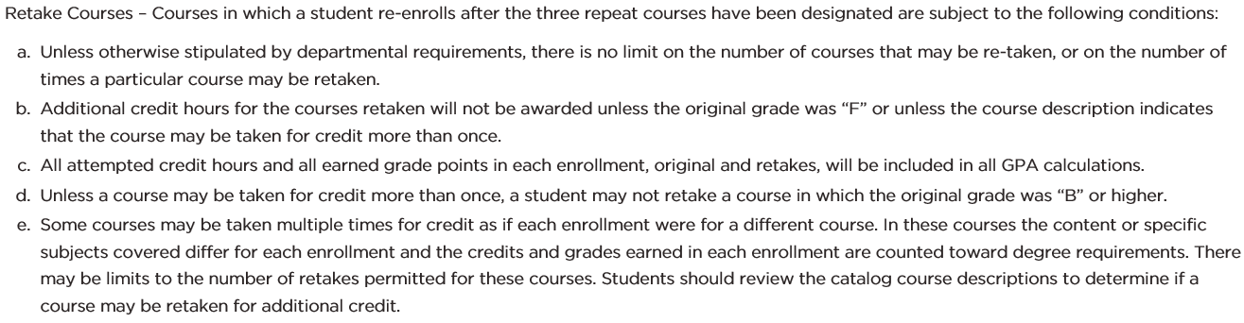
REPETITION OF COURSES
Under Academic Policies→Repetition of Courses
Radford Advising Conference

Slide 28
INCOMPLETE GRADES/GRADE CHANGES
Final grades cannot be changed to incompletes after the term has ended.
Registrar’s Office does not automatically revert I’s to F’s until the last day of classes of the following Fall/Spring term (not necessarily date on the course contract).
Faculty needing to correct errors on final grades need to submit grade change form within one year after submission of original grade.
Radford Advising Conference

Slide 29
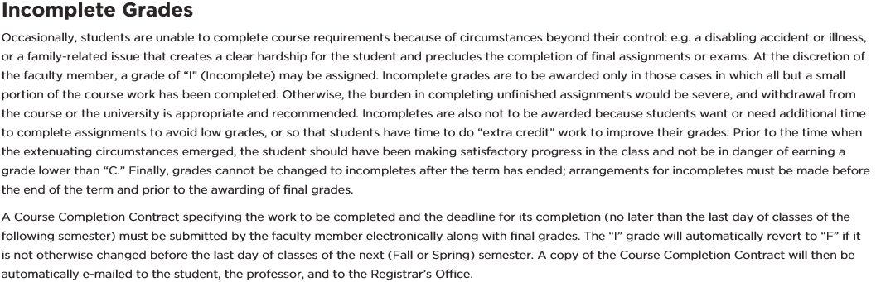
INCOMPLETE GRADES/GRADE CHANGES
Under Academic Policies→Grades and Credit
Radford Advising Conference

Slide 30
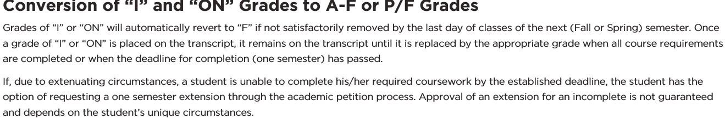
INCOMPLETE GRADES/GRADE CHANGES
Under Academic Policies→Grades and Credit
Radford Advising Conference

Slide 31
TRANSFER CREDIT
Myth:
Student thinks they can take a class at another institution to improve their RU GPA.
Students cannot earn transfer credit for a class in which they already have RU credit.
Grades do not transfer (not computed in RU GPA)
Transfer classes cannot be used as repeats (repeat policy not applied).
Busted
Radford Advising Conference

Slide 32
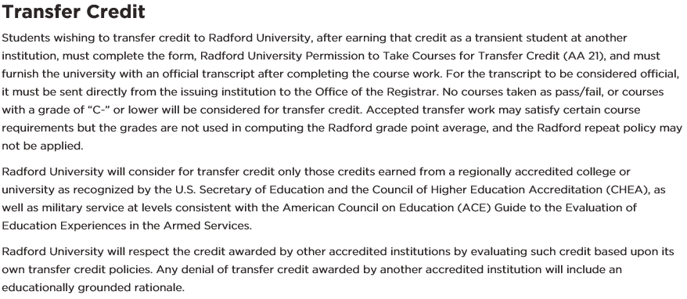
TRANSFER CREDIT
Under Academic Policies→Grades and Credit→Transfer Credit and also under Admissions→Transfer Student
Radford Advising Conference

Slide 33
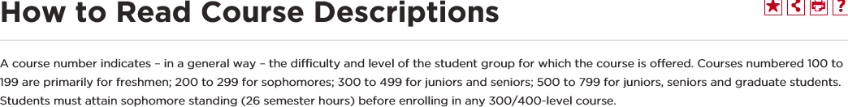
HELPFUL REMINDERS
Sophomore standing (26 semester hours) is required before registering for 300/400 level classes.
Under Courses-Click here for information about how to read a course description
Radford Advising Conference

Slide 34
HELPFUL REMINDERS
“Prerequisite and Test score error”
General registration error message for most prerequisites (including specific required courses, GPA requirements, etc.)
Under Courses-Select any course to view catalog prerequisites
Radford Advising Conference

Slide 35
Q&A
Megan Coulter: mcoulter2@radford.edu, x5751
Registrar’s Office: registrar@radford.edu, x5271
catalog.radford.edu
Radford Advising Conference

