Slide 1
Radford University’s Polar Research Program
Rhett Herman
Radford University Department of Physics
Dan Blake
Southwest Virginia Governor’s School

Slide 2
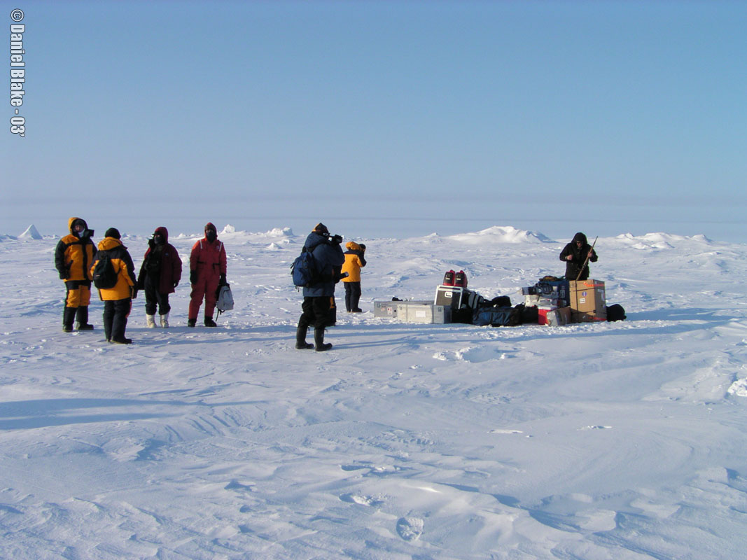
One thing led to another and then 2 students and I were at the North Pole in April of 2003 with other scientists and educators.

Slide 3
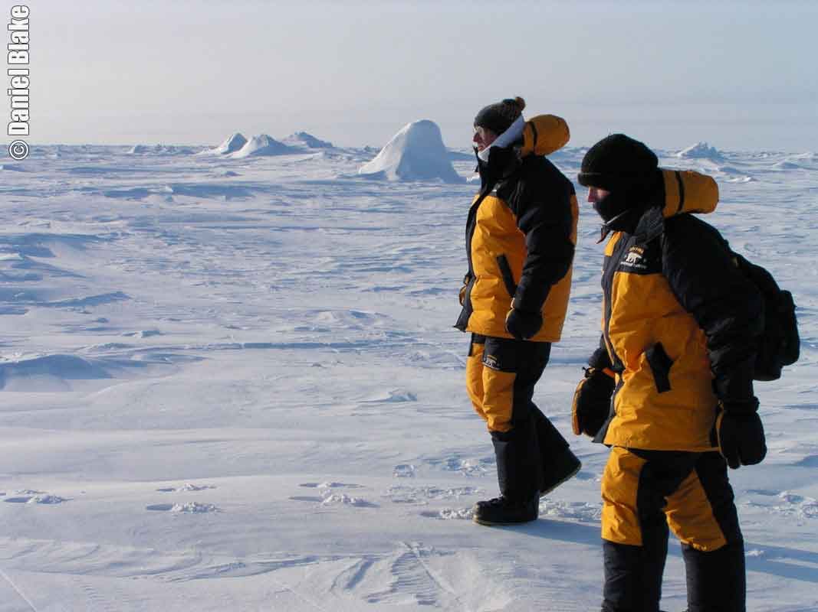
One thing led to another and then 2 students and I were at the North Pole in April of 2003 with other scientists and educators.

Slide 4
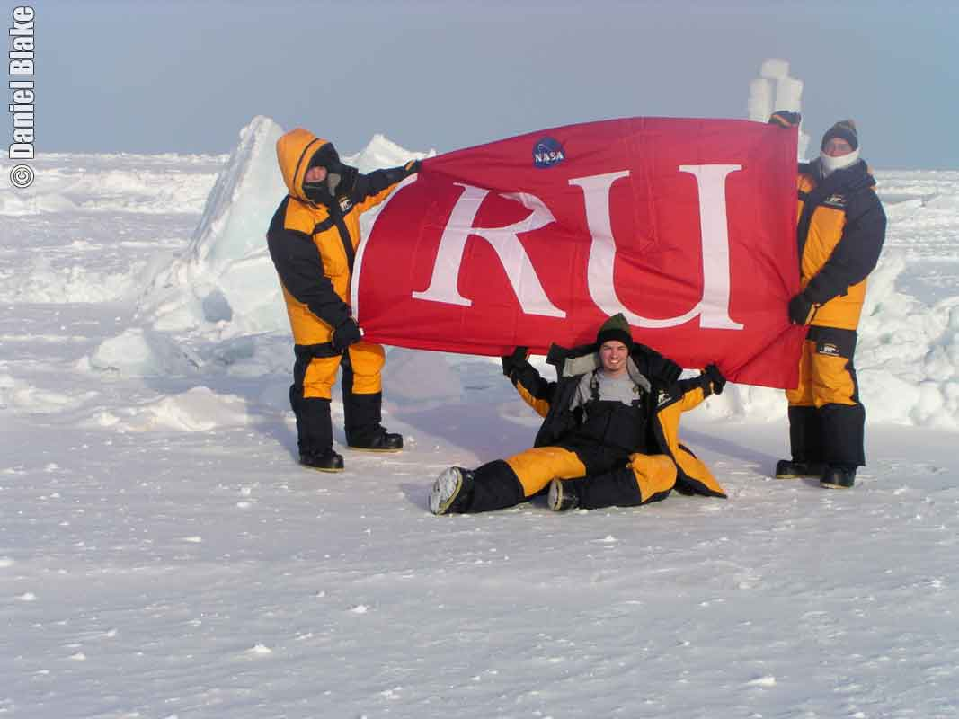
One thing led to another and 2 students and I were at the North Pole in April of 2003 with other scientists and educators.

Slide 5
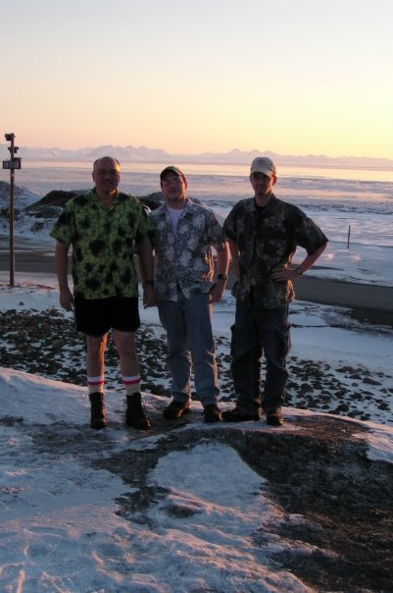
And of course no such trip would be complete without the tacky-Hawaiian-shirt photo in sub-zero temperatures! ☺

Slide 6
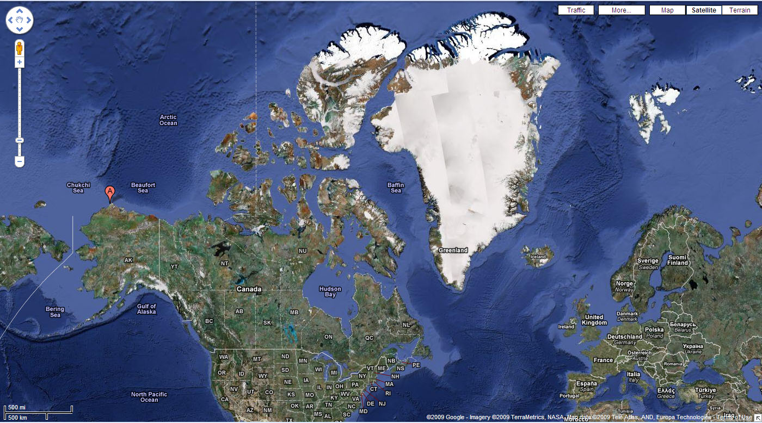
This quick trip actually sparked a big interest in polar research for me.
Svalbard,
Norway
Barrow,
Alaska
Radford,
Virginia

Slide 7
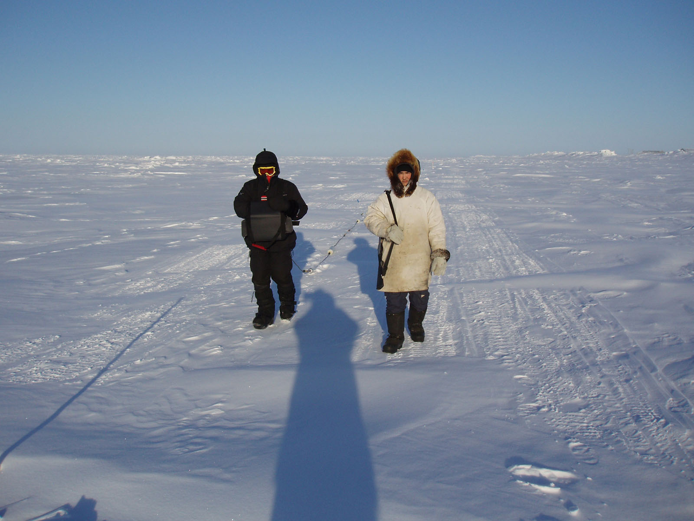
March 2006, Barrow, Alaska—James Inman and “bear guide” on sea ice
James is pulling the OhmMapper electrical resistivity array.

Slide 8
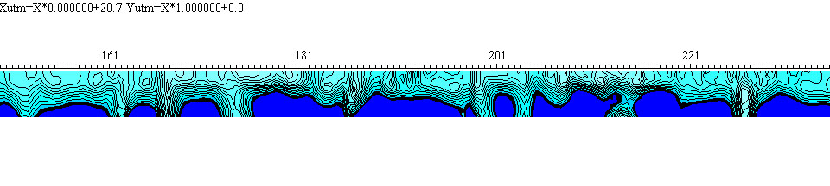
The scientific goal was to accurately measurethe thickness of the sea ice.
Satellites show horizontal extent easily, but thickness is the tough one.
Note that the sea ice is only about 2 meters thick!

Slide 9
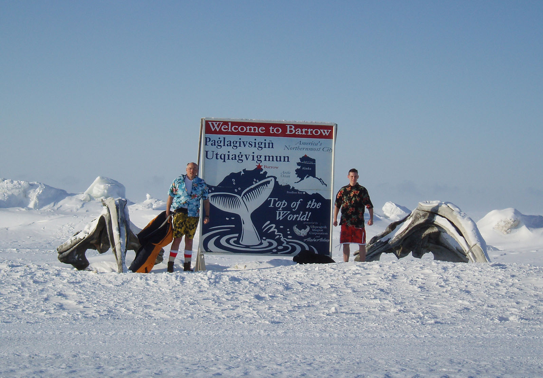
And of course the required formal portrait in 30-below-zero temperatures!

Slide 10
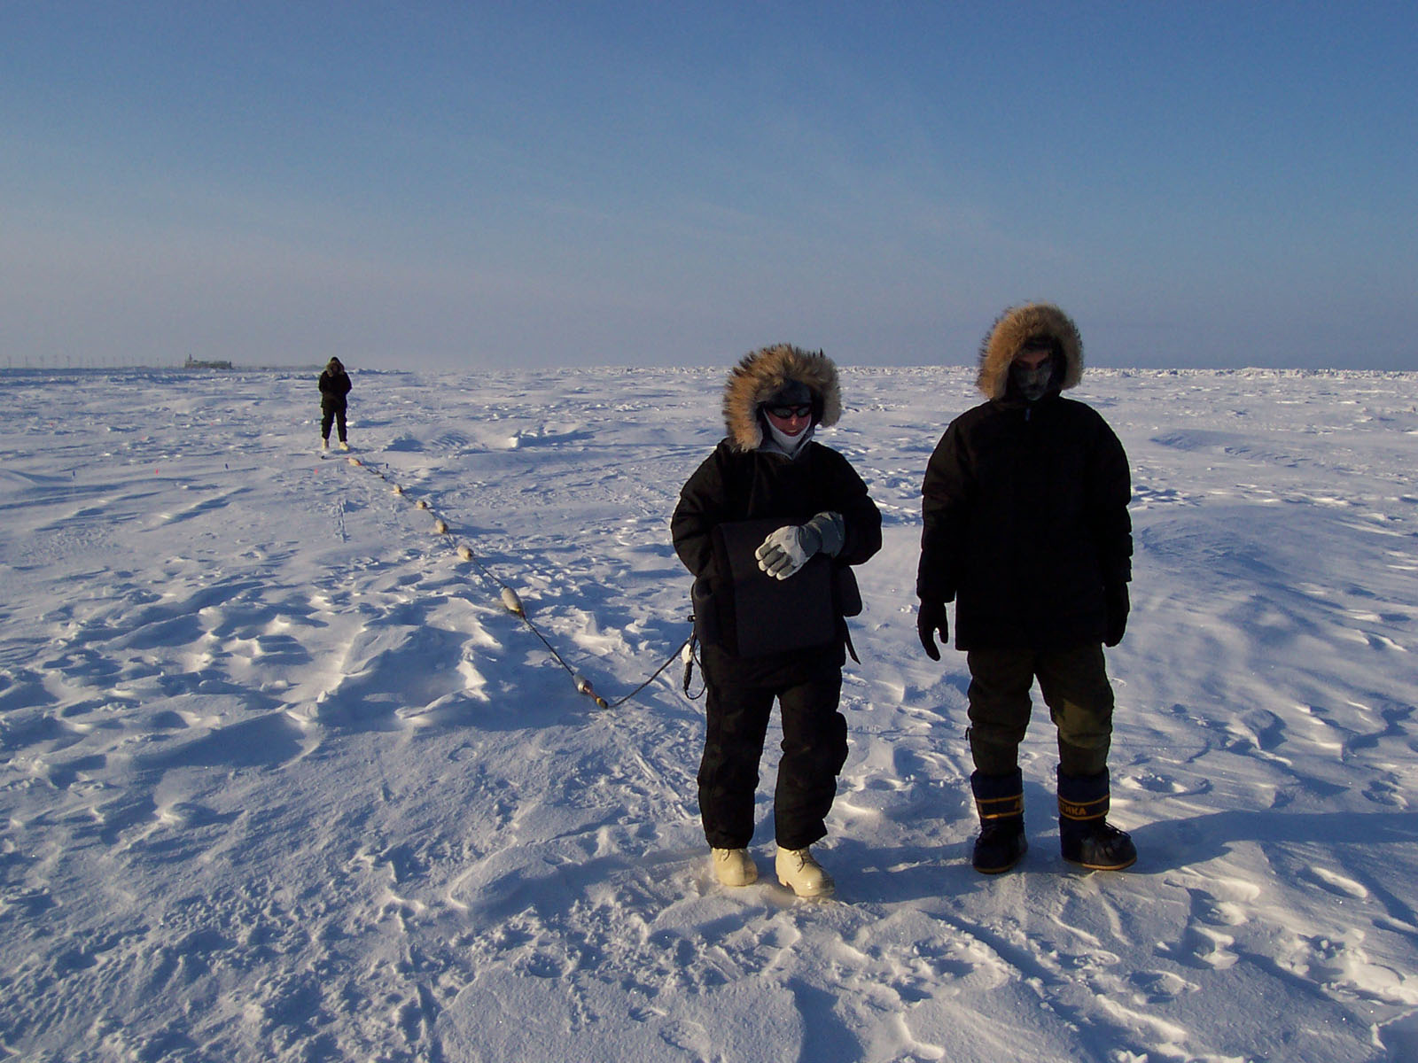
March 2008, Barrow, Alaska—another trip with more students
Caleigh is pulling the expanded OhmMapper, Trevor is there to keep her from falling since it gets hung up on things at odd times.

Slide 11
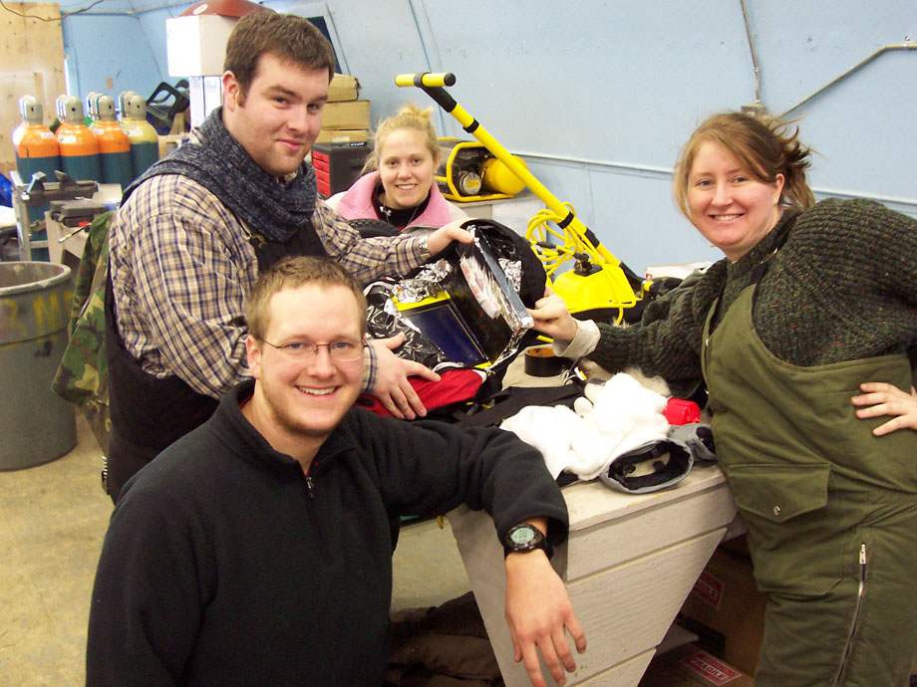
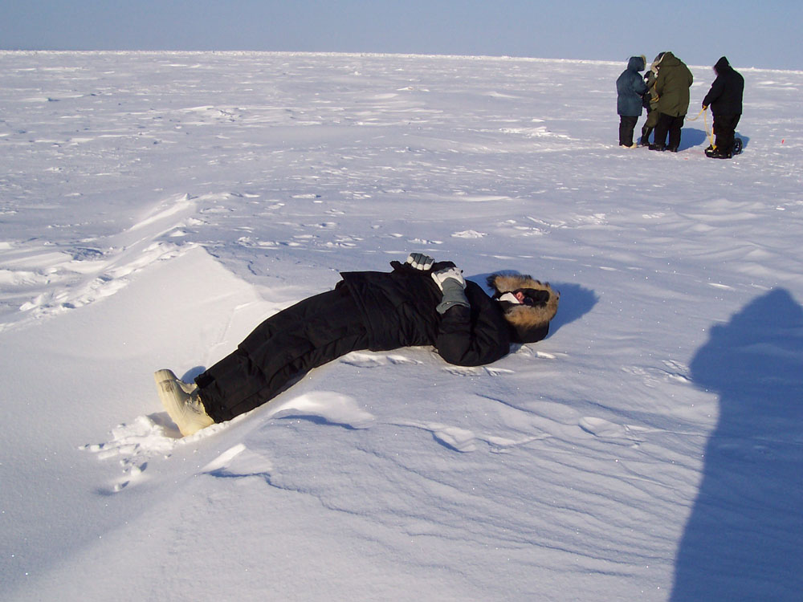
March 2008, Barrow, Alaska—another trip with more students
Jury-rigging cold protection for the ground penetrating radar control console
Caleigh actually worked up a sweat→ pulling the OhmMapper resistivity array

Slide 12
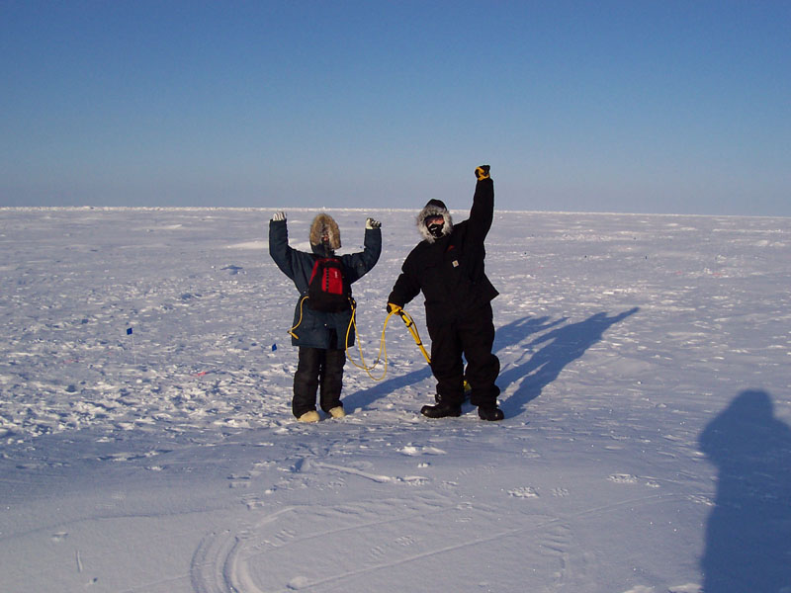
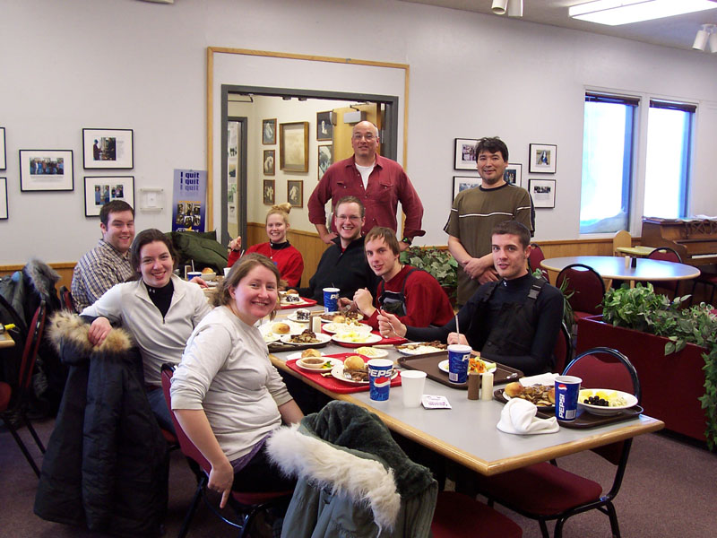
March 2008, Barrow, Alaska—another trip with more students
Laura and Jeremy have successfully finished the ground penetrating radar work for the day
Group picture in the cafeteria of →
the community college on grounds
of the Naval Arctic Research Lab
(NARL) where we stayed.
Lewis Brower (to my right) let us sample some real Native delicacies—whale, elephant seal, etc.

Slide 13
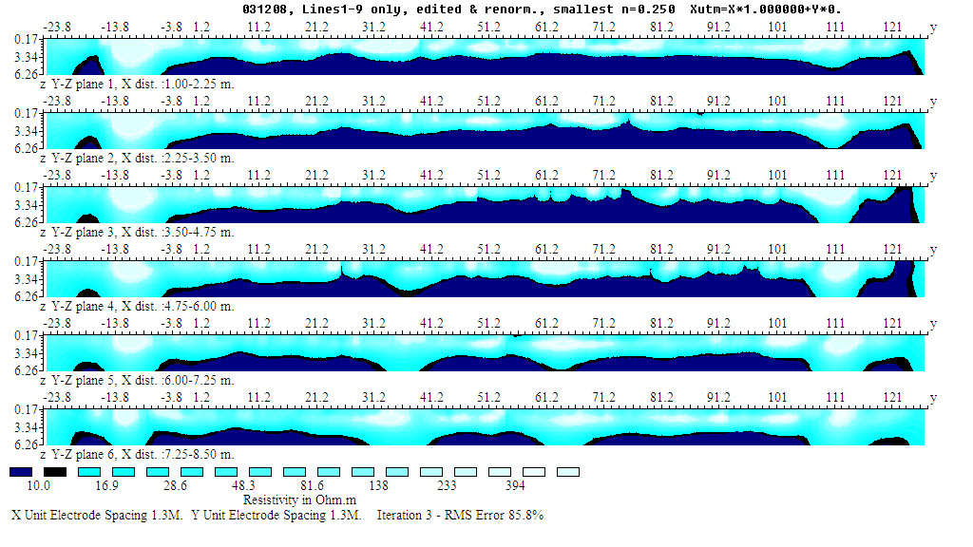
But the bottom line is always the relevant scientific work.
For the first time we had data for imaging the ice in 3 dimensions.

Slide 14
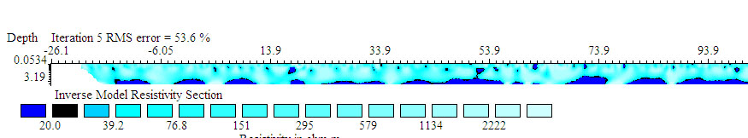
But the bottom line is always the relevant scientific work.
We also have unprecedented 500-meter line to compare with 2006.

Slide 15
But the bottom line is always the relevant scientific work.
And we may have quantified the health and age of the sea ice using fractal analysis.
Fractal analysis quantifies the “degree of roughness” of the ice/water boundary.

Slide 16
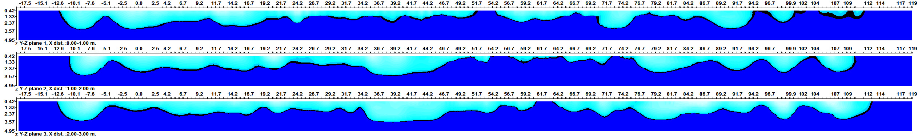
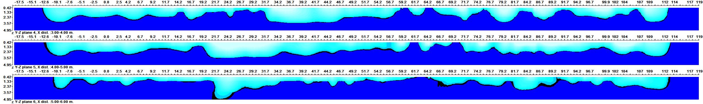
But the bottom line is always the relevant scientific work.
Start with an image of the ice (in intuitive colors).

Slide 17
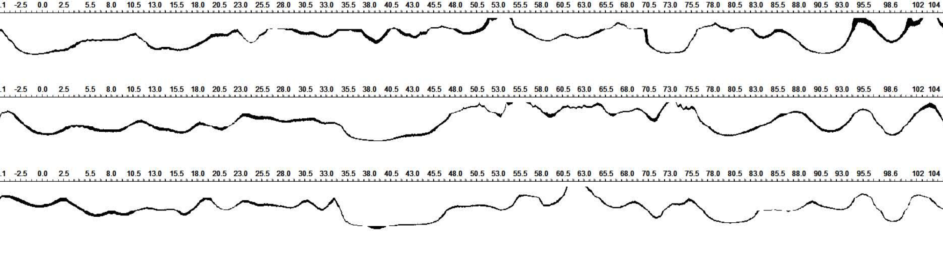
But the bottom line is always the relevant scientific work.
Create a black-and-white scale which isolates the ice/water boundary.

Slide 18
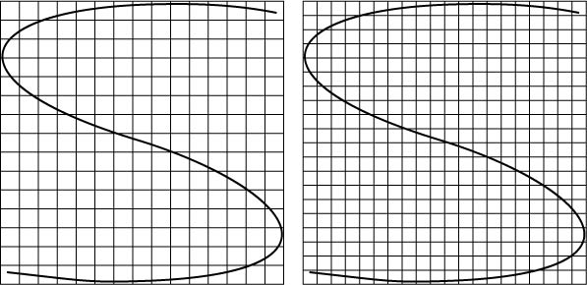
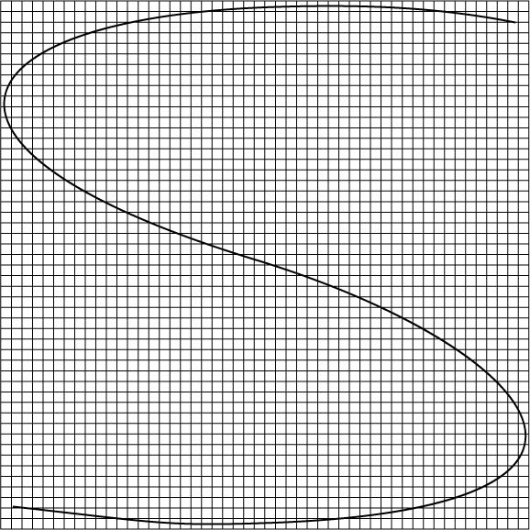
Analyze the boundary line for its fractal dimension

Slide 19
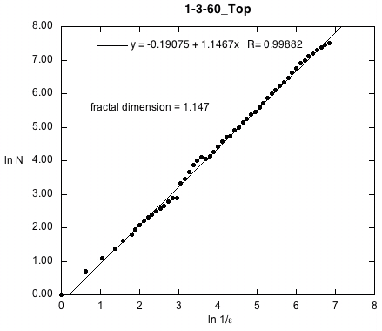
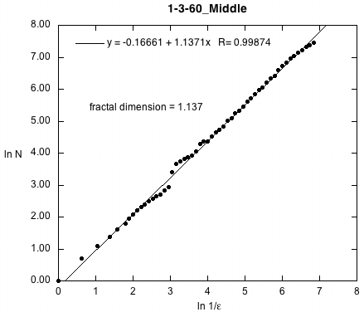
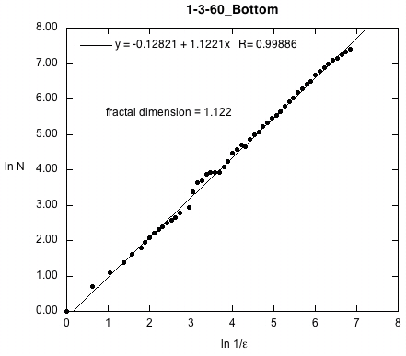
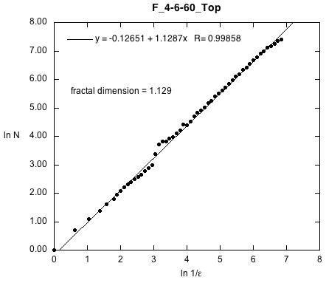
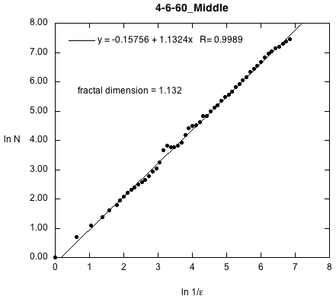
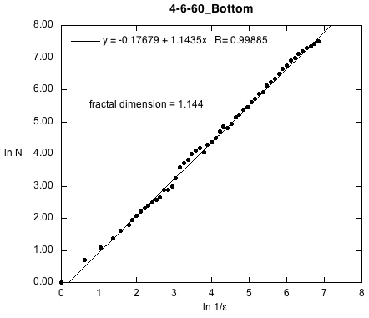
Analyze the boundary line for its fractal dimension
Line 1
D=1.147
Line 2
D=1.137
Line 3
D=1.122
Line 4
D=1.129
Line 5
D=1.132
Line 6
D=1.144

Slide 20
Analyze the boundary line for its fractal dimension
Does that fractal dimension relate to things like the age or health of the sea ice???

Slide 21
Analyze the boundary line for its fractal dimension
Does that fractal dimension relate to things like the age or health of the sea ice???

Slide 22
Analyze the boundary line for its fractal dimension
Does that fractal dimension relate to things like the age or health of the sea ice???
There was a surprisingly consistent fractal dimension present in these cross-sections
D=1.135 ± 0.009 R=0.999
  This ice was less than 2 months old (recent breakup)
  Fractal dimension of multiyear ice needed for comparison
  Fractal dimension of 2d inversions should be compared to 3d inversions

Slide 23
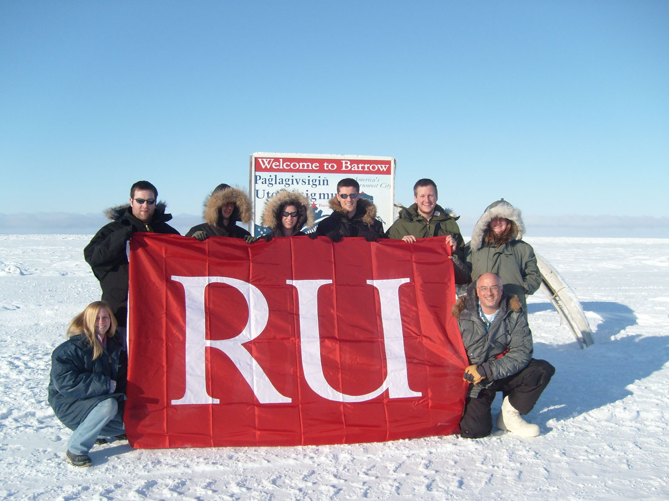
However…in the meantime…we did get the usual 25-below-zero “class picture” as with all such classes…

Slide 24
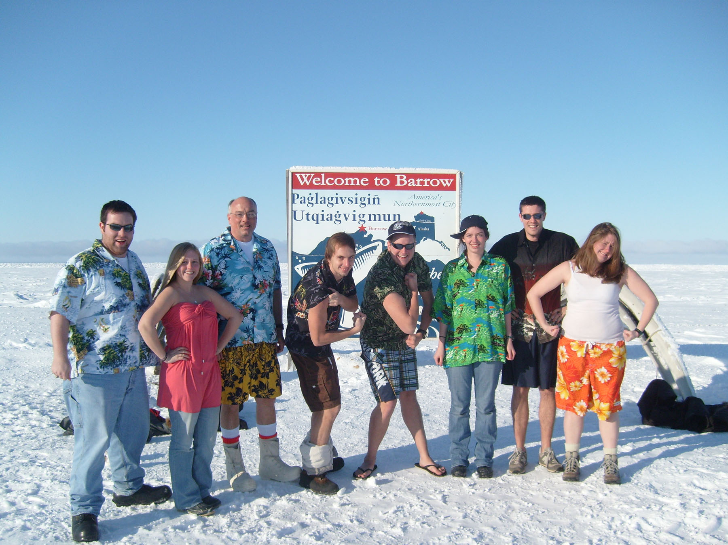
…as well as the REAL class photo!

Slide 25
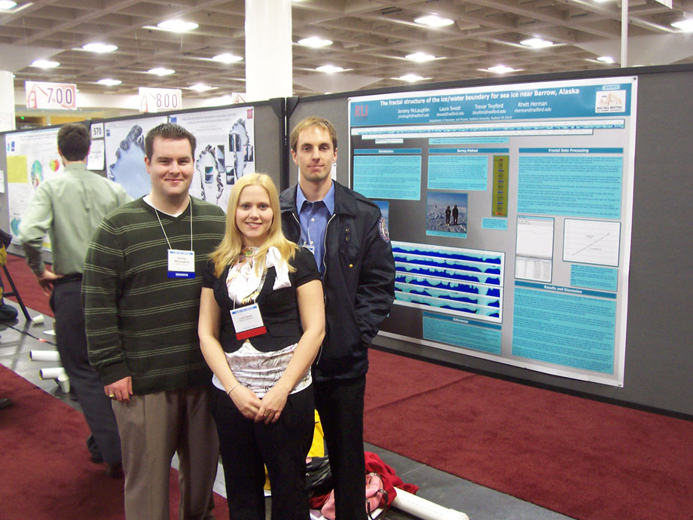
Some students and I presented our work at the American Geophysical Union annual meeting in San Francisco, December 2008.
Laura Sweat, Jeremy McLaughlin and Trevor Twyford in front of our poster at the AGU meeting.
Their presentation and discussion were so good that we were invited by the head of NASA’s Cryospheric Research Branch at the NASA Goddard Space Flight Center to give a talk to his research group!
We went to NASA Goddard in March 2009 to give our research talk and consulted with them about the scientific plan for the next trip in 2010.

Slide 26

The March 2010 Arctic Geophysics class built on what we had done before…
Two full weeks, February 27-March 13…
1 RU Physics Professor…
5 RU Physics students…
1 high school Physics teachers…
3 high school Physics students…
1 middle school Physical Science teacher…
4 pieces of geophysical equipment…
and...
…a camera ready for the best class picture of them all!

Slide 27
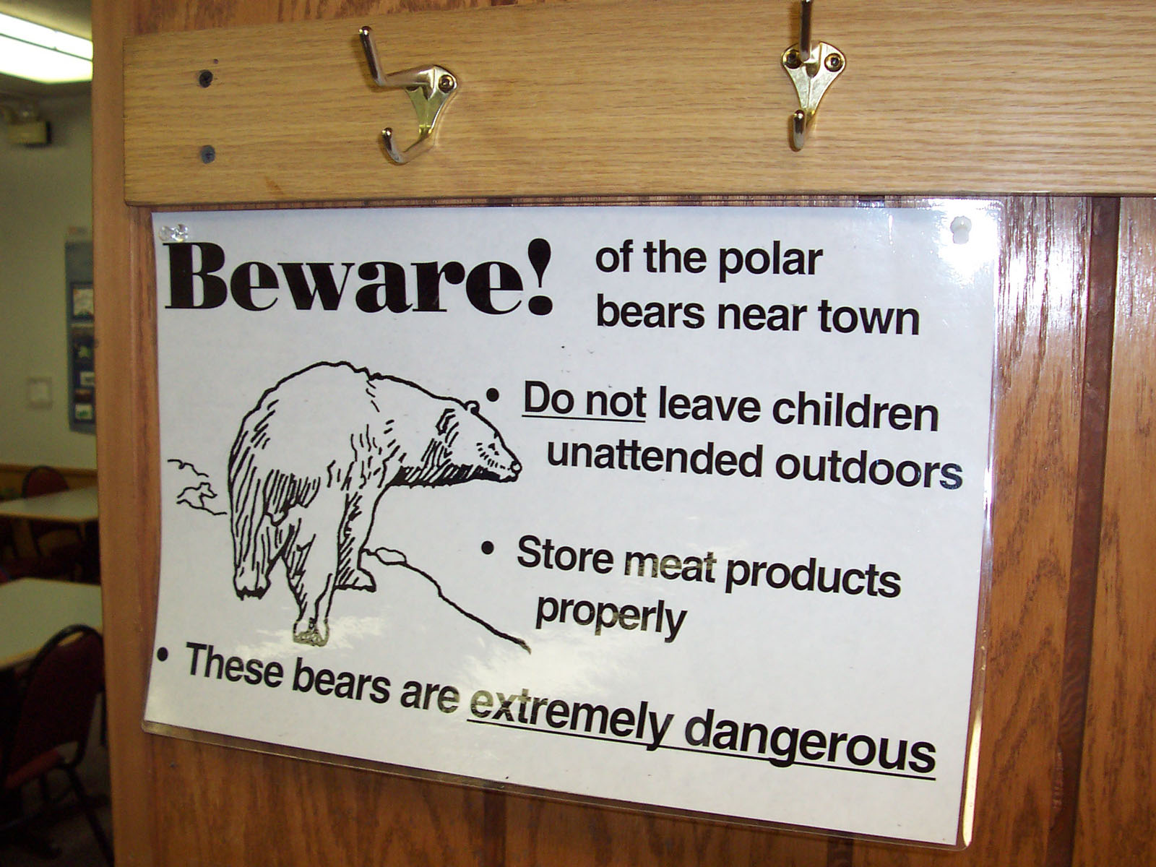
But before we go that route, let’s take a moment for some tourist pictures.

Slide 28
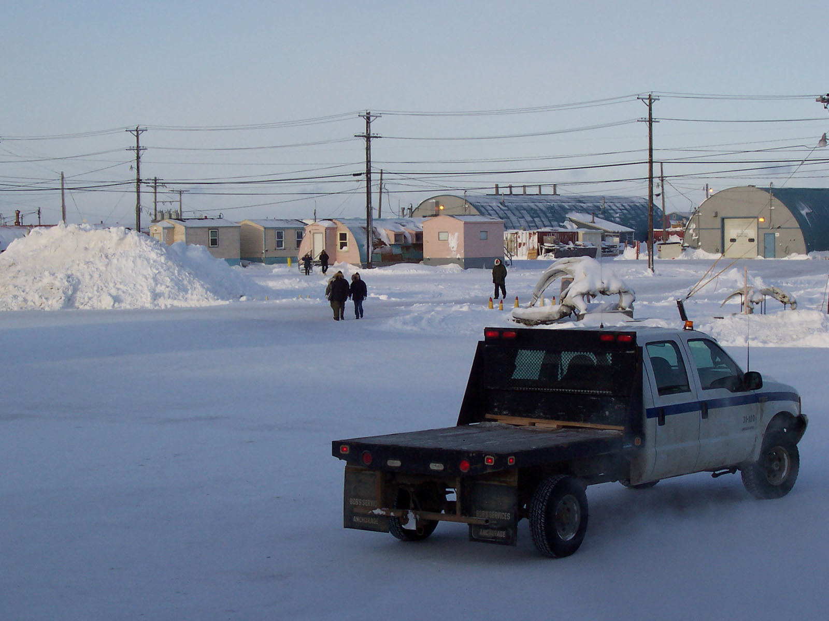
Our little pink house on the grounds of the Naval Arctic Research Lab

Slide 29
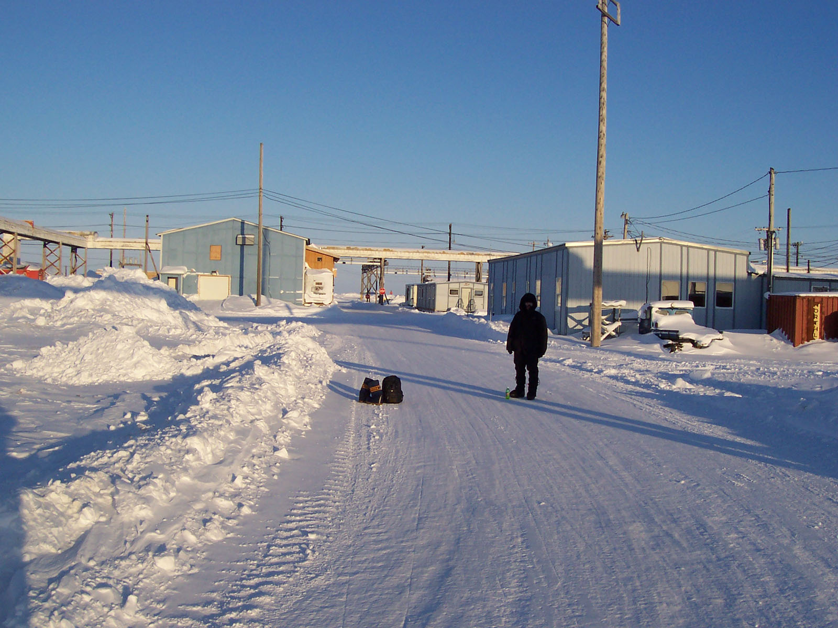
James Inman walking to work (March 2006 trip)

Slide 30
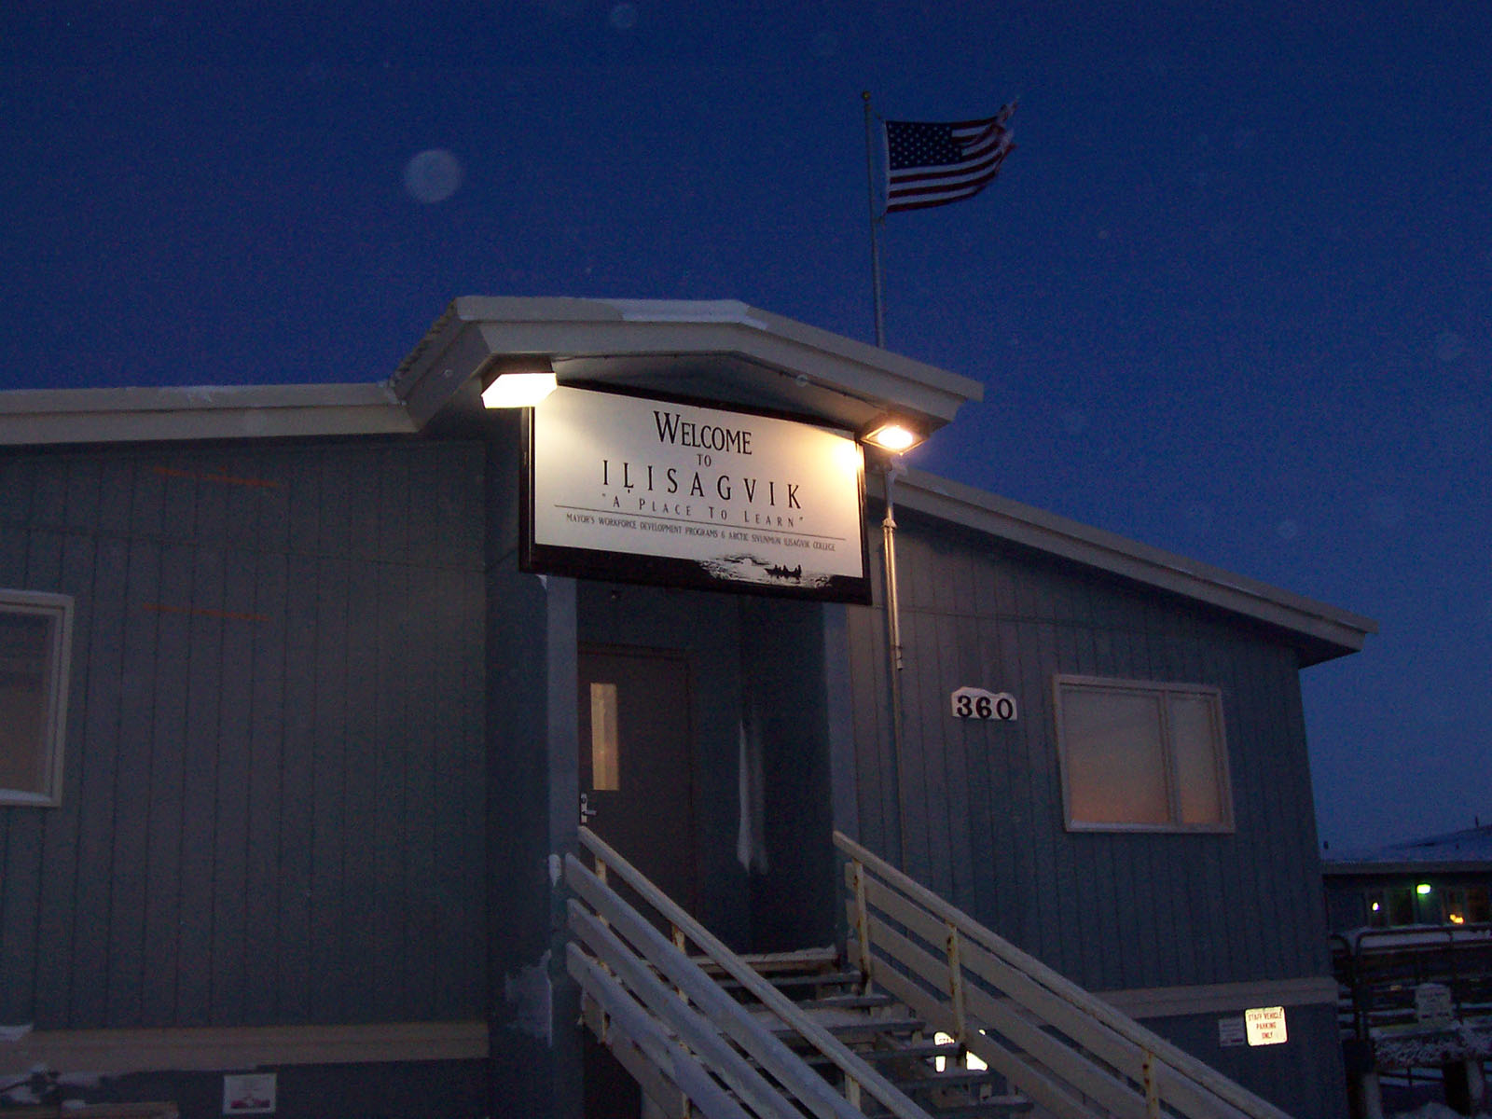
One of the entrances to the residential community college that also houses the Barrow Arctic Science Consortium (BASC)

Slide 31
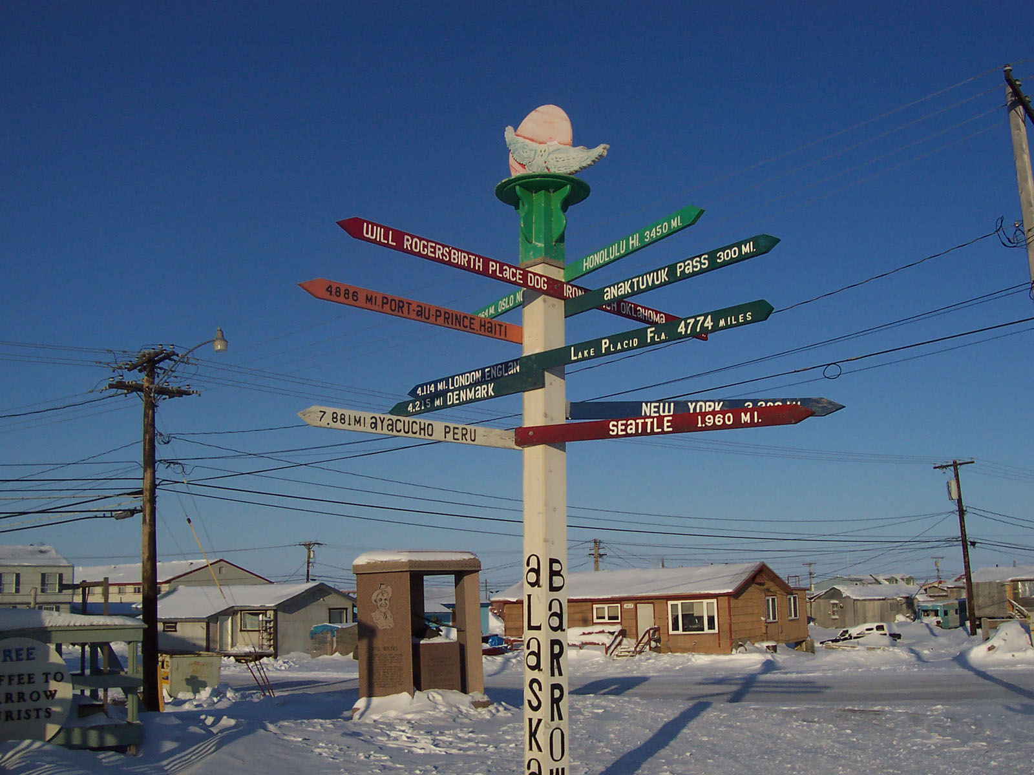
Barrow is a long way from a lot of places!

Slide 32
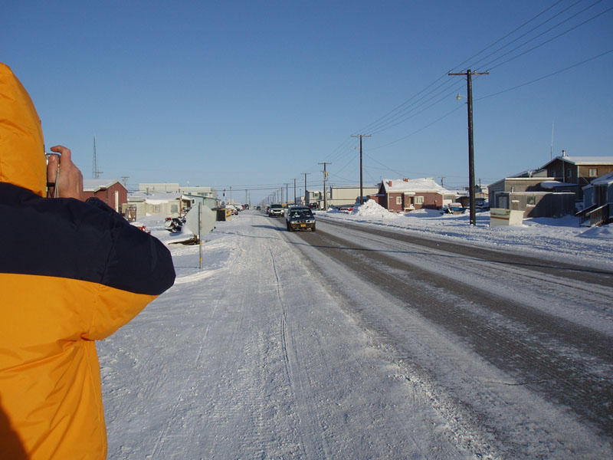
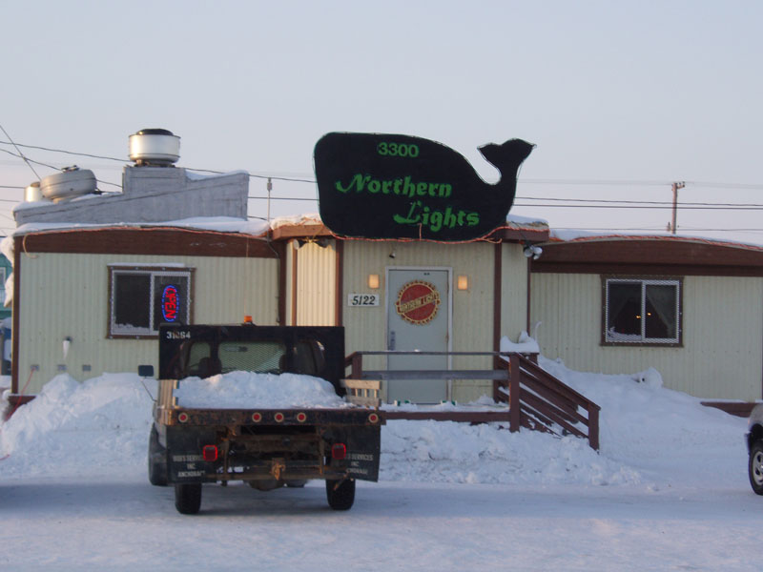
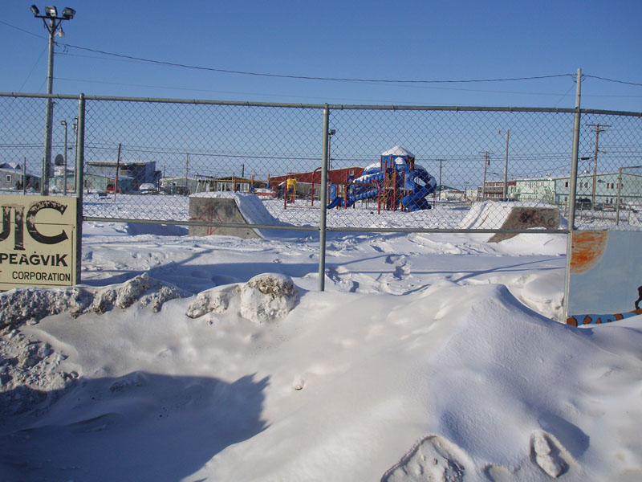
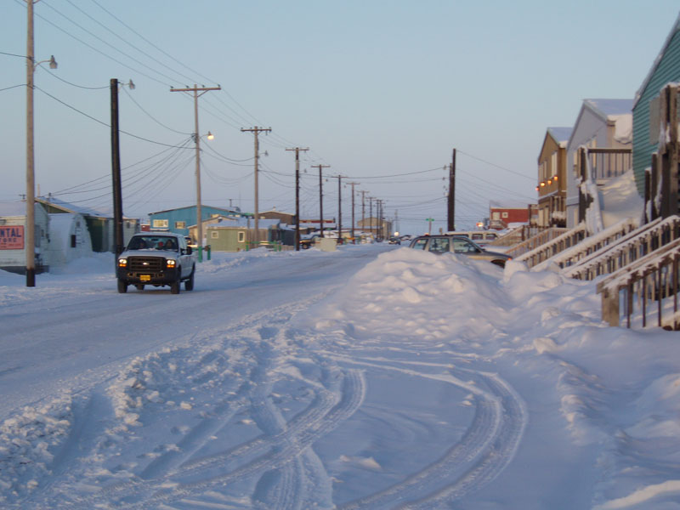
Pictures in the town of Barrow (right next to Browerville)

Slide 33
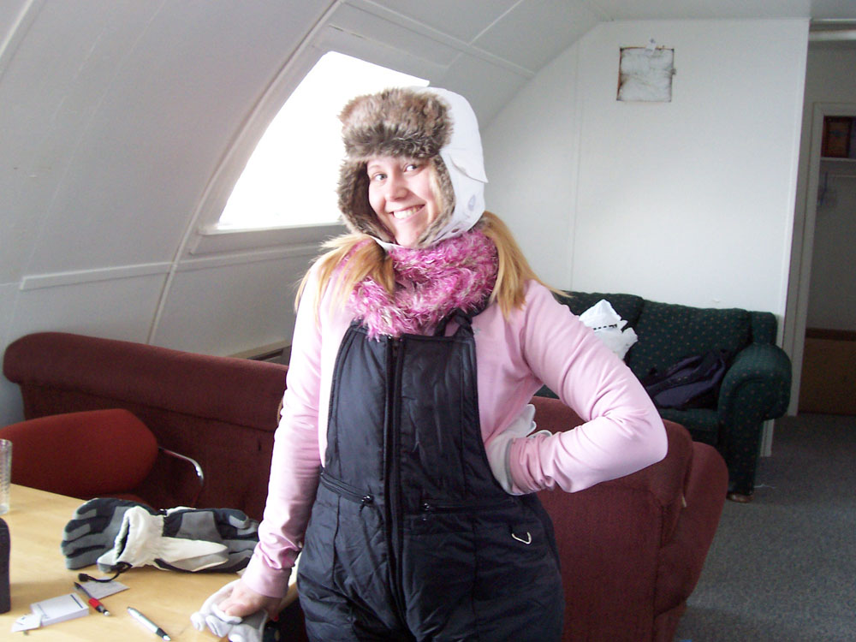
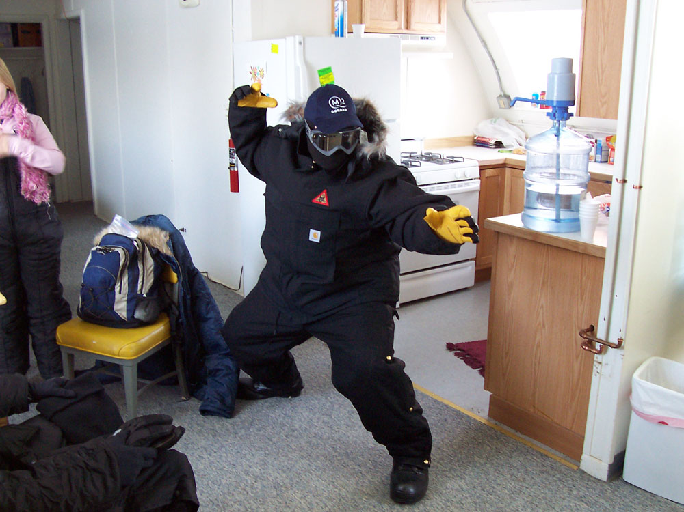
Laura demonstrating that you can look good and be good at physics.
Jeremy practicing his ninja moves in his cold-weather gear.

Slide 34
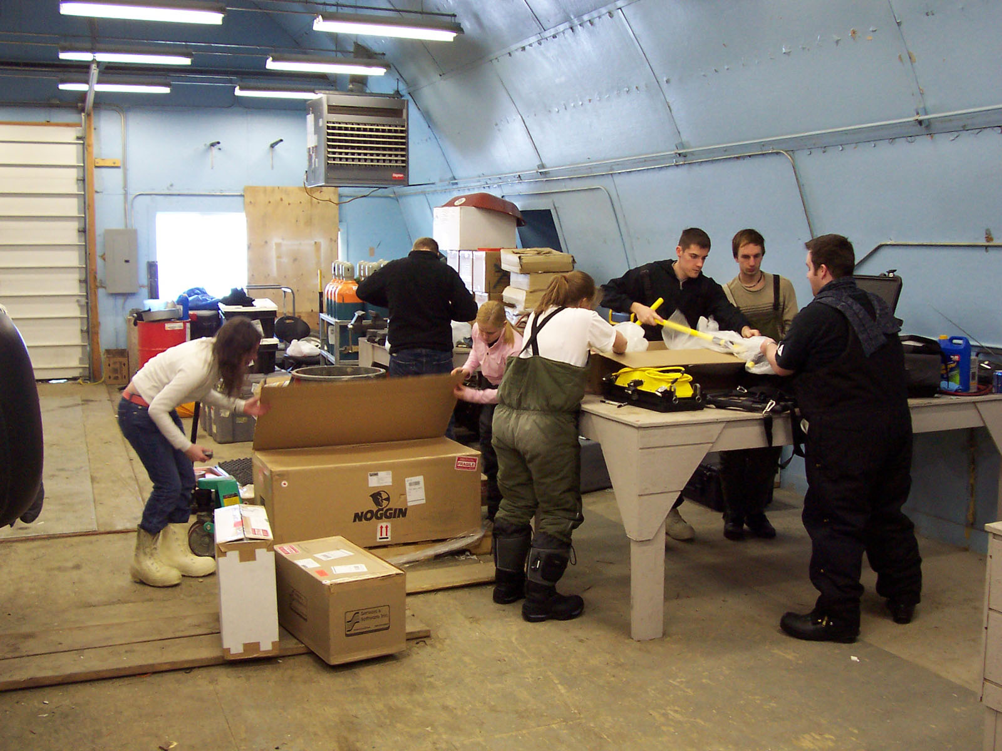
Students hard at work with their advisor “supervising” and taking pictures.

Slide 35
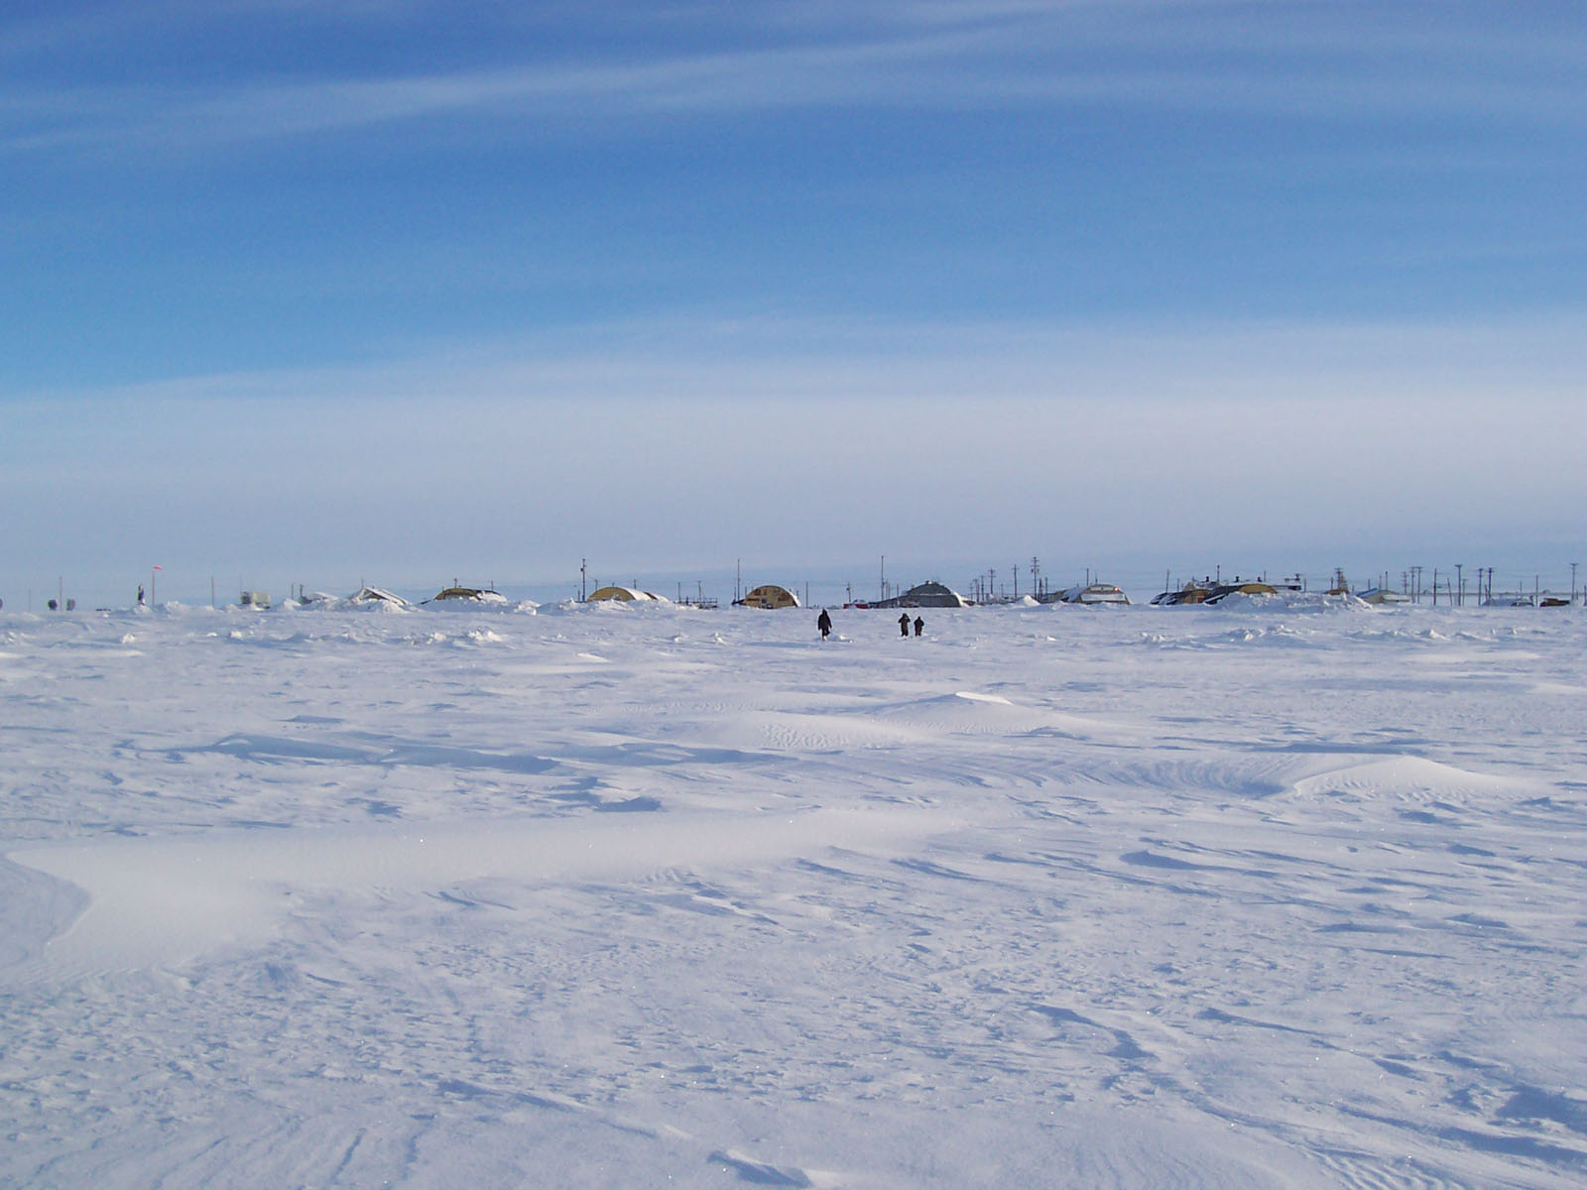
I am about 300 meters offshore as one crew heads back.

Slide 36
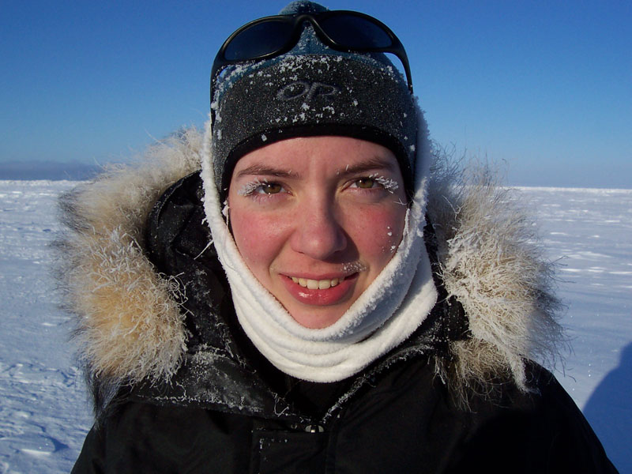
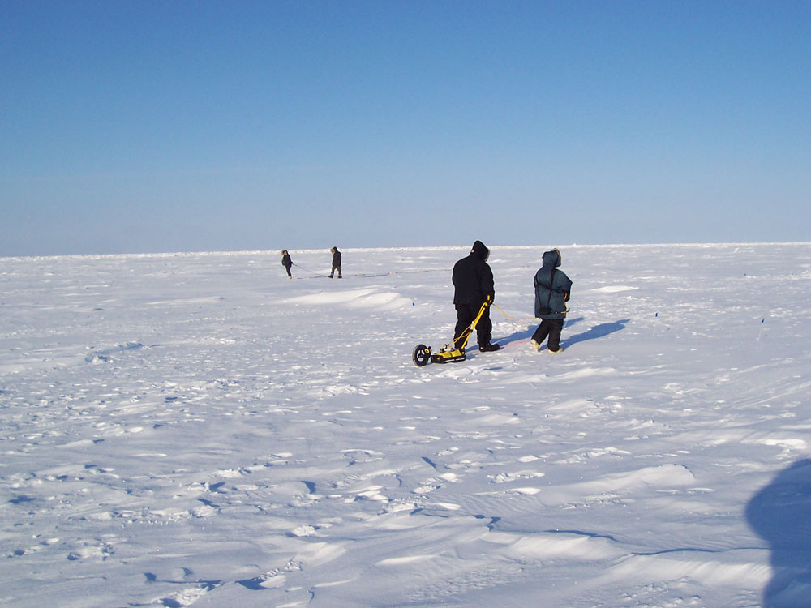
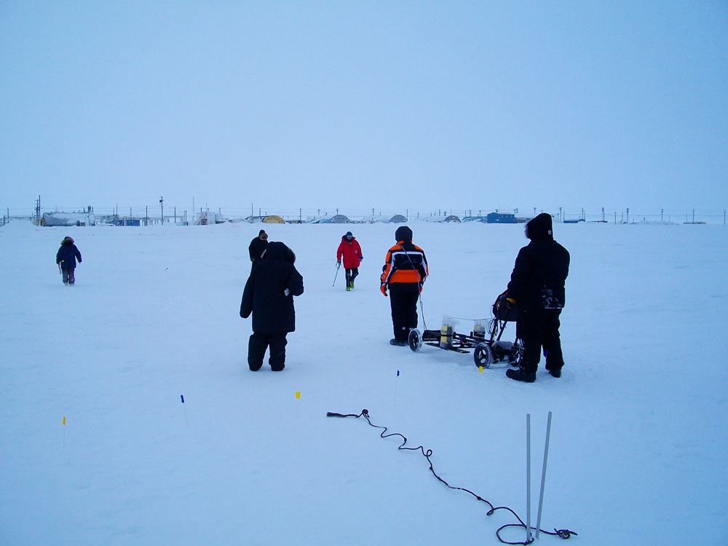
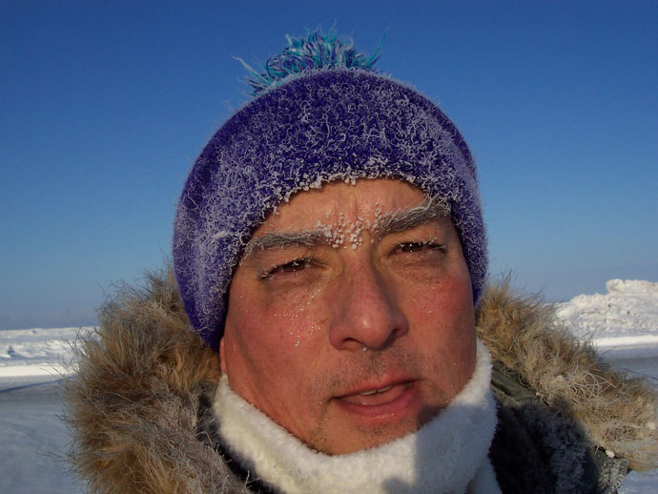
The cold and ice are ever-present.

Slide 37
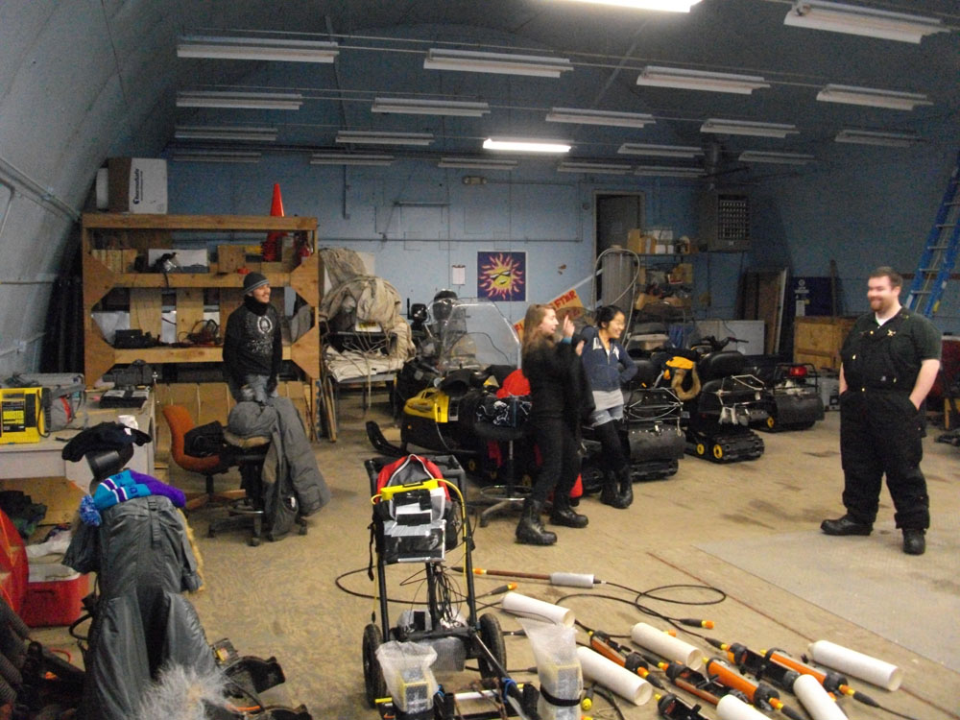
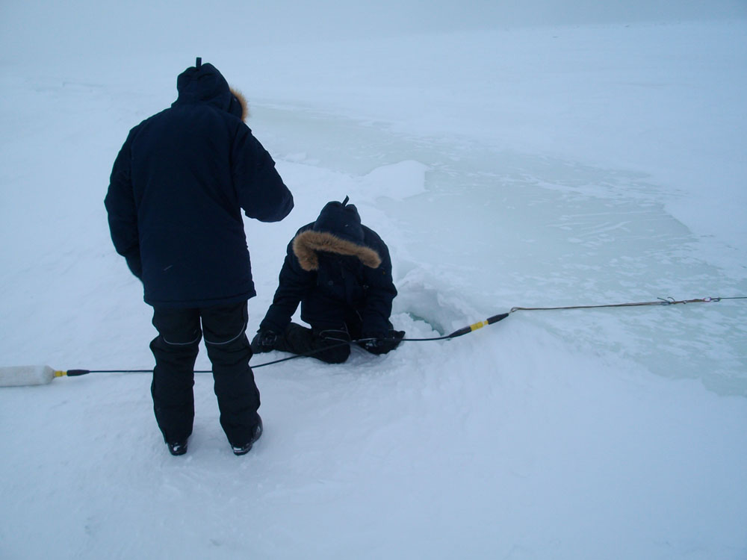
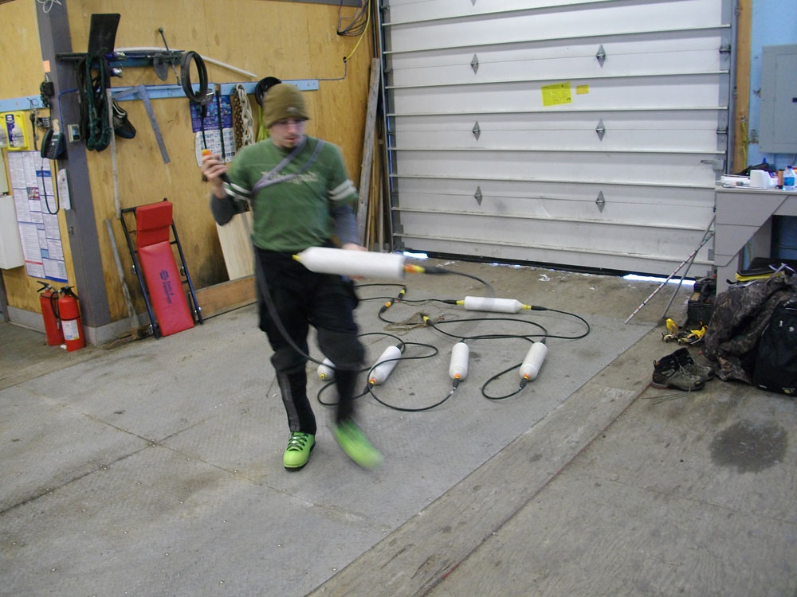
In the “Theatre” staging building getting ready to go out in the cold
Biyuan and Ashley working on the Ohmmapper connections

Slide 38
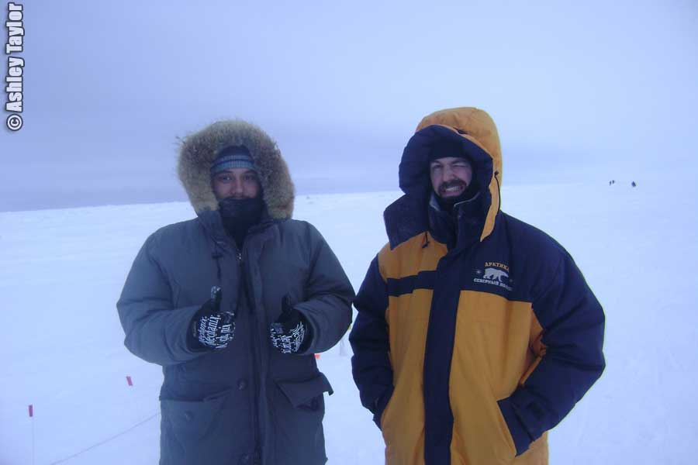

You would not want to meet these sketchy dudes on a dark, cold, frozen street at night.
Biyuan can finally see!

Slide 39


We did finally see a polar bear…from the safety of the van.
And of course we got the all-important data.

Slide 40



More collecting and analyzing the data

Slide 41



Preliminary processing of the data

Slide 42
March 2010
And now the real data processing had to be done…

Slide 43

March 2010
And now the real data processing had to be done…
…but we finished it just in the nick of time!

Slide 44
One question that was posed to us by the Cryospheric Research Group at the NASA Goddard Space Flight Center in March 2009:
“How quickly does the underside of the sea ice change?”

Slide 47
And an idea is born…
What do the Governor’s school students do while there?
  Follow the RU leader?
  Develop complex new experiment costing $$$$?
  Come up with simple idea that is easy to test?
Enter Thermochrons
  And the collective minds of 5 people

Slide 48
Thermochron
Self contained temperature data logger
Size of about 5 Nickels stacked
Ruggedized
Reliable
Accurate
Cheap! (between $10-$30 each)

Slide 49
Basic plan
Step 1: Learn to use thermochrons before leaving
Step 2: Determine a procedure
Step 3: Test procedure at home
Step 4: Pack equipment
Step 5: Go to Alaska, collect magnificent data, bask in glory

Slide 50
Basic results
Learned to use thermochrons
Developed procedure
Tested procedure at home
Packed equipment
Went to Alaska
Lost thermochrons
Discovered what “Ruggedized” means

Slide 51
Surprise!
Thermal relaxation ~40min
High power transmitters and thermochrons
  A convenient reset button
Movement marking
  Thermal spike -> infinity and beyond
Downloading on the ice
  Frozen computers, frozen fingers, lost time…
New idea time

Slide 52
Regroup
New strategy is needed
  Time to form the collective with 10+ now
Requirements:
  No touching
  Quick movements
  No on-ice download
  Nothing complex

Slide 53
The new idea is born!
Tie thermochrons together
  Separated by 1m
Move across ice as one unit
Use precise timing
Don’t let Ohmy and Wall-e near the kids!

Slide 54
The days roll on...
Day 7…Governor’s school leaves
Day 8…New Arrivals, new ideas…no luck
Day 9…no luck
Day 10…no luck
Day 11…no luck
Day 12…NO LUCK
Day 13…SUCCESS!!!!!
Day 14…Go HOME

Slide 55
Back home
Taking a look at the data
  Looks terrible
  No correlation appears
  Fear of contamination
  A waste of time?
Time to mass our minds together
  Strength and safety in numbers

Slide 56
Working together
Be CAREFUL!
  Read field book in DETAIL
  Count data points careful
  Match data to field book
  Recheck work
  Double check work
  Have someone else check work
  Compare to OhmMapper data
State of mind: SHOCK

Slide 57

March 2010
And here’s the punchline for the temperature and resistivity data.

Slide 58
March 2010
And here’s the punchline for the temperature and resistivity data.
But then you say, “So what??”

Slide 59
March 2010
Here’s the bottom line:
NASA can see the lateral extent of the polar ice cap…
…but not the thickness with the accuracy needed to completely nail down the (confirmed!!) rate of disappearance of the polar ice cap.
Our work may lead to a method to do this accurately.

Slide 60
March 2010
And now for the most important scientific exercise of all!!

Slide 61


Barrow, 2010
<--February 26-March 6
March 6-March 13

Slide 62


Barrow, 2010
<--February 26-March 6
March 6-March 13

Slide 63

The stark wilderness of the open ice
is sometimes overpowering,
but always beautiful…

