Slide 1
Research, Review & Recommendations re: Administrators with Tenured Faculty Appointments
April 25th 2019
Larry Ashby, Brad Bizzell, Tim Channell, Margaret Devaney, Jane Machin, Jeanne Mekolichick, Jean Mistele, Nora Reilly, Laura Quesenberry, Tammy Wallace

Slide 2
Working Group Membership
Faculty Representatives
Brad Bizzell, Ph.D
Tim Channell, Ed.D
Margaret Devaney (Dean)
Jane Machin, Ph.D
Jean Mistele, Ph.D
Nora Reilly, Ph.D
Tammy Wallace, Ph.D (Dean)
Administrative Representatives
Larry Ashby (Human Resources)
Jeanne Mekolichick (Provost Office)
Laura Quesenberry (Budget Office)

Slide 3
Working Group Remit
There are no policy guidelines at Radford University governing so-called retreat salaries, resulting in inconsistent compensation practices. The task of this group then is to:
Research and review the process in which tenured faculty members leave administrative positions and return to, or assume, teaching positions.
Policy at Virginia public institutions and peer institutions
State law and historical practices at Radford University
Alternative sources (e.g. recruitment companies)
Provide recommendations for a policy for Radford University
Establish consistency
Set limits that are generous but fair
Collect feedback on recommendations

Slide 4
Institutional Policies Reviewed
Public Institutions in VA Christopher Newport University
College of William and Mary
George Mason University
James Madison University
Longwood University
Norfolk State University
Old Dominion University
Radford University
University of Mary Washington
University of Virginia
University of Virginia's College at Wise
Virginia Commonwealth University
Virginia Military Institute
Virginia State University
Virginia Tech
Radford Peer Institutions Appalachian State University
Bloomsburg University of Pennsylvania
California State University - Chico
California State University - San Bernardino
Gonzaga University
Hofstra University
Indiana University of Pennsylvania - Main Campus
Kutztown University of Pennsylvania
Loyola Marymount University
Minnesota State University - Mankato
Monmouth University
Rowan University
Saint Cloud State University
Salisbury University
Seattle University
SUNY College at Brockport
Texas Christian University
The University of Tampa
University of Northern Colorado
University of Georgia
University of Northern Iowa
University of Wisconsin - Eau Claire
University of Wisconsin - Oshkosh
Western Carolina University
William Paterson University of New Jersey
Winthrop University
St. Leo College

Slide 5
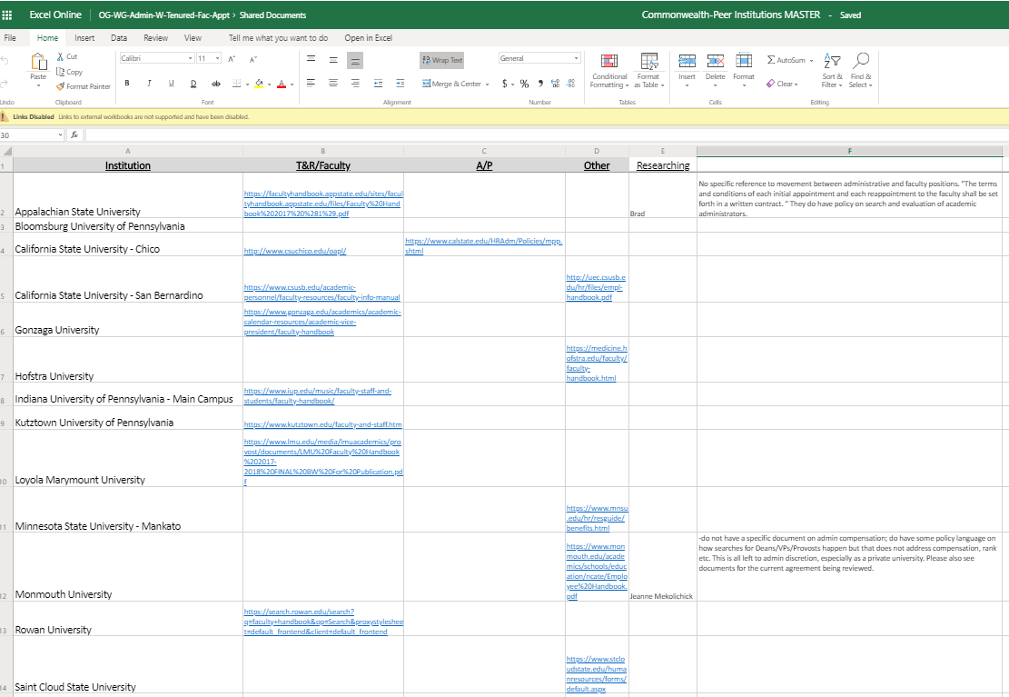
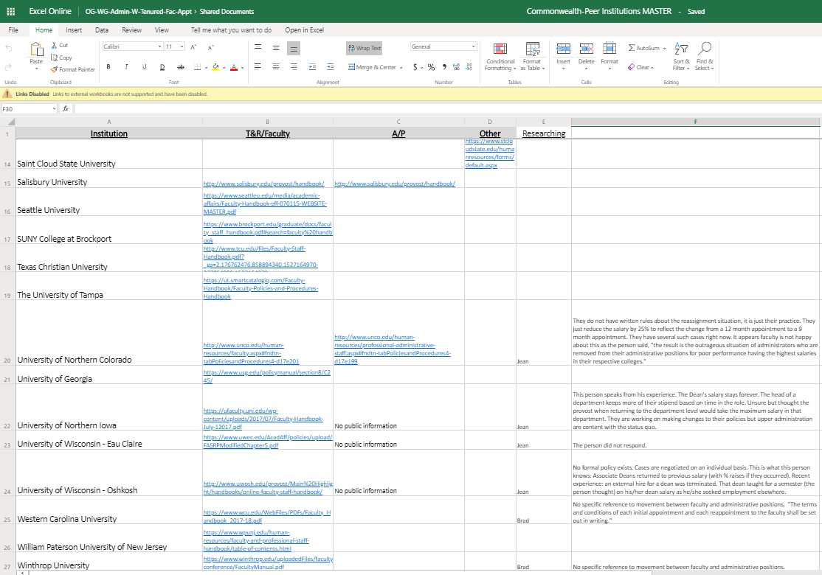
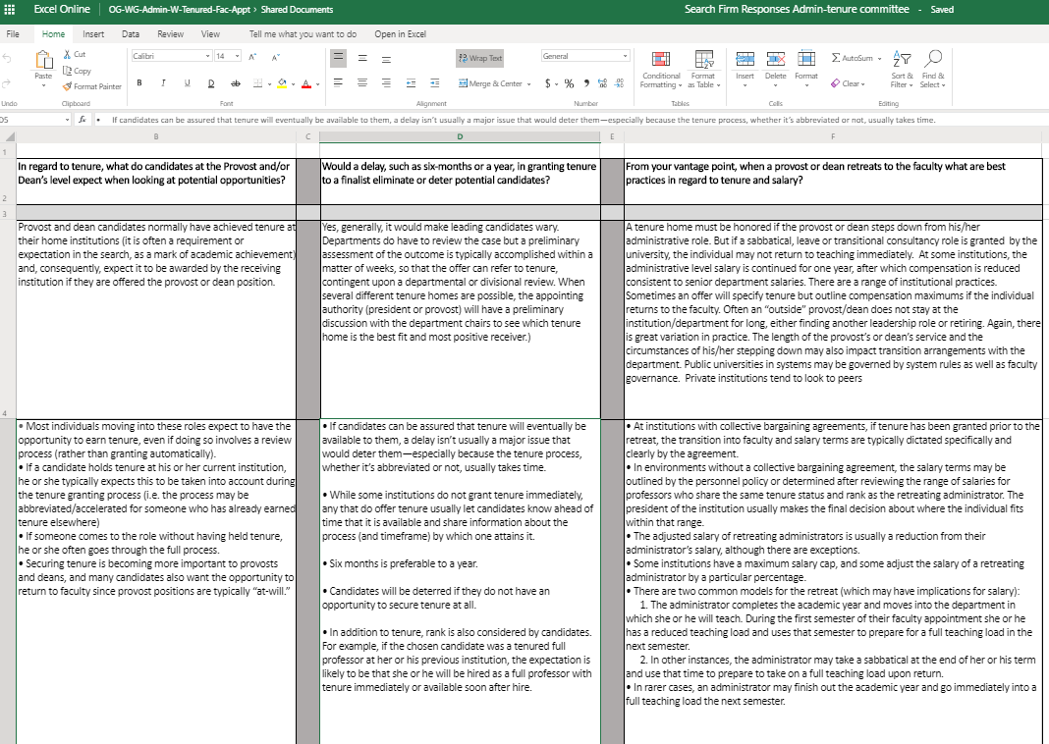
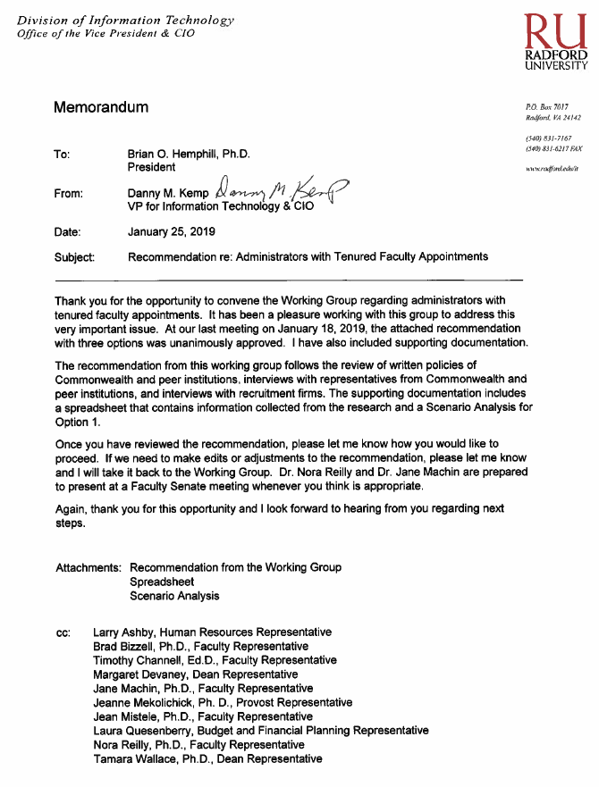
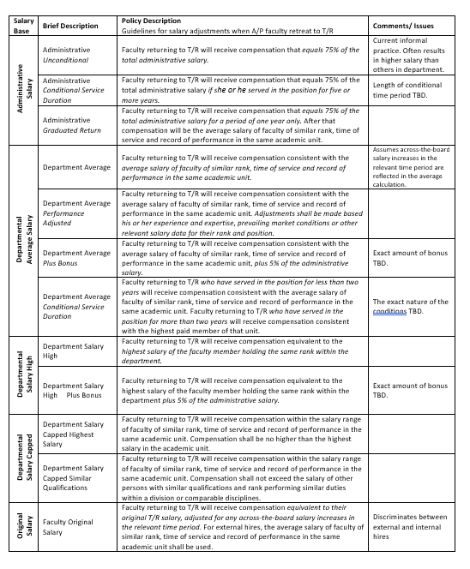
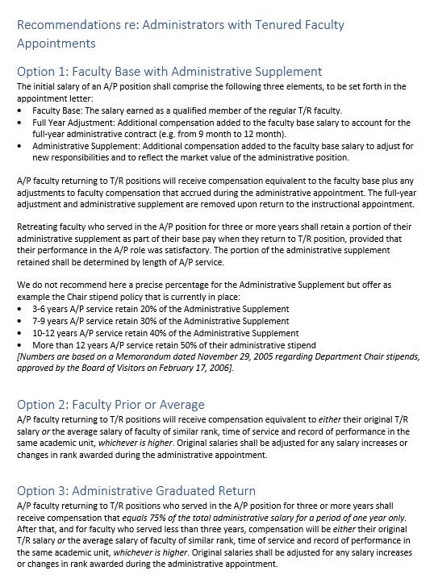
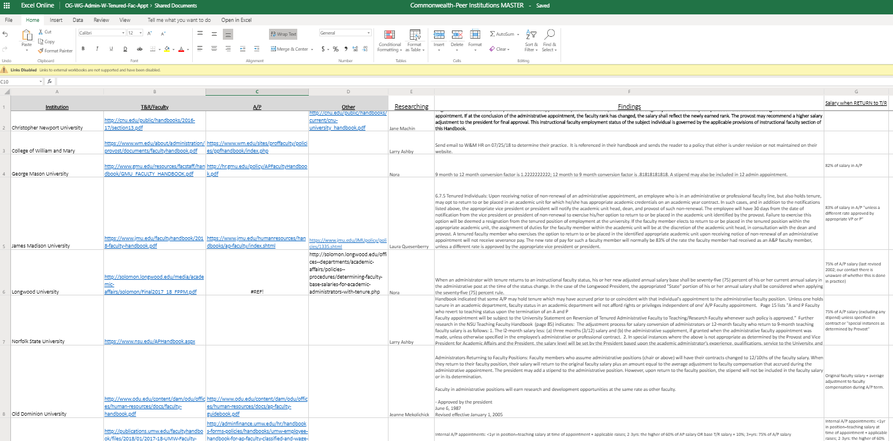
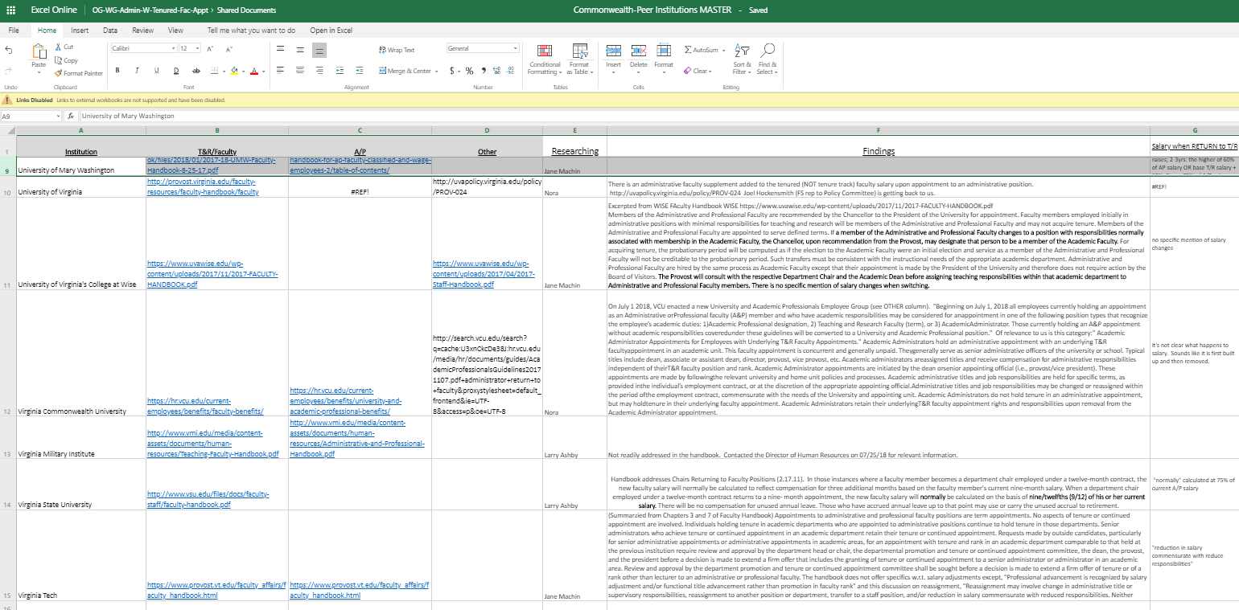
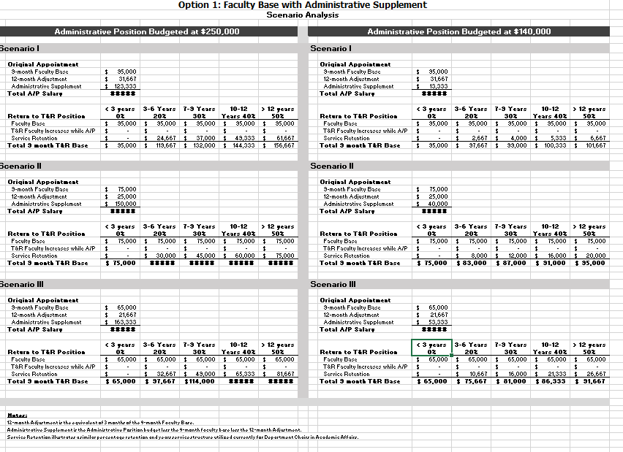
Working Group Process
Completed
Ongoing
Committee formed and first meeting held with briefing from President Hemphill
Understand the scope of the project and identify peer and Commonwealth institutions for policy review
Distributed institutions for review among members and agreed review constraints
Individuals each reviewed policies at 4+ institutions found in official documents and interviews with key personnel. Reported in Excel
Review, discussion and amendments to policies; Clarification from President
Revised policies per discussion and guiding principles. Cost analysis examined. Three different options presented to President Hemphill
Revised policies to improve clarity based on President feedback
Options reduced to two and to be presented to the faculty senate for discussion and feedback.
Present to faculty senate for approval
Summarize individual findings and discuss common themes
Content analysis to identify key themes and differences among institutions. Draft of 12 different variations on retreat policy created.
June 2018
May 2018
Sept 2018
Jan 2019
March 2019
TBD
Work completed during meetings
Work completed between meetings

Slide 6
Guiding Principles
Employees are compensated for the job they have at that time.
There is no automatic link between salaries earned as an administrator and the salary earned upon return as a faculty member.
Appointments to administrative and professional faculty positions are term appointments. No aspects of tenure or continued appointment are assumed or involved.
An administrator’s post-administrative appointment to a department/cost center should not be a financial burden to that unit.
Salaries and retreat packages should balance length of service and performance in administrative positions with good stewardship of university resources.

Slide 7
Key Recommendations
Guidelines only – Human Resources will write final policy
Apply to academic administrator positions including
Provost and Associate Provosts
Deans and Associate Deans
Apply to internal and external hires
Apply to future contracts only

Slide 8
Key Recommendations Option 1
Option 1: Faculty Prior or Average
For internal promotions to administrative appointments, A/P faculty returning to T/R positions will receive compensation equivalent to the greater of:
the institutional base pay as a T&R faculty prior to the administrative appointment plus any division wide T&R faculty salary increase(s) &/or change in faculty rank awarded during the administrative appointment or
the average institutional base pay of T&R faculty of similar rank, time of service and record of performance in the same academic unit.
For external hires with administrative appointments, A/P faculty transitioning to a T&R position will receive compensation equivalent to:
1. the average institutional base pay of T&R faculty of similar rank, time of service and record of performance in the same academic unit.

Slide 9
Key Recommendations Option 2
Option 2: Administrative Graduated Return
A/P faculty relinquishing an administrative appointment who served in the A/P position for three or more years shall receive compensation that equals the monthly total administrative salary increased by the total months to be appointed in the T&R position for a period of one year only (e.g. A/P total administrative salary = $140,000 / 12 A/P mo. = $11,666.67 A/P monthly salary x 9 T&R mo. = $105,000 T&R salary). After that, and for A/P faculty who served less than three years, compensation will be determined based on the administrative appointment being from an internal promotion or external hire.
For internal promotions to administrative appointments, A/P faculty returning to T/R positions will receive compensation equivalent to the greater of:
the institutional base pay as a T&R faculty prior to the administrative appointment plus any division wide T&R faculty salary increase(s) &/or change in faculty rank awarded during the administrative appointment or
the average institutional base pay of T&R faculty of similar rank, time of service and record of performance in the same academic unit.
For external hires with administrative appointments, A/P faculty transitioning to T/R positions will receive compensation equivalent to:
the average institutional base pay of T&R faculty of similar rank, time of service and record of performance in the same academic unit.

Slide 10
Key Recommendations
Institutional Base Pay
The annual compensation paid by the University for an employee’s appointment, whether that individuals time is spent on research, teaching, administration, or other activities. The Institutional Base Pay does not include supplemental payments (one time or recurring), administrative supplements, and/or any other types of compensation for special programs and activities.

Slide 11
Key Recommendations Summary
Option 1: Faculty Prior or Average
For internal promotions to administrative appointments, A/P faculty returning to T/R positions will receive compensation equivalent to the greater of:
the institutional base pay as a T&R faculty prior to the administrative appointment plus any division wide T&R faculty salary increase(s) &/or change in faculty rank awarded during the administrative appointment or
the average institutional base pay of T&R faculty of similar rank, time of service and record of performance in the same academic unit.
For external hires with administrative appointments, A/P faculty transitioning to a T&R position will receive compensation equivalent to:
1. the average institutional base pay of T&R faculty of similar rank, time of service and record of performance in the same academic unit.
Option 2: Administrative Graduated Return
A/P faculty relinquishing an administrative appointment who served in the A/P position for three or more years shall receive compensation that equals the monthly total administrative salary increased by the total months to be appointed in the T&R position for a period of one year only (e.g. A/P total administrative salary = $140,000 / 12 A/P mo. = $11,666.67 A/P monthly salary x 9 T&R mo. = $105,000 T&R salary). After that, and for A/P faculty who served less than three years, compensation will be determined based on the administrative appointment being from an internal promotion or external hire.
For internal promotions to administrative appointments, A/P faculty returning to T/R positions will receive compensation equivalent to the greater of:
the institutional base pay as a T&R faculty prior to the administrative appointment plus any division wide T&R faculty salary increase(s) &/or change in faculty rank awarded during the administrative appointment or
the average institutional base pay of T&R faculty of similar rank, time of service and record of performance in the same academic unit.
For external hires with administrative appointments, A/P faculty transitioning to T/R positions will receive compensation equivalent to:
the average institutional base pay of T&R faculty of similar rank, time of service and record of performance in the same academic unit.
Note on Institutional Base Pay: The annual compensation paid by the University for an employee’s appointment, whether that individuals time is spent on research, teaching, administration, or other activities. The Institutional Base Pay does not include supplemental payments (one time or recurring), administrative supplements, and/or any other types of compensation for special programs and activities.

