Slide 1
Student alert processes
Advising
August 2015

Slide 2
ALERT TYPES
ACADEMIC ALERT via the Faculty Feedback Survey
Faculty to Primary Advisor
- Student has missed several classes, missed several assignments and/or not performing well on examinations and assignments
BEHAVIORAL ALERT
Faculty, Faculty Advisor, Professional Advisors to the BCT (Behavior Consultation Team)
- Students whose behavior may be of concern, disruptive or otherwise problematic.
SOCIAL ALERT
Professional and Faculty Advisor to Lauren Hatfield and Amber Mullen (Residential Life)
- This alert is used when the Professional Advisor or Faculty Advisor has made several attempts to contact the student and the student doesn’t respond. The alert prompts the Residential Life staff to perform a Wellness Check on the student (Residential Life staff will physically go the student’s dorm room to make sure they are okay).
Advising

Slide 3
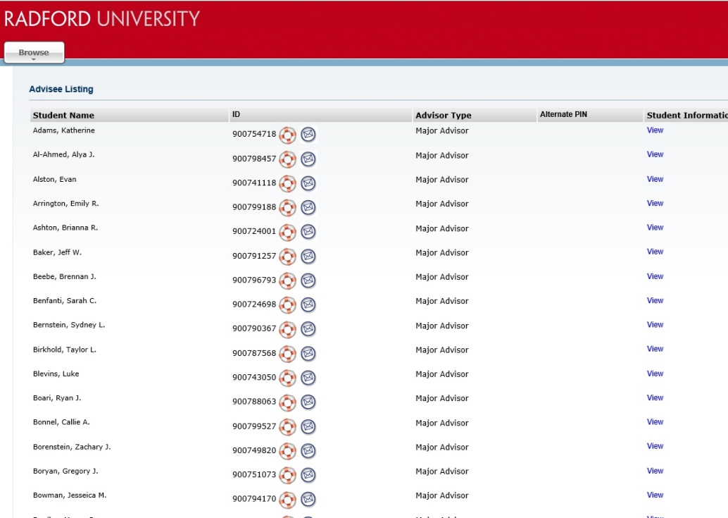
Accessing aLERTS
To initiate an academic or behavioral alert:
In your MyRU Portal (https://my.radford.edu) go to Advisee Listing or Class or Summary Class List.
Click on the Life Preserver next to the student you wish to create an alert for.
Advising

Slide 4
Accessing aLERTS
Review the descriptions of each alert type.
The Academic Alert link will take you to Agile Advisor. You may also complete Social Alerts in Academic Advisor.
The Behavioral Alert link will take you to the Behavioral Consultation Team’s form.
Advising

Slide 5
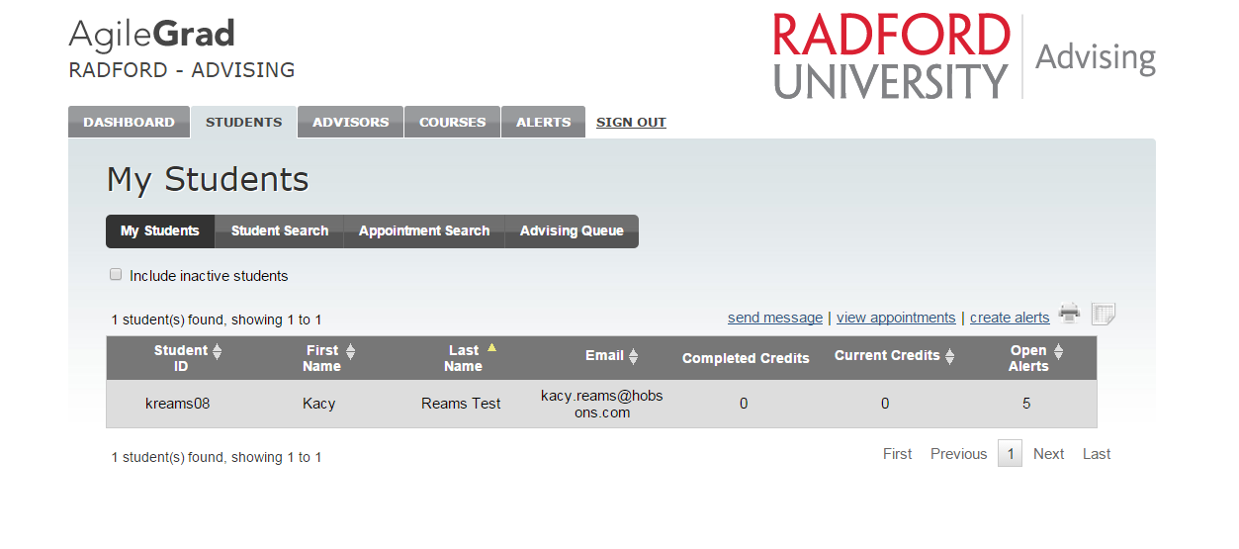
Academic and social aLERTS
Log into Agile Advisor.
Click on the Student Tab.
Then the “create alerts” button.
Advising

Slide 6
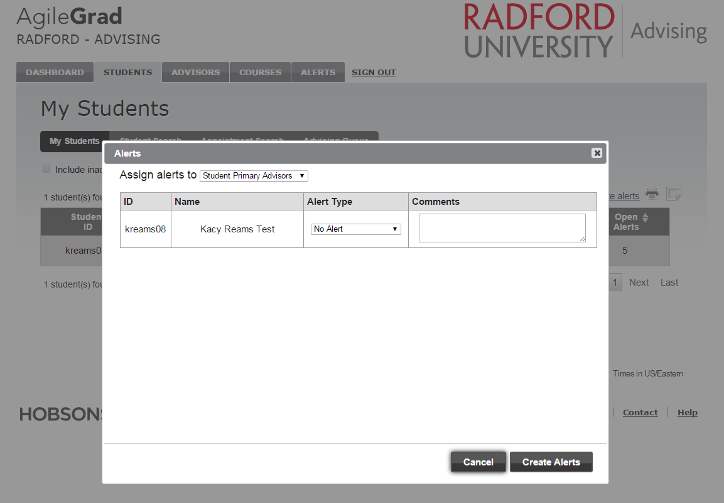
Academic aLERTS
Use the pop-up dialog box to select Alert Type and add comments.
Advising

Slide 7
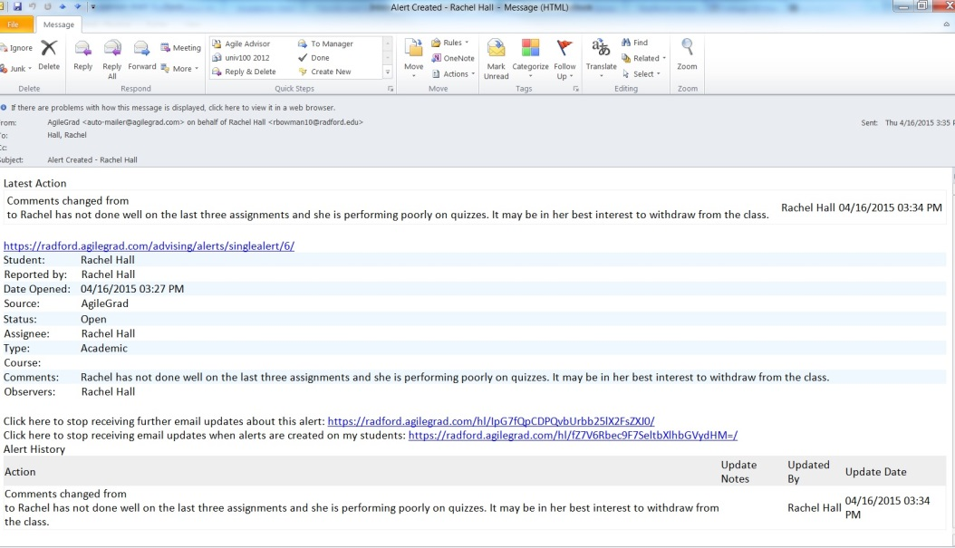
Academic aLERTS
Once an Academic Alert is submitted, an email will go to the student’s Primary Advisor.
An email will be sent each time the alert is updated and when it is resolved.
Advising

Slide 8
social aLERTS
Same process to access pop-up dialog box.
You must add Amber Mullen and Lauren Hatfield as an Observer (next slide).
Advising

Slide 9
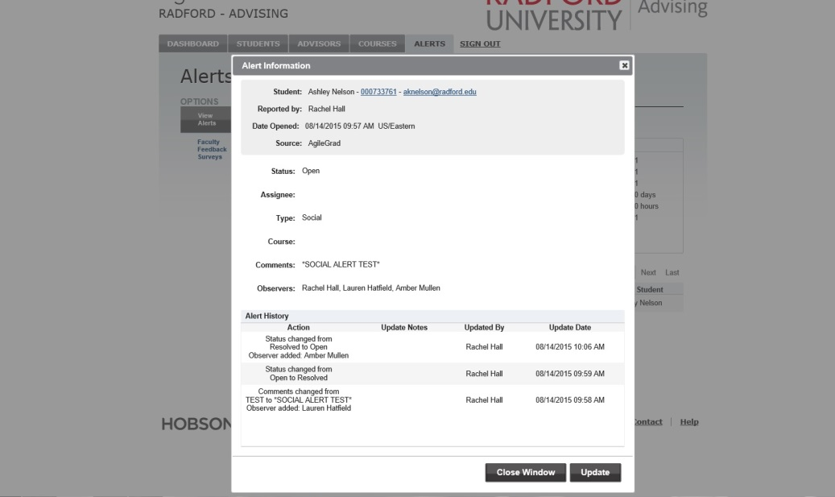
Adding an observer
To add an observer, go to the student’s profile, click on the Alerts tab then click on the Alert itself to open it.
Click Update, add Observers then click Save.
An email will be sent to added Observers.
Advising

Slide 10
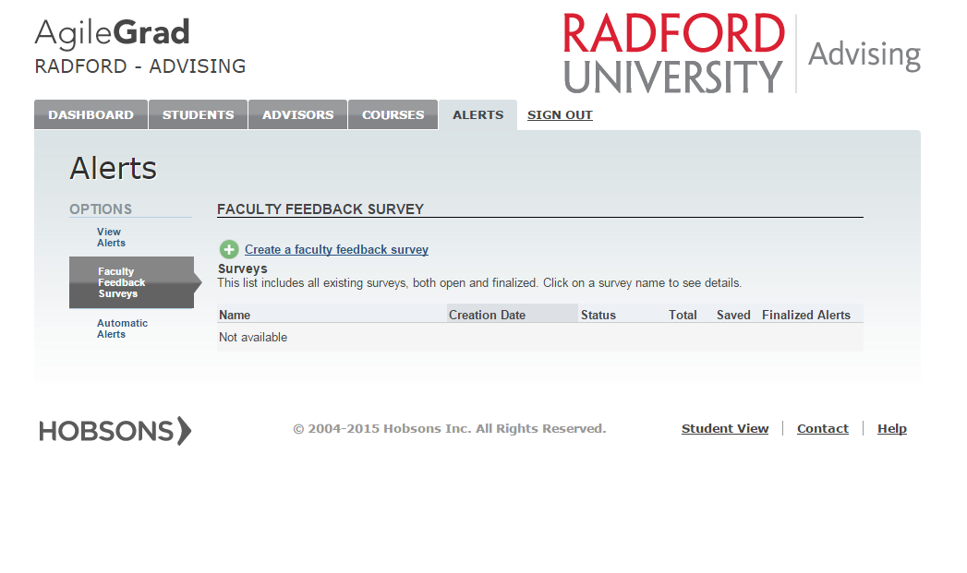
Alerts in faculty feedback
You can also add Alerts through the Faculty Feedback Survey if the student is in a class you’re teaching.
Click on the “Alerts” tab
Then, Click “Faculty
Feedback Surveys” (the
second option on the left).
Advising

Slide 11
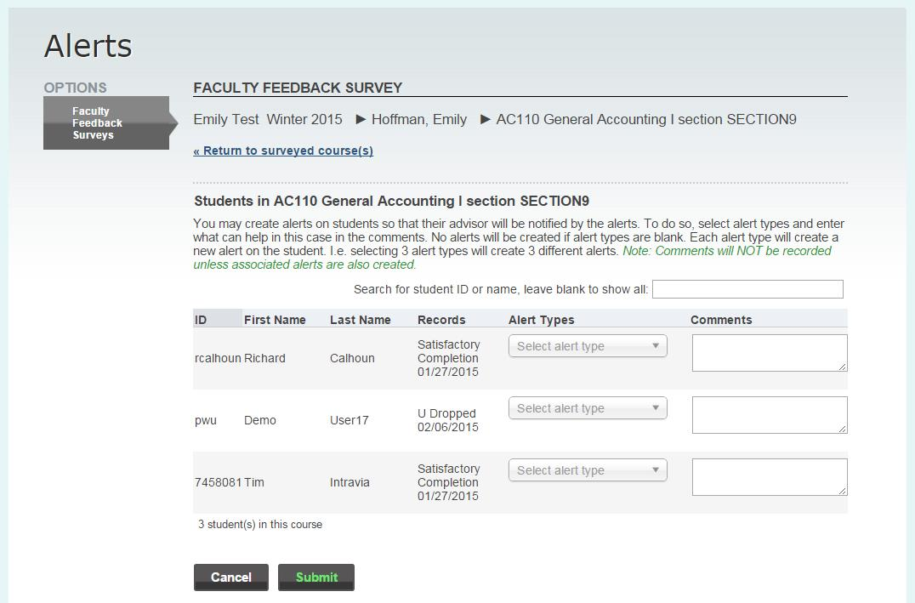
Alerts in faculty feedback
Add appropriate alert types and comments for one or many students.
Be sure to select “Submit.”
Alerts submitted through Faculty Feedback Surveys will go to the student’s Primary Advisor.
Advising

Slide 12
For more information
On how to know which Alert is appropriate: Michele Jenkins, New Student Programs
On academic alerts: the student’s advisor or your college’s professional advising staff
On social alerts: Amber Mullen and Lauren Hatfield, Residential Life
On behavioral alerts: the Behavioral Consultation Team (bct@radford.edu)
Advising

