Slide 1
Enrollment Management and Retention
Retention/New Student Programs
Spring 2016

Slide 2
New Student Programs Updates/Requests
Quest 2016
New philosophy: “Success” messaging with focus on June-September 1
Need for deans’ participation
UNIV 100 Fall 2016
Textbook
D2L
Recruitment of Faculty Instructors
Retention/New Student Programs

Slide 3
Current Retention Issues
2015-2016 Fall-to-Spring Retention Rates were the Lowest in 20 Years:
Fall-to-Spring Retention (New Freshmen)
Term | Cohort | Retain | SQ | PB | GS | Retain | SQ | PB
Fall 2013 | 1,986 | 1,748 | 118 | 30 | 90 | 88.0% | 5.9% | 1.5%
Fall 2014 | 2,015 | 1,778 | 121 | 32 | 84 | 88.2% | 6.0% | 1.6%
Fall 2015 | 1,962 | 1,689 | 123 | 33 | 117 | 86.1% | 6.3% | 1.7%
Change 2014-2015 |  |  |  |  |  | -1.9% | 0.3% | 0.2%
The average fall-to-spring retention rate for the Fall 2003-Fall 2012 cohorts was 90.6%.
Source for all data in presentation (unless otherwise indicated): RU Office of Institutional Research
Retention/New Student Programs

Slide 4
RU is Losing Students at Both Ends of the Qualifications Spectrum:
Approximately 8% of Fall 2015 new freshmen who were not retained were not in good standing after the fall semester:
6.3% of new freshmen were suspended
1.7% could have returned on academic probation, but did not
Approximately 6% left in good academic standing, compared to 4.5% following fall 2013 and 4.1% following fall 2014.
What is happening? Have been working with Institutional Research to gather information.
Retention/New Student Programs

Slide 5
Who Are Our Students?
2015-2016 First-Time Freshman Profile (GPA)
Institution | Median HSGPA | Median SAT Math | Median SAT Verbal | Median Total SAT
UVA | 4.26 | 680 | 670 | 1350
CWM | 4.17 | 680 | 680 | 1360
VT | 3.98 | 630 | 590 | 1220
CNU | 3.80 | 570 | 580 | 1150
JMU | 3.79 | 560 | 560 | 1120
GMU | 3.65 | 570 | 570 | 1140
VMI | 3.63 | 570 | 560 | 1130
VCU | 3.60 | 550 | 540 | 1090
UMW | 3.54 | 530 | 550 | 1080
LU | 3.42 | 490 | 490 | 980
UVA-W | 3.42 | 470 | 470 | 940
ODU | 3.27 | 510 | 510 | 1020
RU | 3.14 | 480 | 480 | 960
NSU | 2.93 | 370 | 370 | 740
VSU | 2.93 | 420 | 430 | 850
Source: SCHEV. (RU’s median HSGPA since 2010 has ranged between 3.11 and 3.19.)
Retention/New Student Programs

Slide 6
Who Are Our Students?
2015-2016 First-Time Freshman Profile (SAT)
Institution | Median HSGPA | Median SAT Math | Median SAT Verbal | Median Total SAT
CWM | 4.17 | 680 | 680 | 1360
UVA | 4.26 | 680 | 670 | 1350
VT | 3.98 | 630 | 590 | 1220
CNU | 3.80 | 570 | 580 | 1150
GMU | 3.65 | 570 | 570 | 1140
VMI | 3.63 | 570 | 560 | 1130
JMU | 3.79 | 560 | 560 | 1120
ODU | 3.27 | 510 | 510 | 1120
VCU | 3.60 | 550 | 540 | 1090
UMW | 3.54 | 530 | 550 | 1080
LU | 3.42 | 490 | 490 | 980
RU | 3.14 | 480 | 480 | 960
UVA-W | 3.42 | 470 | 470 | 940
VSU | 2.93 | 420 | 430 | 850
NSU | 2.93 | 370 | 370 | 840
Source: SCHEV. (RU’s median SAT in 2010 was 1020.)
Retention/New Student Programs

Slide 7
Conclusions . . .
Our state competitors are not who we think they are.
Many of our freshmen almost certainly need additional support to succeed.
Retention/New Student Programs

Slide 8
Radford University Probation/Suspension Policy (In Effect Since Fall 2013)
The academic suspension threshold for continuing students is determined by the number of hours attempted, according to the following scale:
Hours Attempted | Cumulative GPA Required to Avoid Suspension
13-23 | 1.00
24-35 | 1.50
36-47 | 1.80
48 or more | 2.00
Students with cumulative GPAs below 2.00 but above the suspension thresholds are placed on academic probation.
Retention/New Student Programs

Slide 9
Students Who Do Not Find Success Early are Less Likely to Graduate
About 6% of new freshmen are suspended each fall and another 13% are on academic probation. Even those on probation are unlikely to graduate:
Term | Cohort | Good Standing | Probation | Suspension | Probation Retained Spring | Probation Retained Fall | Probation Graduated 6 Years | All RU Students Graduated 6 Years
Fall 2005 | 1,896 | 83% | 13% | 4% | 93% | 61% | 32% | 55%
Fall 2006 | 1,733 | 86% | 8% | 6% | 93% | 69% | 35% | 60%
Fall 2007 | 1,841 | 87% | 8% | 5% | 93% | 71% | 33% | 59%
Fall 2008 | 1,875 | 88% | 8% | 4% | 93% | 62% | 22% | 59%
Fall 2009 | 1,447 | 83% | 9% | 7% | 93% | 64% | 40% | 59%
Fall 2010 | 1,837 | 84% | 10% | 6% | 89% | 64% | - | -
Fall 2011 | 2,035 | 80% | 12% | 8% | 93% | 61% | - | -
Fall 2012 | 2,053 | 83% | 11% | 7% | 91% | 68% | - | -
Fall 2013 | 1,986 | 79% | 15% | 6% | 90% | 61% | - | -
Fall 2014 | 2,015 | 79% | 15% | 6% | 89% | 62% | - | -
For all RU new freshmen: 90% were retained spring; 76% were retained fall.
Retention/New Student Programs

Slide 10
Question: Who is in Greatest Need of Support in Order to Be Retained?
Answer: Students with Low High School Grade Point Averages
High School GPA
Rank | Value | Total Number | Number Persisted | Persistence Rate (%) | Lift
1 | 3.46 or Greater | 1493 | 1225 | 82.05 | 1.08
2 | 3.14 to 3.45 | 1479 | 1168 | 78.97 | 1.04
3 | ZZ | 16 | 12 | 75.00 | 0.99
4 | 2.84 to 3.13 | 1528 | 1144 | 74.87 | 0.99
5 | 2.83 or Less | 1528 | 1029 | 67.34 | 0.89
Total |  | 6044 | 4578 | 75.74 | 1.00
Source: Ruffalo Noel Levitz Spring 2015 Retention Model for Radford University
Retention/New Student Programs

Slide 11
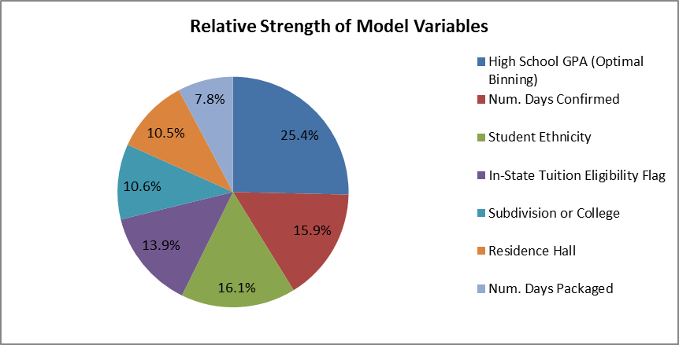
Ruffalo Noel Levitz RU 2015 Standard Retention Predictor (SRP) Model
Source: Ruffalo Noel Levitz Spring 2015 Retention Model for Radford University
Retention/New Student Programs

Slide 12
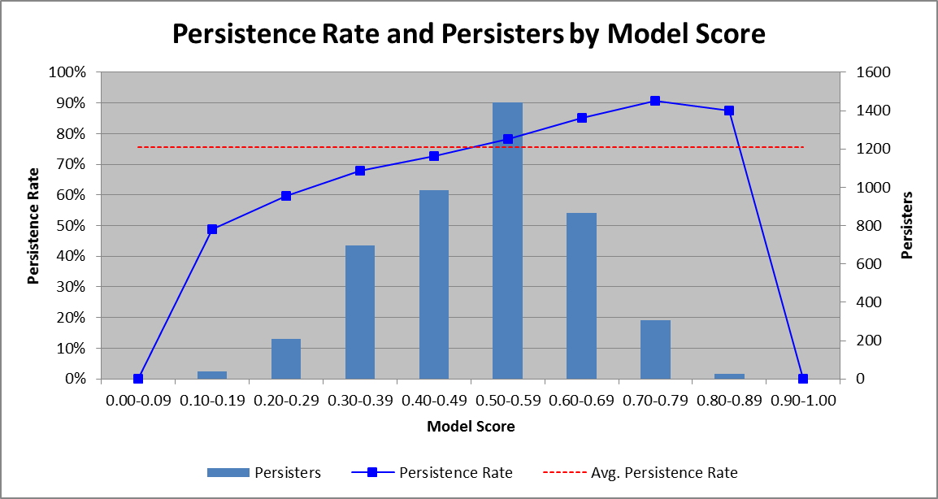
Predictive Value of the Model, 2012-2014
Source: Ruffalo Noel Levitz Spring 2015 Retention Model for Radford University
Retention/New Student Programs

Slide 13
Question: Who is in Greatest Need of Support in Order to Be Retained?
. . . NOT Students with Low SAT Scores:
SAT Combined Score
Rank | Value | Total Number | Number Persisted | Persistence Rate (%) | Lift
1 | 921 to 990 | 1218 | 938 | 77.01 | 1.02
2 | 1071 or Greater | 1224 | 936 | 76.47 | 1.01
3 | 920 or Less | 1278 | 965 | 75.51 | 1.00
4 | 991 to 1070 | 1188 | 889 | 74.83 | 0.99
5 | ZZ | 1136 | 850 | 74.82 | 0.99
Total |  | 6044 | 4578 | 75.74 | 1.00
Source: Ruffalo Noel Levitz Spring 2015 Retention Model for Radford University
Retention/New Student Programs

Slide 14
Fall 2015 Conditional Admits
Approximately 30 students with acceptable high school GPAs but low SAT scores were conditionally admitted.
Conditions:
Enrollment in UNIV 100
Schedules created by professional advisors
Regular meetings with advisors
Participation in MASH (Mentoring Academically Successful Highlanders): peer mentoring, workshops, intrusive advising, etc.
The program was very successful, but since HSGPA is the best predictor of retention, the “conditional admits” were less of a retention risk than about 500 other new freshmen . . .
Retention/New Student Programs

Slide 15
Conditional Admits and Other NF by HSGPA
New Freshmen Profile Percentages (Fall 2015) by HSGPA
Percentile* | HSGPA | SAT Combined
5th | 2.48 | 830
10th | 2.59 | 850
15th | 2.66 | 870
20th | 2.74 | 880
25th | 2.80 | 890
Conditional Admits | 2.85 | 800
30th | 2.87 | 910
35th | 2.94 | 920
*Each percentile represents approximately 100 students.
Retention/New Student Programs

Slide 16
Recommendation:
If we offer students conditional admission and provide those students with additional support, the students offered conditional admission should be determined by their high school GPAs, not their SAT scores.
Retention/New Student Programs

Slide 17
A Critical Retention Reality: We Must Teach the Students We Have, Not Those We Wish We Had
If improving retention rates is a goal (and it should be, if only for the selfish reason than improved retention rates enables the Office of Admissions to be more selective!) we must provide additional support to Radford University freshmen.
Some recommendations, first for students with lesser entrance criteria . . .
Retention/New Student Programs

Slide 18
Recommendations:
Offer more sections of courses in which freshmen find success. This will enable advisors to . . .
Place more students in balanced first-semester schedules that are more conducive to their success.
Use CSI results (e.g., responses to questions about math/science and verbal/writing confidence) and SRP scores to inform first-semester schedule construction.
“A new student’s academic success during the first semester should be dependent upon his/her effort and motivation, not whether he/she got first choices or “leftovers” because of how early or late in the process he registered.” (Source: “Retention at Radford University: Current Status and Recommendations for Enhancement,” Lerch, Dunn, and Jenkins, December 2012).
Retention/New Student Programs

Slide 19
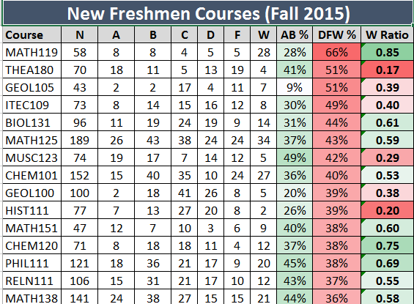
The Combination of Classes New Freshmen Take Dramatically Affect their GPAs/Retention
DFW Rates for New Freshman Courses (Fall 2015) Click here to open the Excel file
Retention/New Student Programs

Slide 20
Recommendations (continued):
Require faculty to assign meaningful midterm grades. Midterm grades predict final grades and have critical advising implications.
 |  | Final Grade
 |  | A | A- | B+ | B | B- | C+ | C | C- | D+ | D | D- | F | W | I | Total | DFW
Mid-Term Grade | A | 67% | 6% | 5% | 14% | 1% | 1% | 3% | 0% | 0% | 1% | 0% | 1% | 0% | 0% | 100% | 3%
 | A- | 35% | 17% | 14% | 15% | 4% | 2% | 4% | 3% | 2% | 1% | 1% | 2% | 1% | 0% | 100% | 4%
 | B+ | 23% | 11% | 15% | 21% | 7% | 5% | 8% | 2% | 2% | 2% | 0% | 2% | 1% | 0% | 100% | 5%
 | B | 23% | 3% | 4% | 36% | 4% | 2% | 16% | 1% | 1% | 4% | 0% | 3% | 1% | 0% | 100% | 9%
 | B- | 9% | 7% | 6% | 22% | 14% | 8% | 17% | 4% | 2% | 5% | 2% | 5% | 1% | 0% | 100% | 12%
 | C+ | 7% | 5% | 9% | 16% | 10% | 12% | 15% | 5% | 2% | 4% | 2% | 10% | 3% | 0% | 100% | 19%
 | C | 7% | 1% | 2% | 24% | 4% | 4% | 27% | 2% | 2% | 13% | 1% | 9% | 4% | 0% | 100% | 26%
 | C- | 5% | 4% | 6% | 10% | 9% | 7% | 19% | 8% | 6% | 8% | 5% | 7% | 5% | 1% | 100% | 25%
 | D+ | 3% | 4% | 5% | 5% | 5% | 10% | 15% | 9% | 5% | 10% | 5% | 9% | 12% | 0% | 100% | 37%
 | D | 4% | 0% | 0% | 13% | 2% | 2% | 24% | 3% | 2% | 20% | 2% | 17% | 11% | 0% | 100% | 49%
 | D- | 1% | 0% | 0% | 5% | 3% | 5% | 9% | 7% | 4% | 15% | 12% | 19% | 20% | 0% | 100% | 66%
 | F | 1% | 0% | 0% | 3% | 1% | 2% | 8% | 1% | 2% | 9% | 2% | 33% | 35% | 1% | 100% | 79%
 | I | 29% | 7% | 2% | 14% | 4% | 3% | 6% | 2% | 2% | 8% | 2% | 15% | 5% | 0% | 100% | 31%
 | (blank) | 32% | 3% | 4% | 15% | 3% | 1% | 7% | 2% | 1% | 5% | 1% | 6% | 20% | 0% | 100% | 31%
 | Total | 31% | 5% | 5% | 18% | 4% | 3% | 12% | 2% | 1% | 6% | 1% | 7% | 6% | 0% | 100% | 20%
Retention/New Student Programs

Slide 21
Recommendations (continued):
Advise freshmen to strategically use course withdrawals. This should turn some suspensions into probation, giving the student a second chance (with the support of UNIV 150) in the spring. UNIV 150 has a two-year successful track record:
Year One of UNIV 150 (Spring 2014)
New Freshmen with Fall 2013 GPA 1.00-1.49 Retention Rates
Spring 2014 UNIV 150 | Spring 2014 | Fall 2014 | Spring 2015 | Fall 2015 | Spring 2016
Passed UNIV 150 (with C or above) | 100.0% | 77.4% | 50.0% | 45.2% | 45.2%
Did not pass UNIV 150 (D, F, W) | 100.0% | 11.8% | 5.9% | 5.9% | 5.9%
Did not enroll in UNIV 150 | 64.9% | 40.5% | 29.7% | 27.0% | 27.0%
Total | 88.8% | 56.0% | 37.1% | 33.6% | 33.6%
New Freshmen with Fall 2013 GPA 1.50-1.99 Retention Rates
Spring 2014 UNIV 150 | Spring 2014 | Fall 2014 | Spring 2015 | Fall 2015 | Spring 2016
Passed UNIV 150 (with C or above) | 100.0% | 75.6% | 66.7% | 55.6% | 51.1%
Did not pass UNIV 150 (D, F, W) | 100.0% | 42.9% | 42.9% | 42.9% | 28.6%
Did not enroll in UNIV 150 | 86.5% | 60.3% | 46.0% | 40.5% | 39.7%
Total | 90.4% | 63.5% | 51.1% | 44.4% | 42.1%
Retention/New Student Programs

Slide 22
Recommendations (continued):
Year Two of UNIV 150 (Spring 2015)
New Freshmen with Fall 2014 GPA 1.00-1.49 Retention Rates
Spring 2014 UNIV 150 | Spring 2014 | Fall 2014 | Spring 2015 | Fall 2015 | Spring 2016
Passed UNIV 150 (with C or above) | x | x | 100.0% | 79.0% | 58.1%
Did not pass UNIV 150 (D, F, W) | x | x | 100.0% | 15.8% | 15.8%
Did not enroll in UNIV 150 | x | x | 54.1% | 35.1% | 29.7%
Total | x | x | 85.6% | 55.1% | 42.4%
New Freshmen with Fall 2014 GPA 1.50-1.99 Retention Rates
Spring 2014 UNIV 150 | Spring 2014 | Fall 2014 | Spring 2015 | Fall 2015 | Spring 2016
Passed UNIV 150 (with C or above) | x | x | 100.0% | 90.6% | 78.1%
Did not pass UNIV 150 (D, F, W) | x | x | 100.0% | 50.0% | 33.3%
Did not enroll in UNIV 150 | x | x | 89.4% | 62.4% | 51.8%
Total | x | x | 91.6% | 67.0% | 55.9%
Retention/New Student Programs

Slide 23
Recommendations (continued):
Advise students to withdraw from Radford University if their midterms are universally bad. (This obviously is not a retention strategy, but it is the right thing to do.)
Below 1.0 At Mid-Term
Term | Count | Good Standing | Probation | Suspension | Withdrew None | Withdrew Some | Withdrew All | Graduated 6 Years
Fall 2005 | 21 | 4 | 7 | 10 | 10 | 8 | 3 | 2 (9.5%)
Fall 2006 | 19 | 4 | 1 | 14 | 10 | 6 | 3 | 1 (5.2%)
Fall 2007 | 19 | 5 | 1 | 13 | 8 | 7 | 4 | 1 (5.2%)
Fall 2008 | 15 | 2 | 4 | 9 | 7 | 7 | 1 | 2 (13.3%)
Fall 2009 | 20 | 2 | 3 | 15 | 8 | 10 | 2 | 4 (20.0%)
Fall 2010 | 30 | 8 | 5 | 17 | 10 | 15 | 5 | -
Fall 2011 | 49 | 14 | 4 | 31 | 13 | 26 | 10 | -
Fall 2012 | 37 | 7 | 3 | 27 | 14 | 19 | 4 | -
Fall 2013 | 59 | 8 | 12 | 39 | 32 | 23 | 4 | -
Fall 2014 | 58 | 8 | 14 | 36 | 22 | 31 | 5 | -
Retention/New Student Programs

Slide 24
Recommendations (continued):
Require UNIV 100 for all freshmen, or at least for those in the bottom 25% of high school GPAs and for late admits.
Discontinue restrictive major change policies.
Involve families by reactivating the electronic family newsletter and changing the FERPA waiver to make it “proactive.”
Implement a University-wide attendance policy for 100-level courses.
Connect freshmen earlier to information about potential careers.
Implement a long-range plan to staff advising centers such that all freshmen are advised by professional advisors.
Retention/New Student Programs

Slide 25
Recommendations (continued):
Implement “Starfish” to its fullest capacities as soon as feasible.
Arrange for full-time, tenure-track faculty—not adjuncts or teaching assistants—to teach more freshman-level courses, especially introductory courses for their majors.
Through faculty development, help faculty assigned to teach 100-level classes understand the special challenges and rewards of teaching college freshmen.
Retention/New Student Programs

Slide 26
We Must Also Recruit and Retain Outstanding Students!
Recruitment Questions:
Is there sufficient financial incentive for students to choose RU? Our lower tuition is not sufficiently offset by availability of merit scholarships . . . Good students will not choose us if they receive more money to go elsewhere!
Can we expand the Honors Academy? Have we made the new criteria too restrictive?
Are we doing everything we can to support the Office of Admissions? James and his staff need our full commitment and support, as well as our facilities and our participation in recruitment activities.
Retention/New Student Programs

Slide 27
We Must Also Recruit and Retain Outstanding Students!
Retention: We lose too many good students:
Dean's List Retention Rate
Term | Cohort | Dean's List |  |  | Good Standing (but not DL) |  |  | Difference
 |  | N | Spring | Fall | N | Spring | Fall | Spring | Fall
Fall 2008 | 1,875 | 470 | 95% | 81% | 1,181 | 95% | 82% | 0% | -1%
Fall 2009 | 1,447 | 368 | 97% | 81% | 837 | 95% | 83% | 2% | -2%
Fall 2010 | 1,837 | 505 | 96% | 84% | 1,042 | 93% | 81% | 3% | 3%
Fall 2011 | 2,035 | 474 | 95% | 81% | 1,159 | 93% | 82% | 2% | -1%
Fall 2012 | 2,053 | 492 | 97% | 85% | 1,206 | 93% | 83% | 4% | 2%
Fall 2013 | 1,986 | 495 | 95% | 82% | 1,074 | 94% | 82% | 1% | 0%
Fall 2014 | 2,015 | 483 | 97% | 88% | 1,110 | 94% | 81% | 3% | 7%
We must connect good students as early as possible with their major curricula, faculty, departments, schools, and colleges.
We must connect good students to High Impact Practices designed to engage and challenge them.
We must offer incentives for outstanding students to stay.
Retention/New Student Programs

Slide 28
Questions?
Retention/New Student Programs

