Slide 1
Measurement is “Fun”
Just like pyromania is “fun”
Shea Fyffe

Slide 2
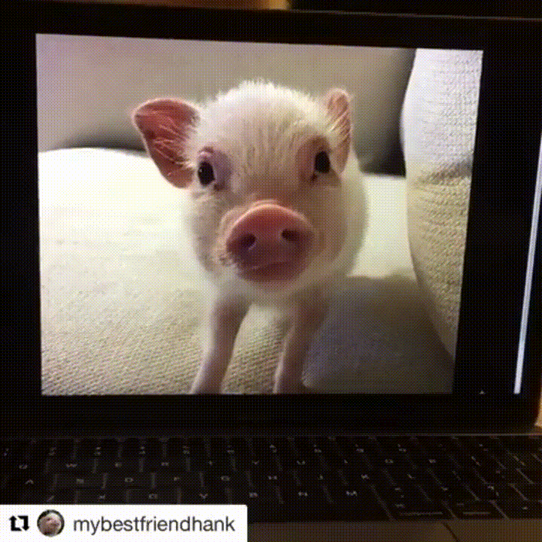
Who Am I
70%

Slide 3
Objective
….it would be great if you took a 20 minute diversion into teaching them some measurement stuff that would make them better people.
Nora

Slide 4
Objective
Chronic
Not pedagogical
Not too psychometric or statistical
IMO: The most tedious process in applied measurement

Slide 5
What is measurement?

Slide 6
Defining Measurement
Tanya: “My boyfriend is sooooo weird.”
Suzy: “Ahhh girl, what did he do now?!”
Tanya: “I realized he puts on 1 sock then 1 shoe then 1 sock then 1 shoe.”
Suzy: “Whhhhatttttt, you need to leave him.”
Tanya: “Well he’s not as bad as my ex.”

Slide 7
Defining Measurement
John: “Let’s hit up Sharkey’s later.”
Michael: “Dude, Riley’s is too lit for me too pass up.”
John: “Why do you like Riley’s? Sharkey’s is way better.”
Michael: “I like to know that at any given moment the cops could show up. I wanna be on the news.”
John: “Ahhhh. Chill.”

Slide 8
Psychological
Measurement:
Person
phenomenon
quantity

Slide 9
Cheating

Slide 10
Litigation

Slide 11
Type I & Type II
Errors

Slide 12
Climate Change

Slide 13
What are we going to talk about?

Slide 14
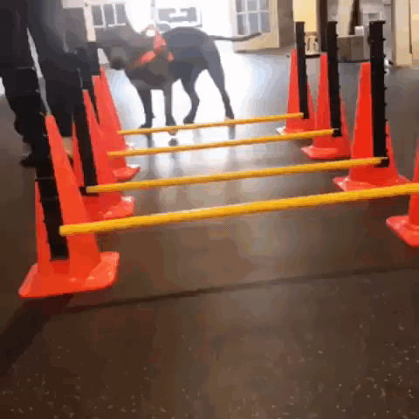
Test Specification

Slide 15
Test Specification: Process
Job Analysis
?
Psychological Measure
Test Specification

Slide 16
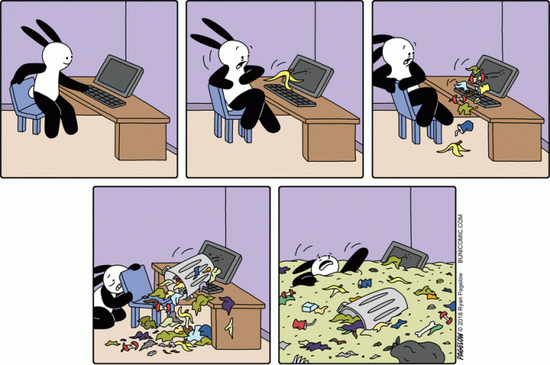
Test Specification: Problems
Validity and Legal Defensibility
Items are worth their weight in gold
Content >> Psychometrics

Slide 17
Today we are going to conduct a test specification

Slide 18
Our goal is to ensure that serial killers aren’t admitted to this program...

Slide 19
Goal: Develop a test that fairly and accurately assesses RU I/O applicants based on social skills

Slide 20
Test Specification: Preliminary Questions
What are we measuring?
KSAOs
Scoring
Measure Type

Slide 21
Psychological Measurement
Clinical Interviews
Observation
Document Review
Standardized Psychological Tests
Cognitive Measures
Non-cognitive Measures
Vigilance/Attention
Processing Speed
Behavioral
Memory
Intelligence
Emotional
Personality
(National Academy of Science, 2015)

Slide 22
Test Specification: Preliminary Questions
How will it be administered?
Resources
KSAOs
Scoring
Personnel
Time
Money

Slide 23
Provide feedback to classmates and faculty regarding group projects.
How would you measure this?

Slide 24
Test Specification: Preliminary Questions
Why is this a bad idea?
External Stakeholders
Psychometrically
Test-Taker Reactions

Slide 25
Recap
Making a test that measures Social Skills for entry into the program
We want something convenient, let’s go with Situation Judgement Tests
We will use a normative-scale for scoring because we only have so many spots in the program

Slide 26
Step 1. Job Analysis (of course)
Work-oriented
(tasks)
Worker-oriented
(KSAOs)
Physical Fidelity
Reliability
Defensibility
Empirical
Psychological Fidelity
Extensibility
Norm-referenced
Competency Modeling

Slide 27
Step 1a. Create Tasks/KSAOs
People suck at ideation
Where do we get these job units?
O*Net?
Brainstorm?
Be intentional and consistent
Standardize structure
Standardize level

Slide 28
Step 1a. Create Tasks/KSAOs Example
Peers
Faculty
You
Students
Clients

Slide 29
Step 1b. Standardize and Validate Tasks
Action | Object of Action | Purpose/Context
Collaborate | with peers | to draft technical document
Collaborate | with peers | to produce research
Communicate | applied project information | to faculty members
Communicate | group dynamics | to faculty members
Present | selection project | to non-technical audience
Provide | social support | to peers
Socialize | with peers | to build relationships
Socialize | with undergrads | to stay up-to-date on latest gossip
Share | information | with peers to complete tasks

Slide 30
Step 1b. Standardize and Validate Tasks
Action | Object of Action | Purpose/Context
Overcome | social difficulties | in order to maintain relationships
Manage | social impressions | to reduce conflict
Communicate | social discomfort | with tact
Communicate | group dynamics | to faculty members
Present | technical information | to non-technical audience
Plan | social events | with peers
Solicit | feedback | to develop socially
Listen | to others | to identify perspective
Share | project information | with peers and faculty to complete tasks

Slide 31
Step 1c. Identify and group the tasks that are critical
 | Frequency | Importance | Criticality
Social Strength (44%) | 3.16 | 3.83 | 36.0
Overcome social difficulties in order to maintain relationships | 3.5 | 5.0 | 14.5
Manage social impressions to reduce conflict | 4.0 | 3.5 | 12.5
Communicate social discomfort with tact | 2.0 | 3.0 | 9.0
Social Engagement (56%) | 4.5 | 4.5 | 45.0
Solicit feedback to develop socially | 5.0 | 5.0 | 16.0
Listen to others to identify perspective | 4.5 | 3.5 | 13.5
Plan social events with peers | 4.0 | 5.0 | 15.5

Slide 32
Step 1d. Derive KSAOs
Overcome social difficulties in order to maintain relationships
Manage social impressions to reduce conflict
Communicate social discomfort with tact
Coordination
Adjusting actions in relation to others
Negotiation
Bringing others together and trying to reconcile differences
Awareness
Monitoring and evaluating self in social setting

Slide 33
Step 2. Create Critical Incidents
Tell me about a time when … Overcame social difficulties in order to maintain relationships … and you negotiated unsuccessfully
That one time when we didn’t know where to have our picnic. I ignored people, so we had 3 different picnics at the same time.
That one time when we cut Greg out of the group because he was making fun of Thomas’ accent. I would just hang out with them separately.
That one time Shea seemed off, and I asked wade to approached him. It was because we didn’t invite him to a party. We let him plan the next party.

Slide 34
Step 2. Create Critical Incidents
Tell me about a time when … Overcame social difficulties in order to maintain relationships … and you negotiated successfully
That one time when we didn’t know where to have our picnic. I reached out to everyone to get their preferences beforehand. The picnic was great.
Greg was making fun of Thomas’ accent. I started making fun of Greg’s accent, to give him perspective. Greg later apologized to Thomas.
That one time Shea seemed off, and we approached him. It was because we didn’t invite him to a party. We let him plan the next party.

Slide 35
Step 2a. Sort Critical Incidents
That one time when Josh was making fun of Slaton because plays Fortnite. We decided to have a Fortnite lan party. Now Josh makes fun of all of us.
That one time when Roger wanted to have his birthday at the Chuck E. Cheese; on the same day, Matt wanted people to meet his new puppy. People had to pick: puppies or Chuck E Cheese.
That one time Shea dressed up for a Victoria’s Secret Angel and an undergrad student recorded him. He’s a disgrace to the program.
That one time Shea seemed off, and we approached him. It was because we didn’t invite him to a party. We let him plan the next party.
That one time when we didn’t know where to have our picnic so we had 3 different picnics at the same time.

Slide 36
Step 3. Plan SJT approach
Stem
Behavioral (i.e., would)
Knowledge (i.e., should)
Complexity of Situations
Length
Comprehensibility
Scoring
Polytomous
Dichotomous

Slide 37
Step 3a. Decompose and start making Situations
That one time when Roger wanted to have his birthday at the Chuck E. Cheese; on the same day, Matt wanted people to meet his new puppy. People had to pick: puppies or Chuck E Cheese.
That one time when Roger wanted to have his birthday at the Chuck E. Cheese; on the same day, Matt wanted people to meet his new puppy. I spent time doing both.
John, a classmate, invited his childhood friend to visit. John really wants you to meet his friend. However, you have a study group on the weekend John’s friend is visiting. Given this situation, what should you do?
Skip the study group and meet John’s friend.
Go to the study group, school is more important.
Spend some time at the study group, then go out with John and his friend.
Contact both parties and see if you can rearrange your schedule.
That one time when we didn’t know where to have our picnic so we had 3 different picnics at the same time.
That one time when we didn’t know where to have our picnic. I reached out to everyone to get their preferences beforehand. The picnic was great.

Slide 38
Step 3b. Screen Responses
John, a classmate, invited his childhood friend to visit. John really wants you to meet his friend. However, you have a study group on the weekend John’s friend is visiting. Given this situation, what should you do?
Skip the study group and meet John’s friend.
Go to the study group, school is more important.
Spend some time at the study group, then go out with John and his friend.
Contact both parties and see if you can rearrange your schedule.
Too ambiguous?

Slide 39
Step 3c. Select keys: Consensus or Empirical?
John, a classmate, invited his childhood friend to visit. John really wants you to meet his friend. However, you have a study group on the weekend John’s friend is visiting. Given this situation, what should you do?
Skip the study group and meet John’s friend.
Go to the study group, school is more important.
Spend some time at the study group, then go out with John and his friend.
Contact both parties and see if you can rearrange your schedule.
Consensus
Mode | Ratio
5 | .24
4 | .19
3 | .14
9 | .43
Empirical
PBis
-.20
.05
.45
.20

Slide 40
Step 3d. Scoring: Dichotomous
John, a classmate, invited his childhood friend to visit. John really wants you to meet his friend. However, you have a study group on the weekend John’s friend is visiting. Given this situation, what should you do?
Skip the study group and meet John’s friend.
Go to the study group, school is more important.
Spend some time at the study group, then go out with John and his friend.
Contact both parties and see if you can rearrange your schedule.
Key = D
Person | Response | Points
1 | A | 0
2 | B | 0
3 | D | 1
4 | D | 1

Slide 41
Step 3d. Scoring: Polytomous
John, a classmate, invited his childhood friend to visit. John really wants you to meet his friend. However, you have a study group on the weekend John’s friend is visiting. Given this situation, rank the following behaviors from MOST to LEAST ideal.
Skip the study group and meet John’s friend.
Go to the study group, school is more important.
Spend some time at the study group, then go out with John and his friend.
Contact both parties and see if you can rearrange your schedule.
Key = D, A, B, C
Person | Response | Points
1 | A,D,B,C | 2
2 | B,A,C,D | 1
3 | C,B,A,D | 0
4 | D,A,B,C | 4

Slide 42
Step 4. Results
Person | Total Points
1 | 25
2 | 19
3 | 10
4 | 8
5 | 6
Pass
Fail

Slide 43
Thank you!
Feel free to reach out if you have any questions:
email: shea.fyffe@gmail.com
https://linkedin.com/in/sheafyffe/
https://github.com/Shea-Fyffe

Slide 44
Some Tips:
Be Desperate
Be Social
Be Confident
Focus on skills (stats, programming, data management, etc)
Resources
Example Emails, CV, Personal Statements
Start Programming

