Slide 1
ITEC 352
Lecture 8
Floating point format

Slide 2
Review
Two’s complement
Excessive notation
Introduction to floating point

Slide 3
Outline
Floating point conversion process

Slide 4
Standards
What are the components that make up a floating point number?
How would you represent each piece in binary?

Slide 5
Why?
Consider
class floatTest
{
public static void main(String[] args)
{
double x = 10;
double y=Math.sqrt(x);
y = y * y;
if (x == y)
System.out.println("Equal");
else
System.out.println("Not equal");
}
}

Slide 6
Normalization
254 can be represented as:
2.54 * 10²
25.4 * 10¹
.254 * 10⁻¹
There are infinitely many other ways, which creates problems when making comparisons, with so many representations of the same number.
• Floating point numbers are usually normalized, in which the radix point is located in only one possible position for a given number.
• Usually, but not always, the normalized representation places the radix point immediately to the left of the leftmost, nonzero digit in the fraction, as in: .254X 10³.

Slide 7
Example
• Represent .254X 10³ in a normalized base 8 floating point format with a sign bit, followed by a 3-bit excess 4 exponent, followed by four base 8 digits.
• Step #1: Convert to the target base.
.254X10³ = 254₁₀. Using the remainder method, we find that 254₁₀ = 376X8⁰:
254/8 = 31 R 6
31/8 = 3 R 7
3/8 = 0 R 3
• Step #2: Normalize: 376X8⁰ = .376X8³.
• Step #3: Fill in the bit fields, with a positive sign (sign bit = 0), an exponent of 3 + 4 = 7 (excess 4), and 4-digit fraction = .3760:
0 111 . 011 111 110 000

Slide 8
Example
Convert (9.375 * 10⁻²)₁₀ to base 2 scientific notation
• Start by converting from base 10 floating point to base 10 fixed point by moving the decimal point two positions to the left, which corresponds to the -2 exponent: .09375.
• Next, convert from base 10 fixed point to base 2 fixed point:
.09375 * 2 = 0.1875
.1875 * 2 = 0.375
.375 * 2 = 0.75
.75 * 2 = 1.5
.5 * 2 = 1.0
• Thus, (.09375)₁₀ = (.00011)₂.
• Finally, convert to normalized base 2 floating point:
.00011 = .00011 * 2⁰ = 1.1 * 2⁻⁴

Slide 9
IEEE 754 standard
Defines how to represent floating point numbers in 32 bit (single precision) and 64 bit (double precision).
32 bit is the “float” type in java.
64 bit is the “double” type in java.
The method: doubleToLong in Java displays the floating point number in IEEE standard.

Slide 10
Considerations
IEEE 754 standard also considers the following numbers:
Negative numbers.
Numbers with a negative exponent.
It also optimizes representation by normalizing the numbers and using the concept of hidden “1”

Slide 11
Hidden “1”
What is the normalized representation of the following:
0.00111
1.00010
100.100

Slide 12
Hidden “1”
What is the normalized representation of the following:
0.00111 = 1.11 * 2⁻³
1.00010 = 1.00 * 2⁰
100.100 = 1.00 * 2²
Common theme: the digit to the left of the “.” is always 1!!
So why store this in 32 or 64 bits? This is called the hidden 1 representation.

Slide 13
Negative thoughts
IEEE 754 representation uses the following conventions:
Negative significand – use sign magnitude form.
Negative exponent use excess 127 for single precision.

Slide 14
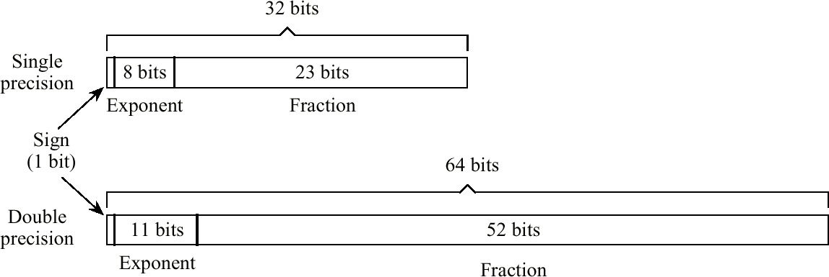
IEEE-754 Floating Point Formats

Slide 15
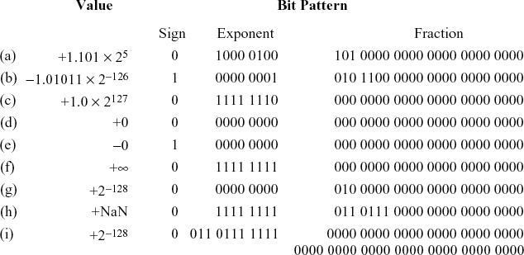
IEEE-754 Examples

Slide 16
IEEE-754 Conversion Example
• Represent -12.625₁₀ in single precision IEEE-754 format.
• Step #1: Convert to target base. -12.625₁₀ = -1100.101₂
• Step #2: Normalize. -1100.101₂ = -1.100101₂ * 2³
• Step #3: Fill in bit fields. Sign is negative, so sign bit is 1. Exponent is in excess 127 (not excess 128!), so exponent is represented as the unsigned integer 3 + 127 = 130. Leading 1 of significand is hidden, so final bit pattern is:
1 1000 0010 . 1001 0100 0000 0000 0000 000

Slide 17
Binary coded decimals
Many systems still use decimal’s for computation, e.g., older calculators.
Representation of decimals in such devices:
Use binary numbers to represent them (called Binary coded decimals)
BCD representation uses 4 digits.
0 = 0000
9 = 1001

Slide 18
Summary
IEEE floating point

